Slide 1




Umbrella Presentation
Cognitive Science of Cyber SA
Collaborative Cyber Situation Awareness
Nancy J. Cooke, ASU & Prashanth Rajivan, Indiana U.
Models and Experiments in Cognition-Based Cyber Situation Awareness
Dave Hall, Michael McNeese, & Nick Giacobe, PSU

Slide 2
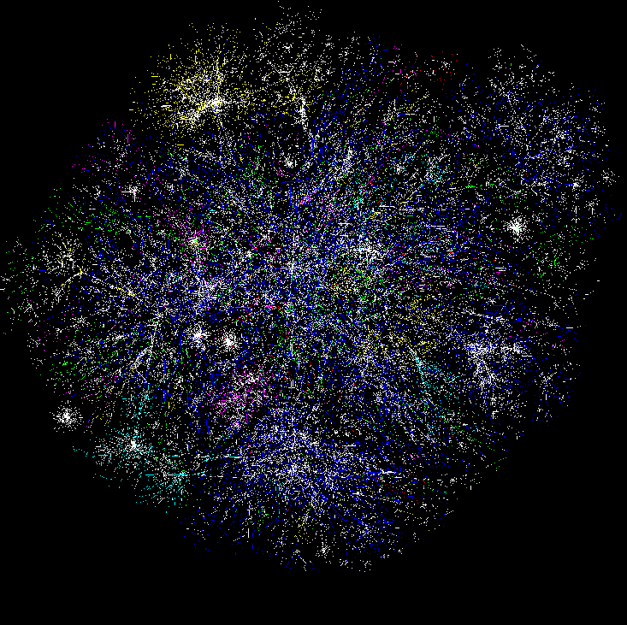

Cognitive Models & Decision Aids
Instance Based Learning Models
Simulation
Measures of SA & Shared SA
Software
Sensors, probes
Hyper Sentry
Cruiser
Information Aggregation & Fusion
Transaction Graph methods
Damage assessment
Automated
Reasoning
Tools
R-CAST
Plan-based narratives
Graphical models
Uncertainty analysis
Data Conditioning
Association & Correlation
Multi-Sensory Human Computer Interaction
Computer network
Enterprise Model
Activity Logs
IDS reports
Vulnerabilities
Real World
System Analysts
Test-bed
Computer network

Slide 3
Cognitive Models & Decision Aids
Instance Based Learning Models
Simulation
Measures of SA & Shared SA
Software
Sensors, probes
Hyper Sentry
Cruiser
Information Aggregation & Fusion
Transaction Graph methods
Damage assessment
Automated
Reasoning
Tools
R-CAST
Plan-based narratives
Graphical models
Uncertainty analysis
Data Conditioning
Association & Correlation
Multi-Sensory Human Computer Interaction
Computer network
Enterprise Model
Activity Logs
IDS reports
Vulnerabilities
Real World
System Analysts
Test-bed
Computer network

Slide 4
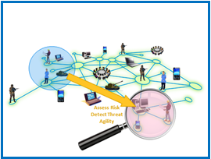
Cyber Security as a Sociotechnical System
Includes humans and technology (of many varieties)
Humans can be analysts, hackers, general public, leaders, industry …

Slide 5
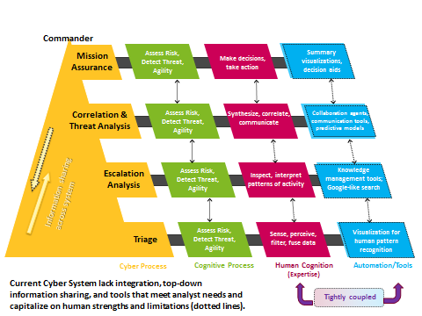
A Complex Cognitive System

Slide 6
Implications of Cyber SA as a
Sociotechnical System
Training and technology interventions to improve Cyber SA need to consider
  Human/Team capabilities and limitations
  Technology capabilities and limitations
  Human-technology interactions
  …all in the context of the system

Slide 7
ASU/PSU Objectives
ASU Objectives
PSU Objectives
To develop theory of team-based SA to inform assessment metrics and improve interventions (training and decision aids)
Iterative Refinement of Cyber Testbeds based on cognitive analysis of the domain
  Cybercog
  DEXTAR
Conduct experiments on Cyber TSA in the testbed to develop theory and metrics
Extend empirical data through modeling
Understand cognitive/contextual elements of situation awareness in cyber-security domains
Implement a systems perspective to research linking real-world analysts with theory and human in the loop experiments
Utilize Multi-Modal research methodology
Focus on the human and team elements within real context applications

Slide 8
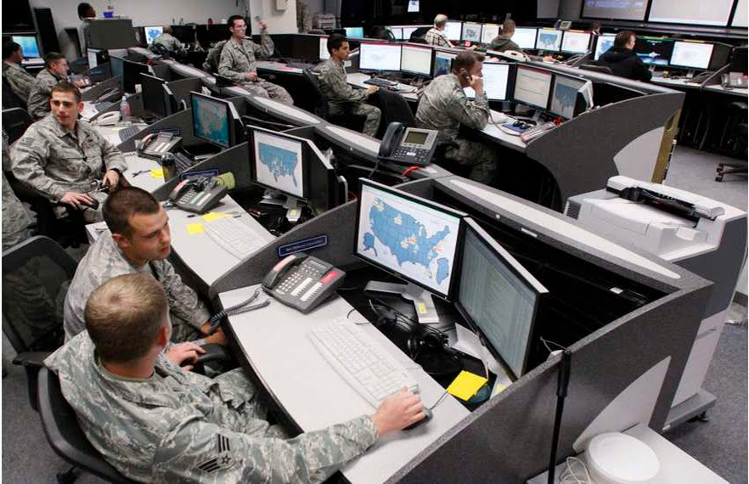
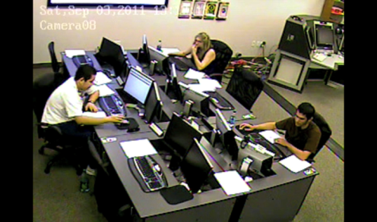
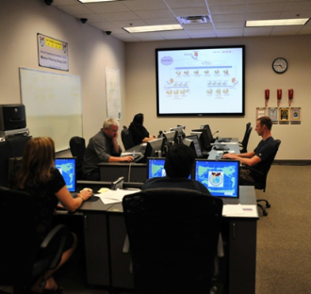
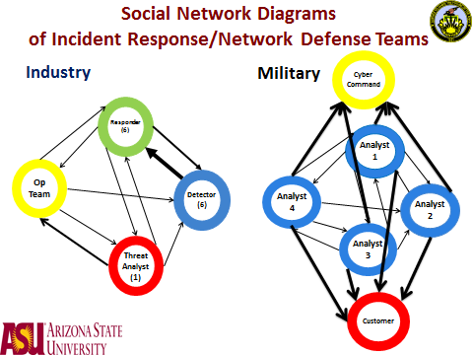

^{The Living Lab Procedure}
BEGIN
Field Data - CTA
END
Testbeds
1) TeamNETS
2) CyberCog
3) DEXTAR
Empirical Studies in Testbeds
Measures
Theory
Development
EAST and Agent Based Modeling

Slide 9

Collaborative Cyber Situation Awareness
Nancy J. Cooke, PhD
Arizona State University
Prashanth Rajivan, PhD
Indiana University
July 9, 2015
This work has been supported by the Army Research Office
under MURI Grant W911NF-09-1-0525.

Slide 10
Overview
Overview of Project
Definitions and Theoretical Drivers
Cognitive Task Analysis
Testbed Development
Empirical Studies and Metrics
Modeling
What We Learned

Slide 11
Theoretical Drivers
Interactive Team Cognition
Team Situation Awareness
Sociotechnical Systems/ Human Systems Integration

Slide 12
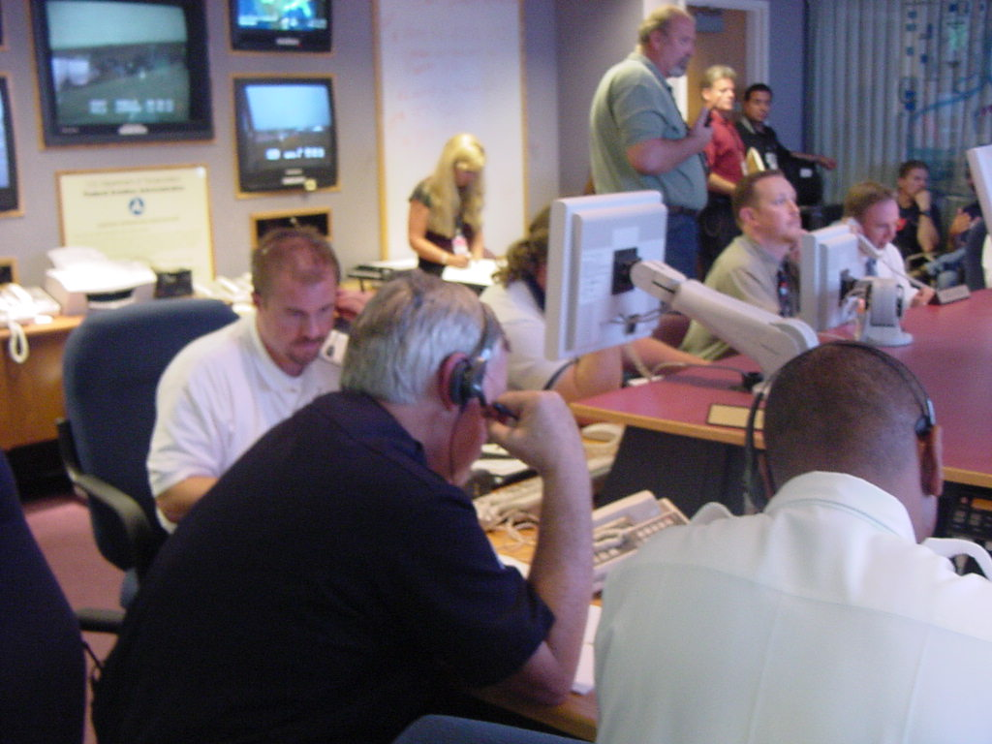
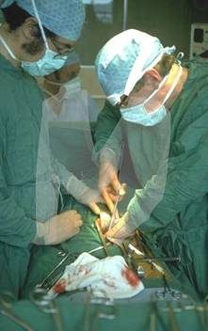
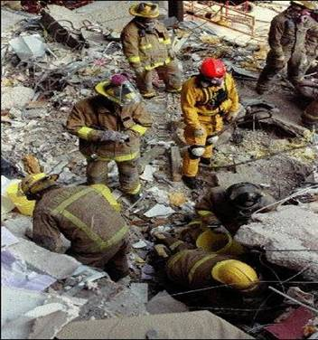
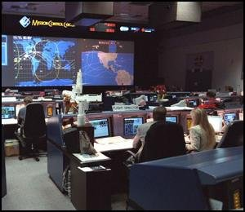
Interactive Team Cognition
Team is unit of analysis = Heterogeneous and interdependent group of individuals (human or synthetic) who plan, decide, perceive, design, solve problems, and act as an integrated system.
Cognitive activity at the team level= Team Cognition
Improved team cognition → Improved team/system effectiveness
Heterogeneous = differing backgrounds, differing perspectives on situation (surgery, basketball)

Slide 13
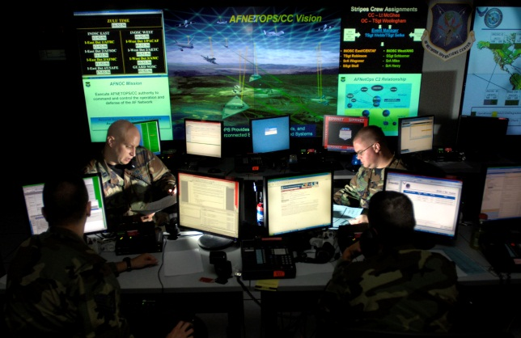
Interactive Team Cognition
Team interactions often in the form of explicit communications are the foundation of team cognition
ASSUMPTIONS
Team cognition is an activity; not a property or product
Team cognition is inextricably tied to context
Team cognition is best measured and studied when the team is the unit of analysis

Slide 14
Implications of Interactive Team Cognition
Focus cognitive task analysis on team interactions
Focus metrics on team interactions (team SA)
Intervene to improve team interactions

Slide 15
Situation Awareness
Endsley’s Definition:
  the perception of elements in the environment within a volume of time and space, the comprehension of their meaning, and the projection of their status in the near future
Perception
Comprehension
Projection
… by humans

Slide 16

Cyber Situation Awareness
Requires Human Cognition
SA is not in the technology alone (e.g., visualization); it is in the interface between humans and technology

Slide 17

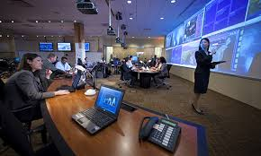
Cyber SA ≠ Display as Much Information as Possible
SA is not the same as information. The user has to interpret that information and in this case less is more.
Big data does not mean big awareness – Peng Liu

Slide 18
Team Situation Awareness
A team’s coordinated perception and action in response to a change in the environment
Contrary to view that all team members need to “be on the same page” or everyone has to take in the same wall of data.

Slide 19
Cyber SA is
Distributed and Emergent
Detector
Responder
Threat Analyst
Perception
Comprehension
Projection

Slide 20
Cyber Defense as a Sociotechnical System
Cyber defense functions involve cognitive processes allocated to
  Human Operators of many kinds
  Tools/Algorithms of many kinds
Human Operators
  Different roles and levels in hierarchy
  Heterogeneity (Information, skills and knowledge)
Tools
  For different kinds of data analysis and visualization
  For different levels of decision making
Together, human operators and tools are a sociotechnical system
  Human System Integration is required

Slide 21
^{The Living Lab Procedure}
BEGIN
Field Data - CTA
END
Testbeds
2) CyberCog
3) DEXTAR
Empirical Studies in Testbeds
Measures
Theory
Development
EAST and Agent Based Modeling

Slide 22
Cognitive Task Analysis Activities
Conducted literature review
Cyber SA Workshop 2011
  one hour breakout session with 3 cyber security analysts.
  Topics:
  Structure of defense CERT departments work of the security analyst
  Tasks performed by each analyst
  Tools used by the analyst to perform the task
  Team structure
  Interaction among analysts within a team
  Reporting hierarchy
Cyber Defense Exercises
  Air Force Academy, Colorado Springs, CO
  CTA collaboration with PSU – WestPoint CDX logs
  iCTF – International Capture the Flag at US Santa Barbara (Giovanni Vigna)
Cyber Survey – web responses

Slide 23

Lessons Learned:
Cyber Defense Analysts
High stress
High attrition rate
High False Alarm Rate
Low Situation Awareness
Cyber analysis task does not make the best use of individual capabilities
Expertise is challenging to identify

Slide 24
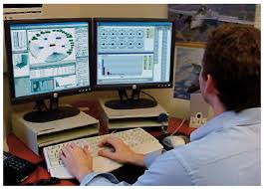
Lessons Learned:
The Analyst Task
Unstructured task; hierarchical within government, but within units it breaks down
Variance across departments, agencies
Ill-structured with no beginning or end
Little to no standardized methodology in
locating and response to an attack
Massive amounts of data, information
overload, high uncertainty
No software standards
Metrics of individual and team performance and process are lacking

Slide 25
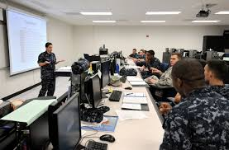
Lessons Learned:
Training Analysts
No cohesive training programs for specific tasks or not standardized enough
No feedback
No way to benchmark or evaluate the efficacy of individuals in the real world. No ground truth
No performance metrics

Slide 26
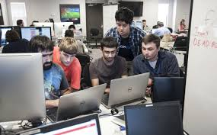
Lessons Learned:
Teamwork Among Analysts
Teamwork is minimal in cyber security
Cyber analysts work as a group – Not as a team
Possible Reasons
  Cognitive overload
  Organizational reward structures
  “Knowledge is Power”
  Lack of effective collaboration tools
Little role differentiation among teammates
Low interaction; a collective with each working independently
Informal, ad hoc interactions, loosely coupled system, and lack of distribution of task

Slide 27
^{The Living Lab Procedure}
BEGIN
Field Data - CTA
END
Testbeds
2) CyberCog
3) DEXTAR
Empirical Studies in Testbeds
Measures
Theory
Development
EAST and Agent Based Modeling

Slide 28

CyberCog
Synthetic Task Environment
Notes:
The first clip shows the team taking a look at a specific set of patterns. They've started to identify that the SMTP server may be involved. However, it falls apart whenever they start looking more into it. Once the team member on the left queries about it - the other analysts go quiet searching for an answer.
The second clip is a continuation of the conversation much later in the exercise. They are looking at events and start trying to categorize them into an attack path. At the end, the third analyst chimes in with information on an alert she needs help with. Although she gives IP details, the other team member requests to share the event showing more information. Overall, this team failed in the attack path.
**THE LINK NEEDS HELP, RUN MOVIE FROM COMPUTER, PLEASE***

Slide 29
CyberCog Synthetic Task Environment
Simulation environment for team-based cyber defense analysis
Recreate team and cognitive aspects of the cyber analysis task
A research testbed for:
  Controlled experiments
  Assessment of interventions, technology, aids

Slide 30
CyberCog Team Task
Three team members monitor IDS alerts and network activity of 3 different sub-networks for a given scenario
  Find IDS alerts pertinent to the attack
  Find the systems affected and attack path
On consensus team submits their findings
Variations: Analysts who specialize (given different information/intrusion events)
Task
Notes:
Analyst 1 - database containing system vulnerabilities
Analyst 2 - wiki-styled website forum-information on possible attack scenarios
Analyst 3 - network map-illustrated systems and their physical layout

Slide 31
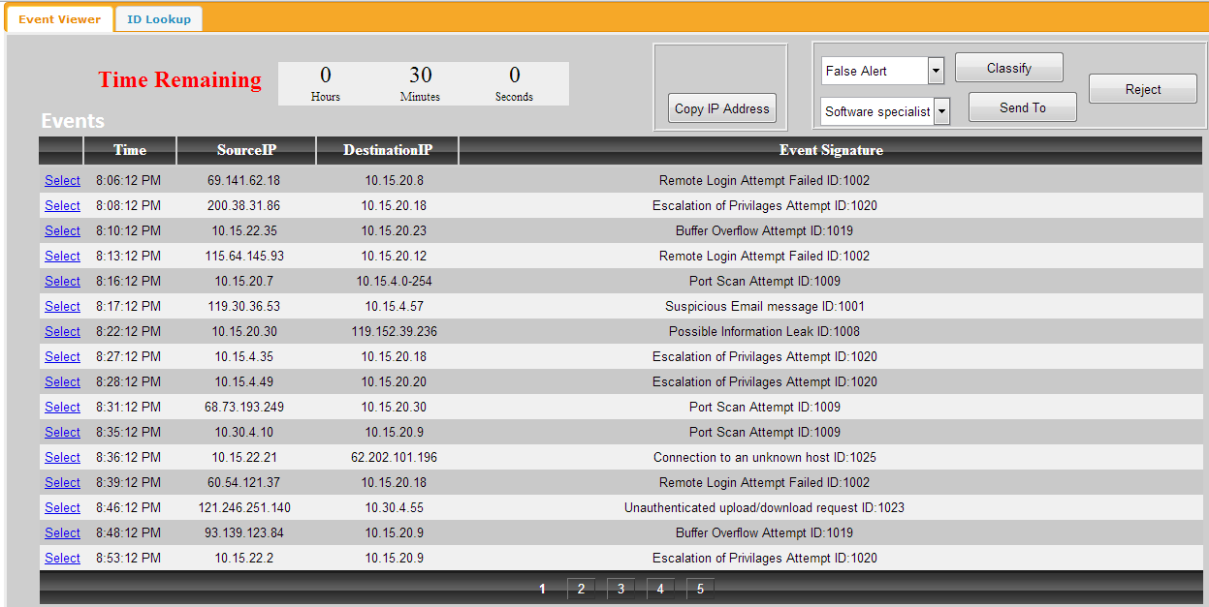
CyberCog Alerts

Slide 32
CyberCog Measures
  PERFORMANCE
  Alert classification accuracy
  TEAM INTERACTION
    Communication – audio data
    Computer events
    Team situation awareness
        Attack path identified (systems, order)
        Attack information distributed across 2-3 team members
        Team coordination is required to identify and act on threat
        Roadblock can be introduced through equipment malfunctions (e.g., tool crash)
  WORKLOAD
  NASA TLX – workload measure

Slide 33
DEXTAR
Cyber Defense Exercise for Team Awareness Research
CyberCog mainly focused on the triage part of the task
Task was not as dynamic and complex as actual task
Difficult to train undergraduates with little computing experience
SOLUTION: DEXTAR
Higher fidelity simulation environment
Requires participants with some experience, graduate students in computer science
Virtual network comprised of from up to 10,000 virtual machines
DEXTAR is capable of manipulation, experimental control of variables, and human performance measurement.
Will basically provide a space for CTF exercises that is also instrumented for performance assessment
A testbed for research and technology evaluation

Slide 34
^{The Living Lab Procedure}
BEGIN
Field Data - CTA
END
Testbeds
2) CyberCog
3) DEXTAR
Empirical Studies in Testbeds
Measures
Theory
Development
EAST and Agent Based Modeling

Slide 35
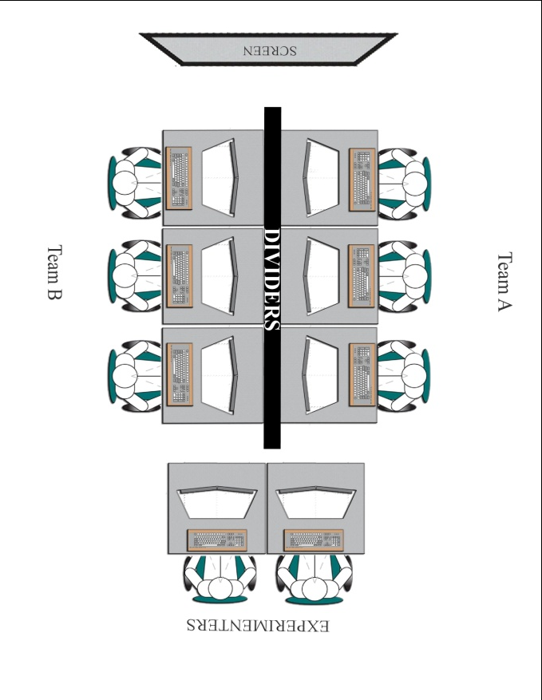
Experiment 1
Training
Practice
Scenario 1
TLX
Scenario2
TLX
Questionnaire
3-person teams/groups in which each individual is trained to specialize in types of alerts
2 conditions:
  Team Work (Primed & Rewarded for team work)
  Group Work (Primed & Rewarded for group work)
6 individuals at a time
  Team Work - Competition between the 2 teams
  Group Work - Competition between the 6 individuals
Experimental scenarios:
  225 alerts
  Feedback on number of alerts correctly classified - constantly displayed on big screen along with other team or individual scores
Simulates knowledge is power for individuals group condition
Measures
    Signal Detection Analysis of Alert Processing
    Amount of Communication
    Team situation awareness
    Transactive Memory
    NASA TLX – workload measure

Slide 36
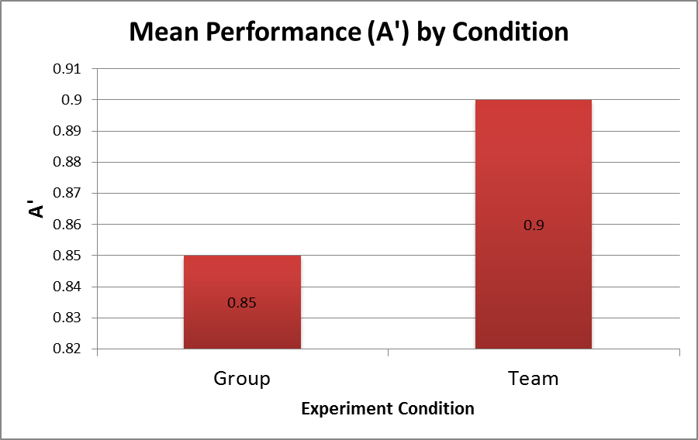
Cyber Teaming Helps When the Going Gets Rough
Sensitivity to true alerts
F(1,18) = 5.662, p = .029** (Significant effect of condition)
Notes:
Working as team helps when alerts are novel and involves multi step analysis, not otherwise.
Signal Detection Measure: A' as performance measure
A' ranges from values 0.5 and 1 with 0.5 indicating lowest performance possible and 1 indicating highest performance possible.

Slide 37
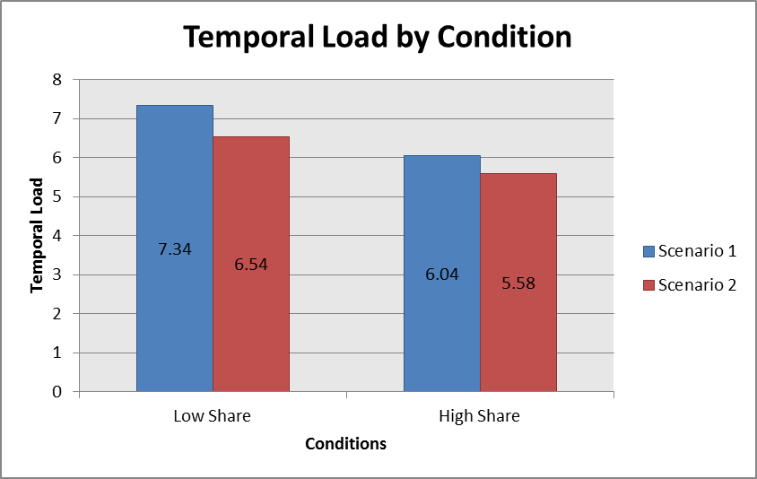
Groups that Share Less Information Perceive
More Temporal Demands than High Sharers
NASA TLX Workload Measure: Temporal Demand
Measures perception of time pressure
Higher the value higher the task demand
Statistically significant across scenarios and conditions
(p-value = 0.020)

Slide 38
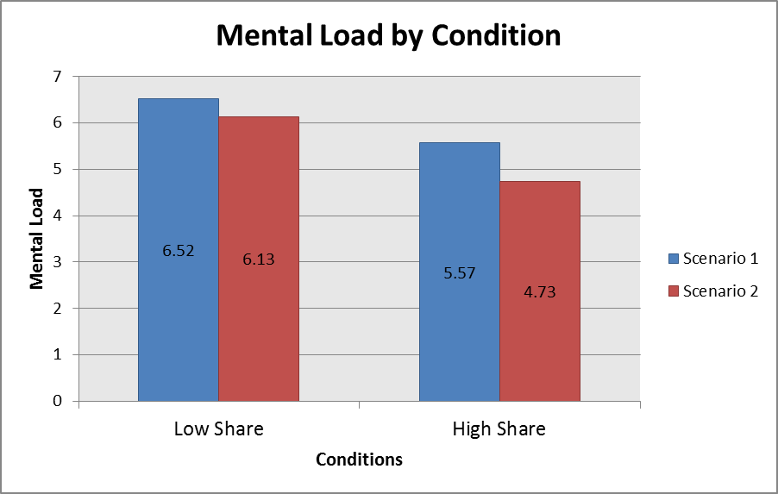
Groups that Share Less Information
Perceive Work to be More Difficult than
High Sharers
NASA TLX Workload Measure: Mental Effort
Measures perception of mental effort
Higher the value, more mental effort required
Statistically significant across scenarios and conditions (p-value = 0.013)

Slide 39
Experiment 1 Conclusion
Break the “Silos”
Use the power of human teams to tackle information overload problems in cyber defense.
Simply encouraging and training analysts to work as teams and providing team level rewards can lead to better triage performance
Need collaboration tools and group decision making systems.

Slide 40
Experiment 2
Effective information sharing is paramount to detecting advanced types of multi-step attacks
Teams in other domains have demonstrated the information pooling bias – tendency to share information that is commonly held
Does this bias exist in this cyber task?
If yes, can we develop and test a tool to mitigate the bias (compare to Wiki)?

Slide 41
Procedure
30 teams of 3 participants
Trained on cyber security concepts, types of attacks and tasks to be performed
Attack data distributed across analysts – some unique, some common
Pre-discussion reading and discussion
Practice mission
2 main missions
Goal – Detect large scale attacks

Slide 42
Experiment Design
 | Trial 1 - Baseline | Trial 2
Tool Type | Slide Based | Slide Based
 | Slide Based | Wiki
 | Slide Based | Collaborative Visualization

Slide 43
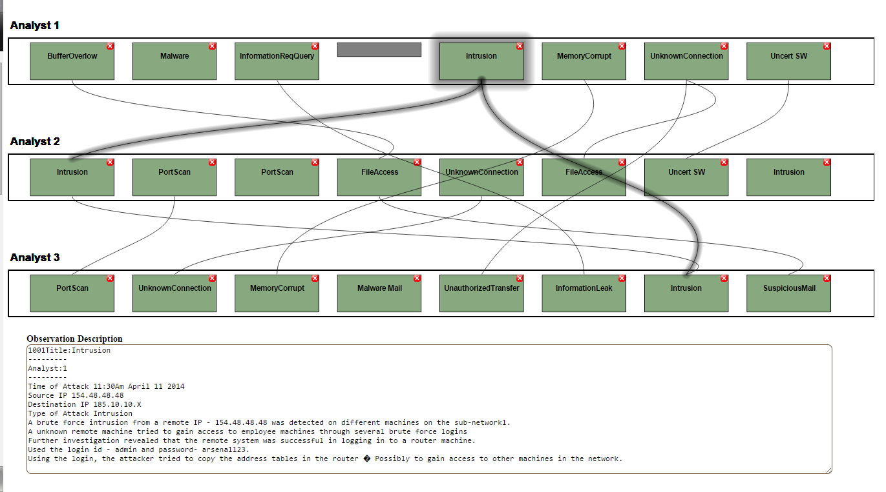
Collaborative Visualization Tool
Notes:
Collaborative visualization tool designed from a cognitive engineering perspective
Cognitive Friendly Visualizations (a new term?)
To mitigate the information pooling bias in cyber defense analysts
Improve information sharing and decision making performance

Slide 44
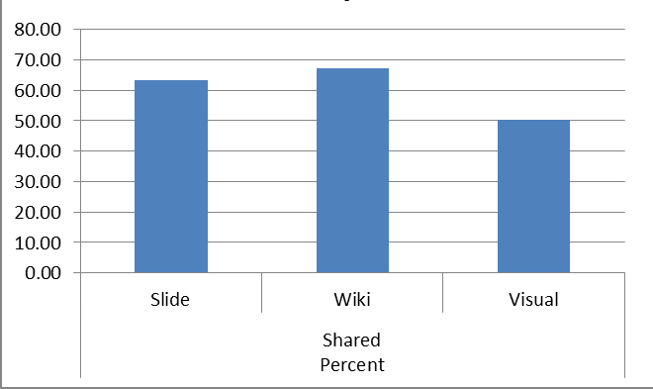
Percentage of Shared Information Discussed in Mission 2
  Percentage of discussion spent on discussing attacks that are shared among members

Slide 45
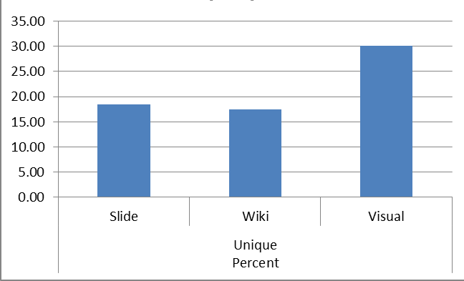
Percentage of Unique Information Discussed in Mission 2
  Percentage of discussion spent on discussing attacks are unique but are part of a large scale attack

Slide 46
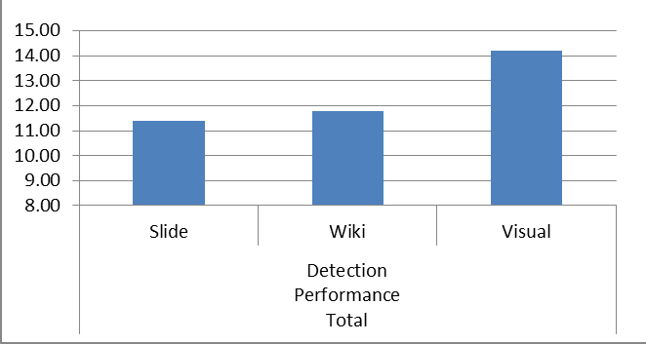
Number of Attacks Detected (Performance) in Mission 2
Notes:
Max possible = 18 (4*3 + 2*3)

Slide 47
Experiment 2 Conclusion
Significantly more percentage of shared attack information discussed
  Cyber Defense analysts undergo information pooling bias
  Prevents from detecting APT kinds of attacks
Use of cognitive friendly visualization reduces the bias, improves performance
Off the shelf collaboration tools did not help

Slide 48
^{The Living Lab Procedure}
BEGIN
Field Data - CTA
END
Testbeds
2) CyberCog
3) DEXTAR
Empirical Studies in Testbeds
Measures
Theory
Development
EAST and Agent Based Modeling

Slide 49
Agent Based Models
Human-in-loop experiment
  Traditional method to study team cognition
Agent based model
  A complimentary approach
Modeling computational agents with
  Individual behavioral characteristics
  Team interaction patterns
  Extend Lab Based Experiments
Notes:
Maybe some picture of agent based models

Slide 50
Model Description
Agents: Triage analysts
Task: Classify alerts
Rewards for classification
Cognitive characteristics:
  Knowledge and Expertise
  Working memory limit
  Memory Decay
Learning Process: Simplified – Probability based – 75% chance to learn
  Cost: 200 points
  Payoff: 100 points
Collaboration: Two strategies to identify partners
  Conservative or Progressive
  Cost: 100 points for each
  Payoff: 50 points for each
Attrition

Slide 51
Model Process
Recruit if needed
Assign alerts
Team?
Yes
No
Adjust
Expertise
And
Remove
Analysts
No
Learn?
No
Know?
Collaborate with Agents
Yes
Yes
Add Knowledge
Get Rewards

Slide 52
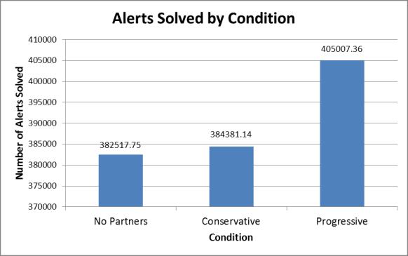
Agents in the Progressive/Teamwork Condition Classified More Alerts
(replicates experiment)
p<0.001
Notes:
Report effect size instead

Slide 53
Agent-Based Modeling Conclusion
Large progressive teams classified most alerts
Large progressive teams accrued least rewards
Large progressive teams
  Lot of collaboration
  Less learning
  Constant knowledge swapping
  More net rewards of 50 points
Notes:
Reduce the text .. And talk abt it.. Or split in two slides..

Slide 54
EAST Models
Event Analysis of Systemic Teamwork) framework
(Stanton, Baber, & Harris, 2012)
Integrated suite of methods allowing the effects of one set of constructs on other sets of constructs to be considered
  Make the complexity of socio-technical systems more explicit
  Interactions between sub-system boundaries may be examined
  Reduce the complexity to a manageable level
Social Network
  Organization of the system (i.e., communications structure)
  Communications taking place between the actors working in the team.
Task Network
  Relationships between tasks
  Sequence and interdependences of tasks
Information Network
  Information that the different actors use and communicate during task performance
With Neville Stanton, University of Southampton, UK

Slide 55
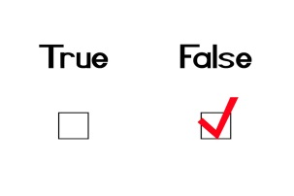
Method
Interviews with cyber network defense leads from two organizations on social structure, task structure, and information needs
Hypothetical EAST models created
Surveys specific to organization for cyber defense analysts developed
Surveys administered to analysts in each organization to refine models

Slide 56
Social Network Diagrams of Incident Response/Network Defense Teams
Cyber Command
Industry
Military
Responder (6)
Analyst 1
Op
Team
Detector (6)
Analyst 4
Analyst 2
Analyst 3
Threat Analyst
(1)
Customer

Slide 57
Sequential Task Network Diagram
Industry Incident Response Team
Detector
(6)
Update Servers
Training
Responder
(6)
Network maintenance
Deeper
Classification Alerts
Op
Team
From:
Un-known
Classify
Alerts
From:
Credit
Card
From: Root
Certificate
Training
Credit
Card
Modeling
From:
Hosting
Accounts
Root
Certificate
Threat Analyst
(1)
Hosting
Accounts
Training
Un-known

Slide 58
Sequential Task Network Diagram
Military Network Defense Team
Handoff
Customer Assignment
Review Events
Gather Batch of Reports
Cyber Command
Review Alerts
Customer
Dispatch

Slide 59
EAST Conclusions
A descriptive form of modeling that facilitates understanding of sociotechnical system
Can apply social network analysis parameters to each of these networks and combinations
Can better understand system bottlenecks, inefficiencies, overload
Can better compare systems
Combined with empirical studies and agent-based modeling can allow us to scale up to very complex systems

Slide 60
Conclusions -The Living Lab Procedure
BEGIN
Field Data - CTA
END
Testbeds
1) TeamNETS
2) CyberCog
3) DEXTAR
Empirical Studies in Testbeds
Measures
Theory
Development
EAST and Agent Based Modeling

Slide 61
Conclusions
Contributions
Testbeds for research and technology evaluation
Empirical results on cyber teaming
Models to extend empirical work
What we Learned
Analysts tend to work alone
Work is heavily bottom up
Teamwork improves performance and cyber SA
Much technology is not suited to analyst task
Human-Centered approach can improve cyber SA

Slide 62

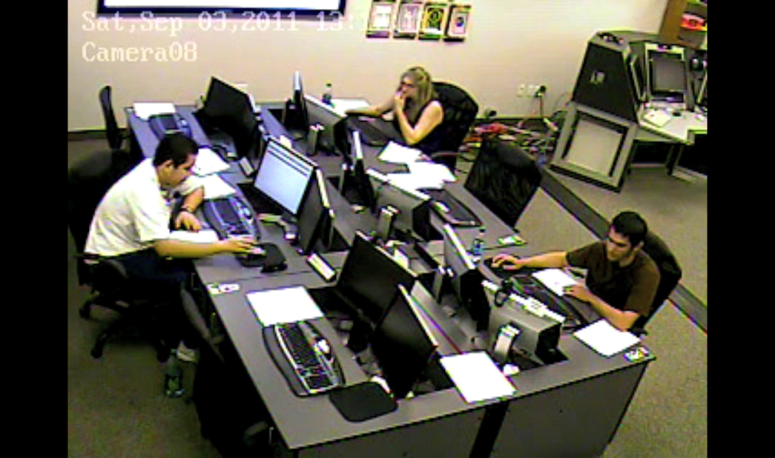
ASU Project Overview
    Objectives:
    Understand and Improve Team Cyber Situation Awareness via
    Understanding cognitive /teamwork elements of situation awareness in cyber-security domains
Implementing a synthetic task environment to support team in the loop experiments for evaluation of new algorithms, tools and cognitive models
Developing new theories, metrics, and models to extend our understanding of cyber situation awareness
Department of Defense Benefit:
Metrics, models, & testbeds for assessing human effectiveness and team situation awareness (TSA) in cyber domain
Testbed for training cyber analysts and testing (V&V) algorithms and tools for improving cyber TSA
Year 6 Accomplishments
No cost extension year – no personnel supported
Rajivan successfully defended dissertation in November 2014
Four publications in preparation based on this work
Challenge
Access to subject matter experts
Struggle to maintain realism in testbed scenarios while allowing for novice participation and team interaction – now addressing with CyberCog and Dextar
Scientific/Technical Approach
Living Lab Approach
  Cognitive Task Analysis
  Testbed development
  Empirical studies and metrics
  Modeling and theory development

Slide 63
Summary of Six Year Key Performance Indicators

Slide 64

Questions
ncooke@asu.edu

