Slide 1
ARO–MURI Thoughts on Visualization for Cyber Situation Awareness
MURI Meeting July 8–9, 2015
Christopher G. Healey Lihua Hao Steve E. Hutchinson
CS Department, NCSU Facebook
Army Research Laboratory
healey@ncsu.edu
http://www.csc.ncsu.edu/faculty/healey
sic parvis magna

Slide 2
Introduction
Goal: Visualization support for network security analysts
“Do not fit our problem to your tool, build a tool to fit our problem”
Focus explicitly on network security analysts, not security data
Balance
Meet the needs of the analysts
Apply knowledge and best practices from visualization
Web-based tools to support flexible, analyst-driven exploration
Overview + detail on demand
Chart-based visualizations to minimize cognitive overhead
Healey, C. G., Hao, L., and Hutchinson, S. E. (2014). “Visualizations and Analysts,” in Cyber Defense and SituationAwareness, A. Kott, C. Wang and R. Erbacher, Eds. New York, New York: Springer Publishing Company, pp. 145–165.

Slide 3
Design Constraints
Mental models
“Fit” the mental models used by analysts to investigate problems
Work Environment
Integrate into analysts’ current working environment
Configurability
Avoid static, pre-defined visualizations of data
Accessibility
Visualizations must be familiar to avoid steep learning curves
Scalability
Support query and retrieval from multiple data sources
Integration
Support, don’t replace, analysts’ current problem-solving strategies

Slide 4
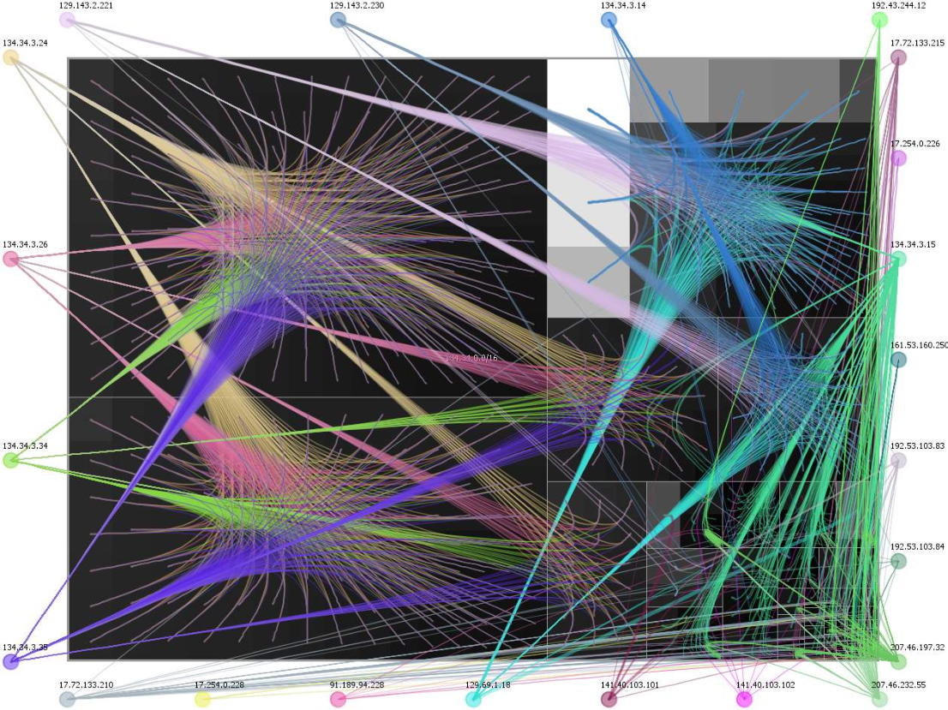
Fischer et al. (2008). Large-Scale Network Monitoring for Visual Analysis of Attacks. VizSec ’08 (Cambridge, MA), Chapter 11

Slide 5
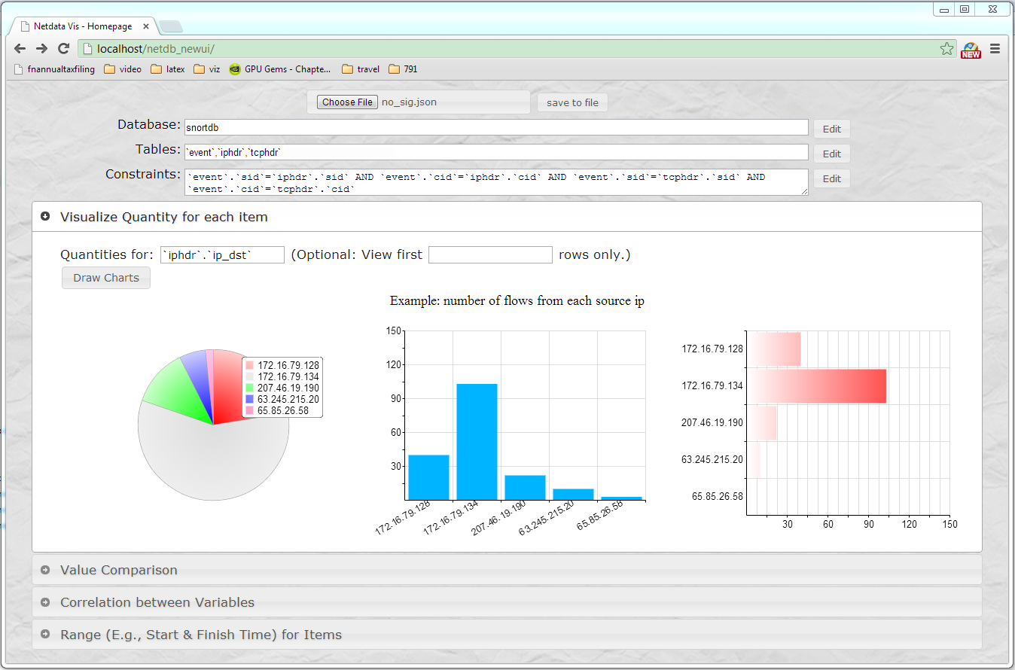
Web-Based Visualization
mental models work environment
web-based application
configurable
analyst-driven displays
accessibility
2D charts
scalability
back-end SQL server
integration
hypothesis-based exploration environment
Snort alert count by destination IP
Flow start–end time containing alert sby destination IP

Slide 6
Real-World Data
For security reasons, not possible to use data from ARL
NCSU Trap server
data collected by network security researchers
real-world traffic from NCSU Computer Science building
transmitted to a Snort sensor to perform: (1) intrusion detection; and (2) network packet extraction
stored as: (1) Netflows; and (2) Snort alerts
Example 24-hour data file
17.4GB of packet headers
938K unique source IPs, 168K unique destination Ips
1.6M Netflows, 615K Snort alerts

Slide 7
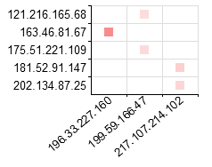
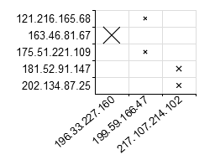
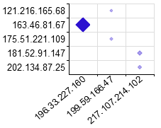
Charts
Simple, well-understood visual framework
Analyst-controlled presentation
Perceptually optimal suggestions on demand
vary opacity
vary size
vary both
Snort alerts by source and destination IP

Slide 8
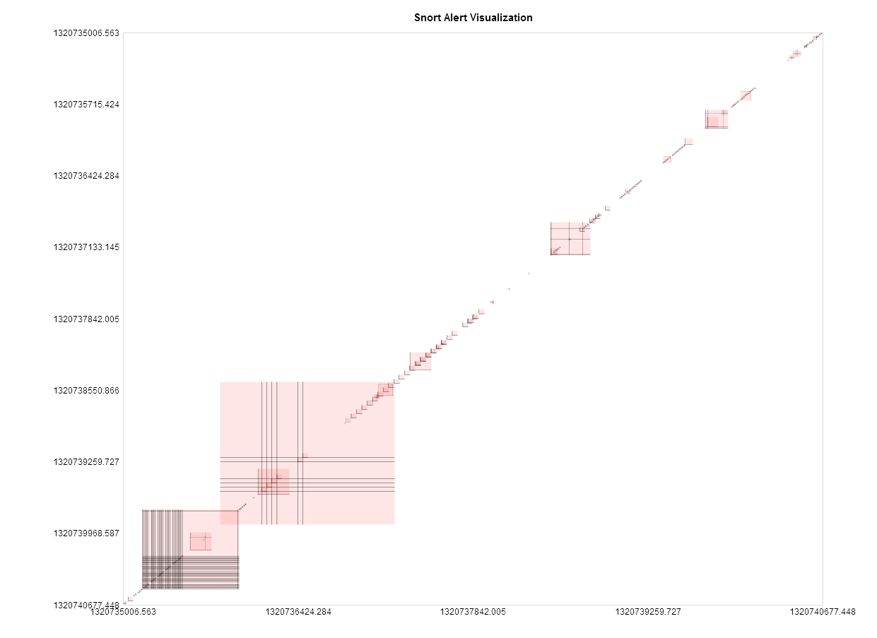
Snort alerts by netflow start and end times

Slide 9
Overview + Detail
Initial display presents overview of data
Analysts can choose where to “zoom in” for more detail
Zoom method provides individual details
Overview of Snort alerts for destination IP 172.16.79.128
Zoom in on second alert set
Zoom in to examine individual Snort alerts

Slide 10
Chart Visualization Summary
Major steps supported by our visualization tool:
High-level aggregation to highlight data of interest
Scatterplots to examine relationships between attributes
Correlated visualizations to provide multiple perspectives
Back-end data management support
User-interface support for analyst control of each step
Analyst-driven visualization
support for analyst-driven data selection
support for hypothesis testing, exploration, validation
pre-defined visualization that can be modified by an analyst
control over what data is visualization, and how
Hao, Healey, Hutchinson (2013). “Flexible Web Visualization for Alert-Based Network Security Analytics,” in Proceedings Visualization for Cyber Security 2013 (VizSec 2013, Atlanta, GA), pp. 33–40.

Slide 11
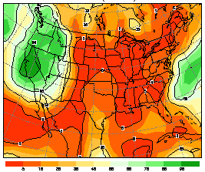
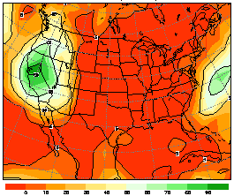
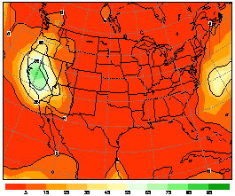
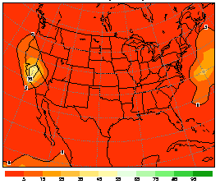
Ensemble Visualization
Ensemble: collection of related datasets (members)
originally created for physical science simulations
large, time-varying, multi-dimensional, multi-attribute
Goals:
exploration of inter-member relationships
member correlation
outlier identification
Member 1
Member 2
Member 3
Member 4
Time (Hour)
. . .
Precipitation Probability Forcast Ensemble

Slide 12
Network Security Visualization
Motivation
network security data is temporal
identification of related and outlier traffic is important
ensemble methods are designed for scalability
Representing network security data as an ensemble
Define a member (e.g., network traffic to a destination)
Define time steps or time windows (e.g., hours, days)
Define data values per time step (e.g., number of alerts)
Apply ensemble analysis and visualization
Are ensemble techniques useful?
If so, work in ensemble visualization potentially applicable
Hao, Healey, Hutchinson (2015). “Ensemble Visualization for Cyber Situation Awareness of Network Security Data,” submitted to Visualization for Cyber Security 2015 (VizSec 2015, Chicago, IL).

Slide 13
Alert Ensemble
Member: combination of data attributes
e.g., destination IP plus destination port
Time steps within member: analyst-driven
e.g., equal-width time windows
Inter-member relationship analytics
similarity of changes in number of alerts over time
Example alert ensemble dataset
extract all alerts from source IP 64.120.250.242
member: destination IP plus desination port
time step: alerts per day

Slide 14
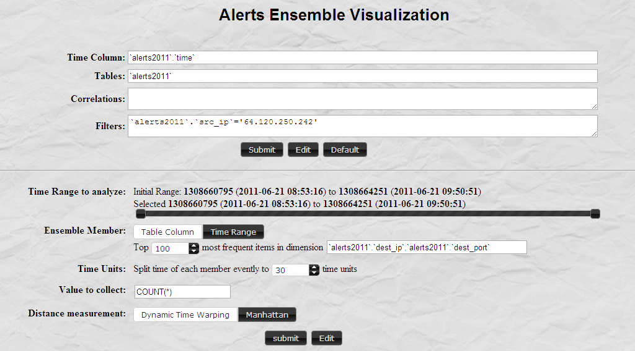
Ensemble dataset
extract alerts
define member
define time step

Slide 15
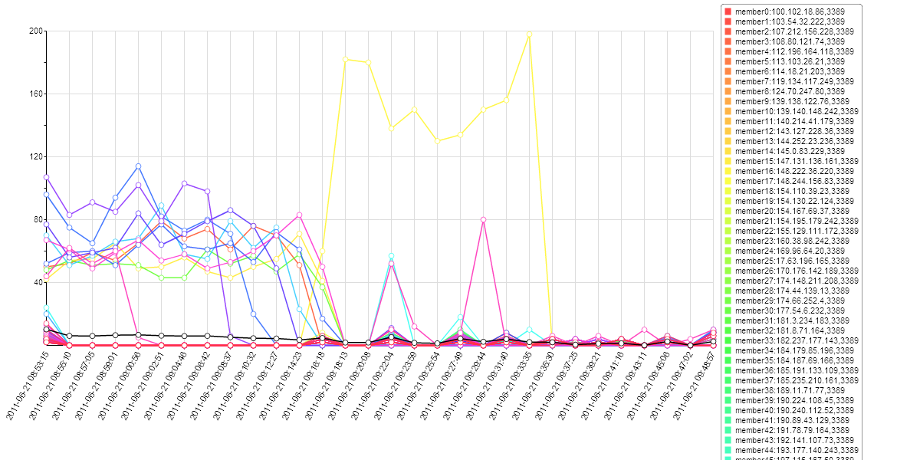
Ensemble dataset
Number of Alerts
define time step
define member
extract alerts
Time Steps (Days)

Slide 16
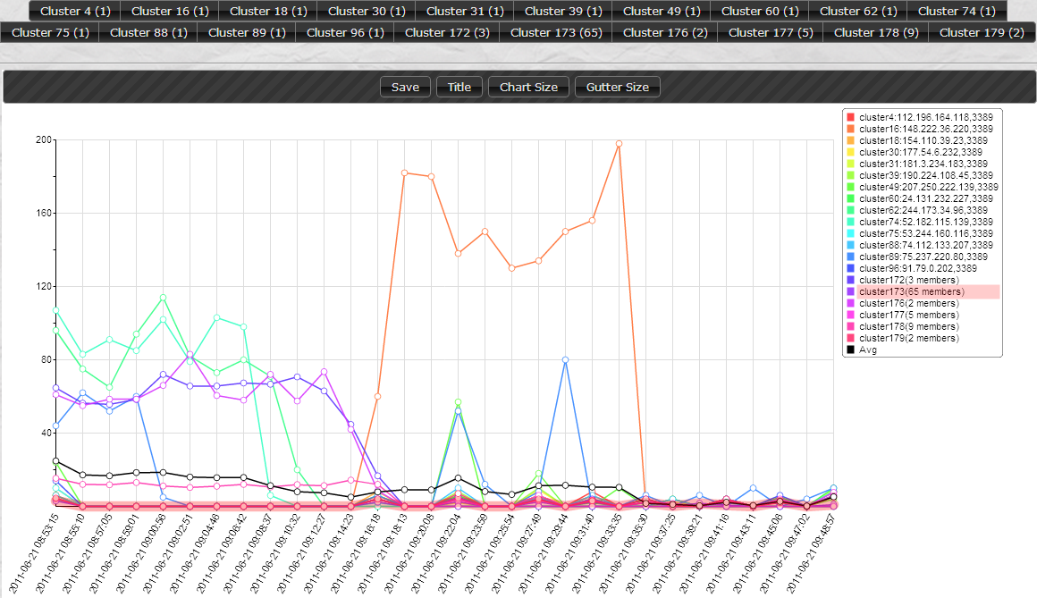
k=20 clusters
Number of Alerts
Time Steps (Days)

Slide 17
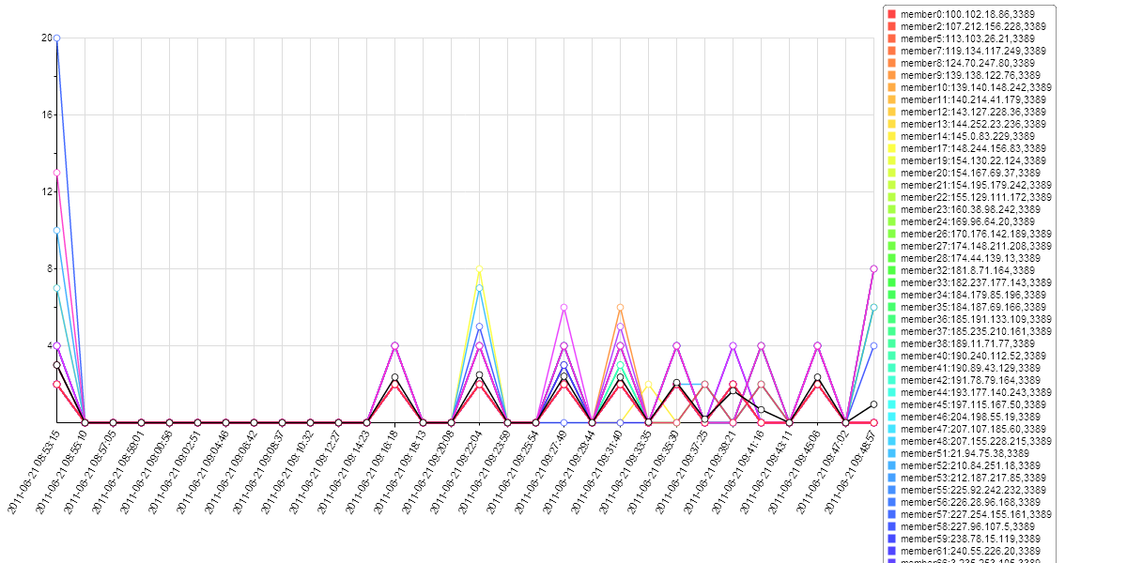
65-member cluster
Number of Alerts
Time Steps (Days)

Slide 18
Flow Ensemble
Member: sequence of NetFlows
e.g., between destination IP.port, source IP.port
Time steps within member: NetFlow-driven
e.g., Netflow duration, gap duration
Inter-member relationship analytics
similarity of NetFlow duration, density and distribution of alerts
Ensemble dataset
65 NetFlows from source IP 64.120.250.242 with similar alert pattern
member: destination IP plus desination port
time step: NetFlow duration plus gap duration

Slide 19
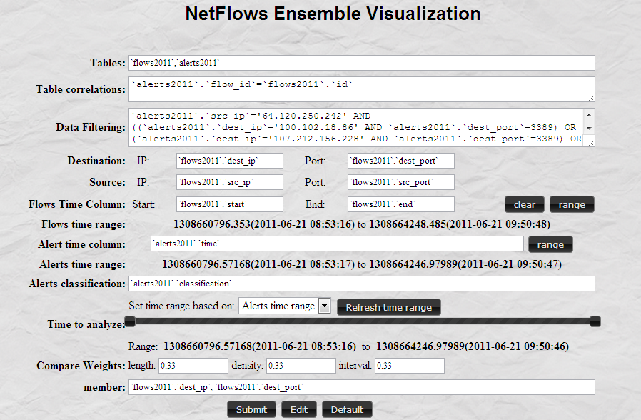
Ensemble dataset
extract NetFlows
with 65 alert patterns
define member

Slide 20
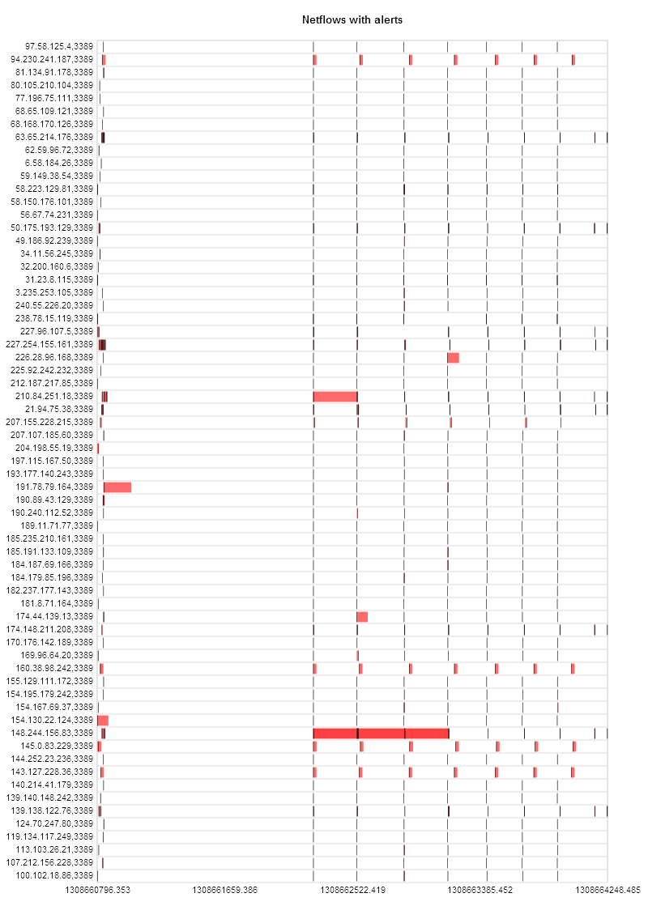
65-member Gantt visualization
Destniation IP.port
Time

Slide 21
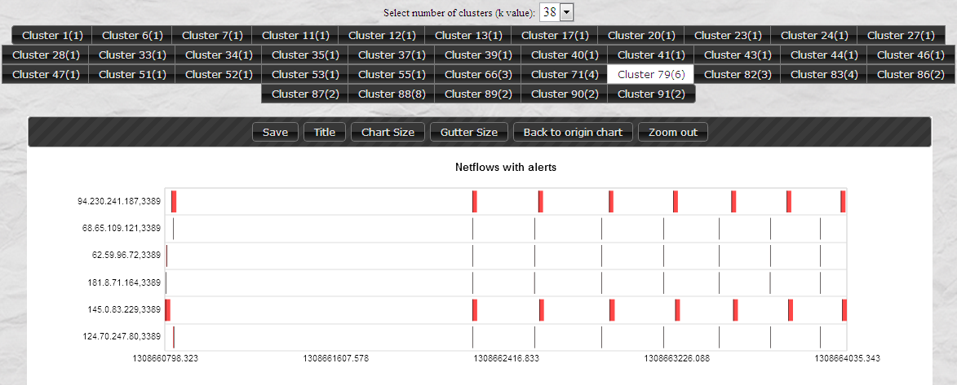
6-member Gantt visualization
1
2

Slide 22
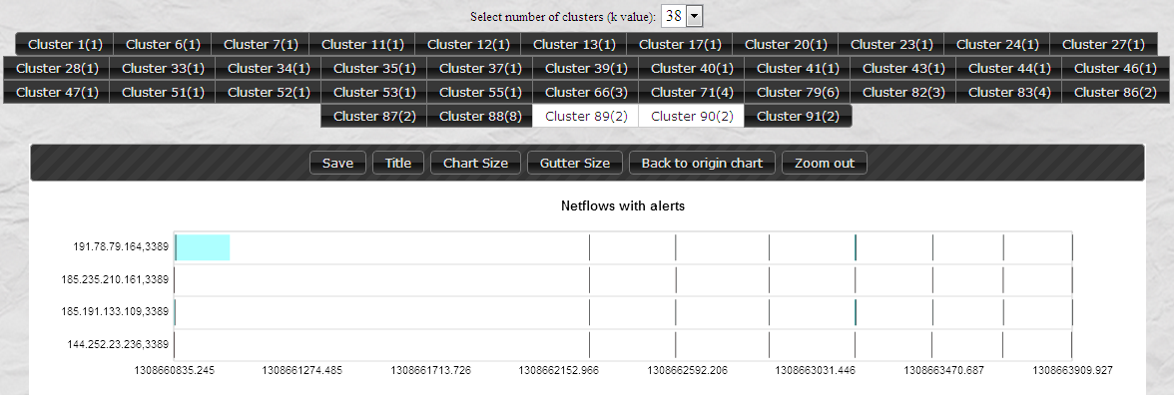
Two-Cluster Comparison

Slide 23
Design Constraints
Mental models
“Fit” the mental models used by analysts to investigate problems
Work Environment
Integrate into analysts’ current working environment
Configurability
Avoid static, pre-defined visualizations of data
Accessibility
Visualizations must be familiar to avoid steep learning curves
Scalability
Support query and retrieval from multiple data sources
Integration
Support, don’t replace, analysts’ current problem-solving strategies

Slide 24
Fin Questions
MURI Meeting July 8–9, 2015
Special Thanks:
Cliff Wang Steve Hutchinson Peng Ning Doug Reeves
healey@ncsu.edu
http://www.csc.ncsu.edu/faculty/healey
sic parvis magna

