Slide 1

A Mission-Centric Framework for
Cyber Situational Awareness
Metrics to Quantify Network Diversity
S. Jajodia, M. Albanese
George Mason University
ARO-MURI on Cyber-Situation Awareness Review Meeting
College Park, MD , July 8-9, 2015

Slide 2
Outline
Overview of Mason’s Role
Network diversity
  Motivation and background
  Use cases
  Diversity metrics
  Experimental evaluation
Year 6 Statistics
Conclusions

Slide 3
Overview of Mason’s Role

Slide 4
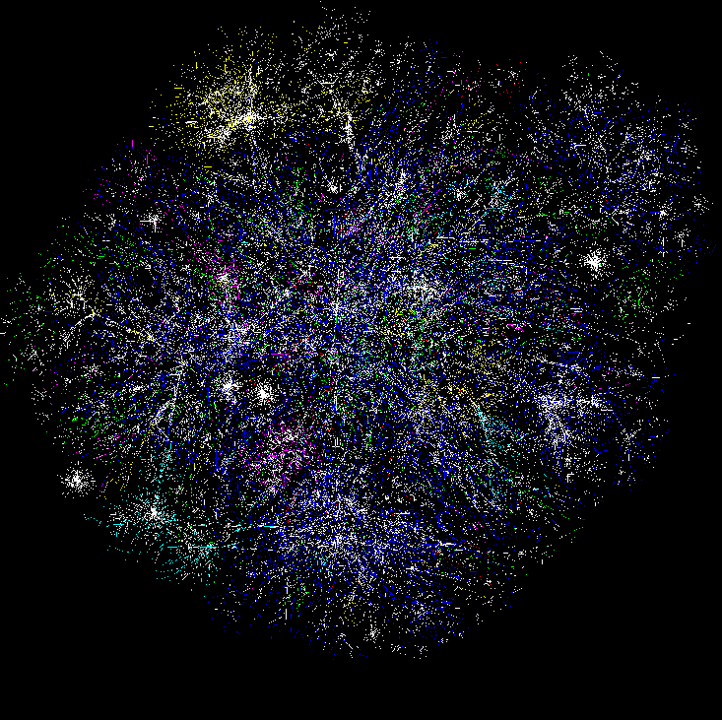
Where We Stand in the Project
Cognitive Models & Decision Aids
Instance Based Learning Models
Simulation
Measures of SA & Shared SA
Software
Sensors, probes
Hyper Sentry
Cruiser
Data Conditioning
Association & Correlation
Information Aggregation & Fusion
Transaction Graph methods
Damage assessment
Automated
Reasoning Tools
R-CAST
Plan-based narratives
Graphical models
Uncertainty analysis
Multi-Sensory Human Computer Interaction
Computer network
Enterprise Model
Activity Logs
IDS reports
Vulnerabilities
Real World
System Analysts
Test-bed
Computer network

Slide 5



Our Vision
Vulnerability Databases
Scenario Analysis & Visualization
Zero-day Analysis
Network Hardening
NVD
CVE
OSVD
Unexplained Behavior Analysis
Cauldron
Analyst
Topological Vulnerability Analysis
Index & Data Structures
Graph
Processing
and Indexing
Cauldron
Switchwall
Stochastic
Attack Models
Situation Knowledge Reference Model
[Attack Scenario Graphs]
Monitored Network
Dependency Analysis
Generalized
Dependency Graphs
NSDMiner
Alerts/Sensory Data

Slide 6
Network Diversity
L. Wang, M. Zhang, S. Jajodia, A. Singhal, and
M. Albanese, “Network Diversity: A Security Metric for Evaluating the Resilience of Networks against Zero-Day Attacks,” Submitted to IEEE Transactions on Information Forensics & Security, 2015

Slide 7
Motivation
Diversity has long been regarded as a security mechanism for improving the resilience of software and networks against various attacks, including zero-day attacks
    The degree of diversity along potential attack paths is an indicator of the network’s capability of resisting attacks
More recently, diversity has found new applications
  Cloud computing security
  Moving Target Defense (MTD)
  Improving the robustness of network routing

Slide 8
Zero-Day Attacks
Zero-day attacks are a real threat to mission critical networks
Governments and cybercriminals are stockpiling zero-day vulnerabilities¹
  The NSA spent more than $25 million in a year to acquire software vulnerabilities
  Example. Stuxnet exploits 4 different/complementary zero day vulnerabilities to infiltrate a SCADA network
But what can we do about unknown attacks?
¹ http://krebsonsecurity.com/2013/12/how-many-zero-days-hit-you-today/

Slide 9
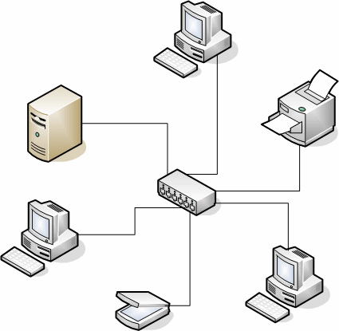







How Could Diversity Help?
Stuxnet’s attack strategy
  3rd party (e.g., contractor) → organization’s network → machine with Siemens Step 7 → PLC
The degree of software diversity along potential attack paths can be considered a good metric for the network’s capability of resisting Stuxnet

Slide 10
Limitations of Current Solutions
Most existing efforts rely on intuitive and imprecise notions of diversity
  Existing models of diversity are mostly designed for a single system running diverse software replicas or variants
At a higher abstraction level, as a global property of an entire network, network diversity and its impact on security has not been formally modeled
  Our modeling effort will help understand diversity and will enable quantitative hardening approaches

Slide 11
Our Contributions
We take the first step towards formally modeling network diversity as a security metric, for the purpose of evaluating resilience of networks w.r.t. zero-day attacks
  We propose a network diversity metric based on well known mathematical models of biodiversity in ecology
  We propose two complementary diversity metrics, based on the least and the average attacking efforts, respectively
  We provide guidelines for instantiating the proposed metrics
    A case study on estimating software diversity is presented
  We evaluate the metrics and algorithms through simulation

Slide 12
New Contributions Since Year 5
A preliminary version of this work appeared in ESORICS
  L. Wang, M. Zhang, S. Jajodia, A. Singhal, and M. Albanese. Modeling network diversity for evaluating the robustness of networks against zero-day attacks. In Proceedings of ESORICS’14, pages 494–511, 2014.
The most significant extensions include
  A new probabilistic model for addressing various limitations of the previous model
  A discussion on how to instantiate the metrics and in particular on collecting inputs about software diversity
  A series of simulations for analyzing the proposed metrics under different use cases

Slide 13
Use Case 1: Stuxnet and SCADA
Stuxnet is one of the first malware to employ multiple zero-day exploits
  Evaluating the risk of zero-day attacks is a challenging task due to the lack of prior knowledge about zero-day vulnerabilities and corresponding attacking methods
Stuxnet targets programmable logic controllers (PLCs) on control systems of gas pipelines or power plants
  These are mostly programmed using Windows machines not connected to the network
    Stuxnet adopts a multi-stage approach
      Infects Windows machines owned by third parties (e.g., contractors)
      Spreads to internal Windows machines through the LAN
      Covers the last hop through removable flash drives

Slide 14
Use Case 2: Worm Propagation
Suppose host 1, 2, and 3 are web servers running IIS, all of which can access files stored on host 4
  Simply counting the number of distinct resources will indicate a lack of diversity and suggest replacing IIS with other software on each host
  However, even if a worm can only infect one web server after such a diversification effort, it can still propagate to all four hosts through the network share
    This simple metric ignores causal
    relationships between resources

Slide 15
Use Case 3: Targeted Attack
Suppose we are more concerned with a targeted attack on the storage server, host 4
  An intuitive solution is to diversify resources along any path leading to the critical asset
    Requires a rigorous study of causal relationships between resources
      Host 4 is only as secure as the weakest path (least attacking effort)
  The least attacking effort only provides a partial picture
    Suppose host 1 and 2 are diversified to run IIS and Apache, respectively, and firewall 2 only allows host 1 and 2 to reach host 4
    Although the least attacking effort has not changed, this diversification effort has actually provided attackers more opportunities to reach host 4
      They can exploit either IIS or Apache

Slide 16
Use Case 4: Moving Targeted Defense
Suppose host 1and 2 are web servers, host 3 an application server, and host 4 a database server
  An MTD approach attempts to enhance security by varying over time software components at different tiers
    A common misconception here is that the combining different components at different tiers will increase diversity
    However, this is usually not the case
      For example, a single flaw in the application server may result in SQL injection that compromises the database server
      Also, more diversity over time may actually provide attackers more opportunities to find flaws
      The lesson here is again that, an intuitive observation may be misleading, and formally modeling network diversity is necessary

Slide 17
Bio-Diversity (1/2)
The notion of network diversity has not been extensively studied
  Its counterpart in ecology, biodiversity, and its positive impact on the ecosystem’s stability resistance to invasion and diseases has been investigated for many decades
We focus on adapting existing mathematical models of biodiversity for modeling network diversity
  Richness of species
  Effective richness
  Similarity-sensitive effective richness

Slide 18
Bio-Diversity (2/2)
Richness of species
  The number of different species in an ecosystem
  Limitation: ignores the relative abundance of each species
Effective number or resources
  Measures the equivalent number of equally-common species, even if in reality all species are not equally common
  Limitation: assumes all resources are equally different
Similarity-Sensitive Effective Richness
  We can use a resource similarity function to account for differences between resources

Slide 19
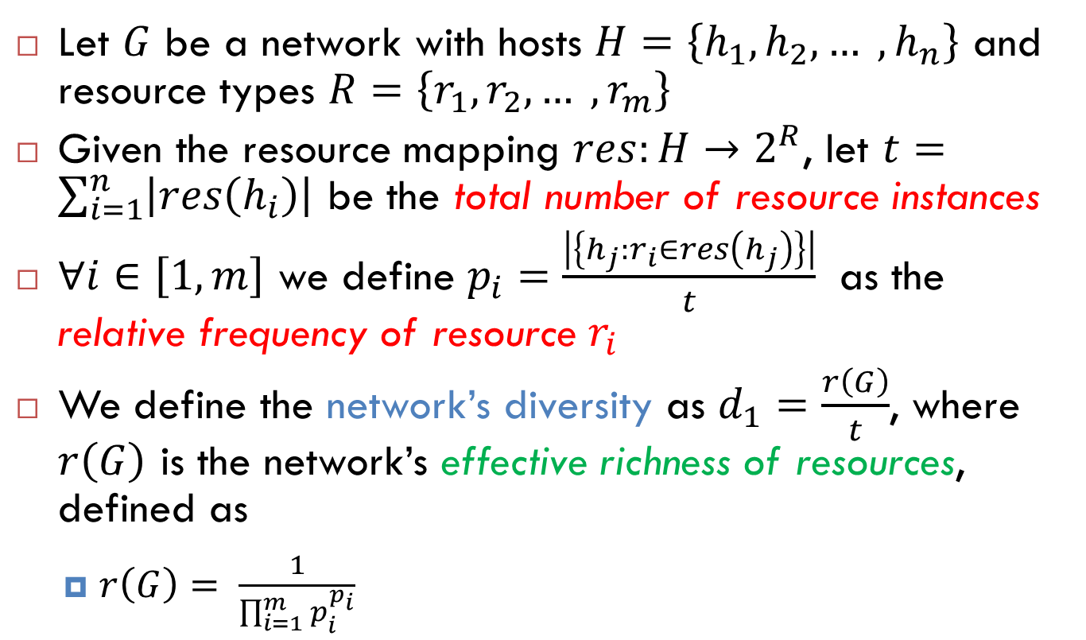
Effective Richness and d₁-Diversity
Let $G$ be a network with hosts $H=\left\{h_{1}, h_{2}, … , h_{n}\right\}$ and resource types $R=\left\{r_{1}, r_{2}, … , r_{m}\right\}$
Given the resource mapping $res:H→2^{R}$, let $t=\sum_{i=1}^{n}{\left|res\left(h_{i}\right)\right|}$ be the total number of resource instances
$∀i∈\left[1,m\right]$ we define $p_{i}=\frac{\left|\left\{h_{j}:r_{i}∈res\left(h_{j}\right)\right\}\right|}{t}$ as the relative frequency of resource $r_{i}$
We define the network’s diversity as $d_{1}=\frac{r\left(G\right)}{t}$, where $r\left(G\right)$ is the network’s effective richness of resources, defined as
  $r\left(G\right)= \frac{1}{\prod_{i=1}^{m}{p_{i}^{p_{i}}}}$

Slide 20
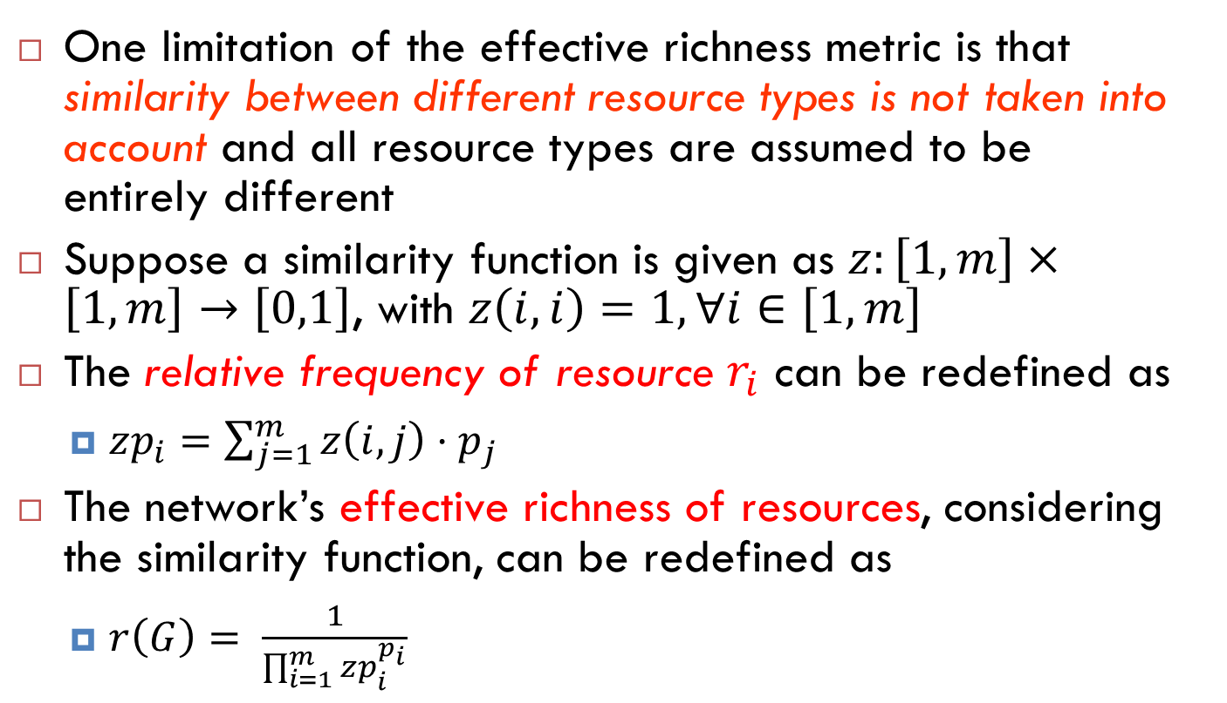
Similarity-Sensitive Effective Richness
One limitation of the effective richness metric is that similarity between different resource types is not taken into account and all resource types are assumed to be entirely different
Suppose a similarity function is given as $z:\left[1,m\right]×\left[1,m\right]→\left[0,1\right]$, with $z\left(i,i\right)=1, ∀i∈\left[1,m\right]$
The relative frequency of resource $r_{i}$ can be redefined as
  $zp_{i}=\sum_{j=1}^{m}{z\left(i,j\right)⋅p_{j}}$
The network’s effective richness of resources, considering the similarity function, can be redefined as
  $r\left(G\right)= \frac{1}{\prod_{i=1}^{m}{{zp}_{i}^{p_{i}}}}$

Slide 21
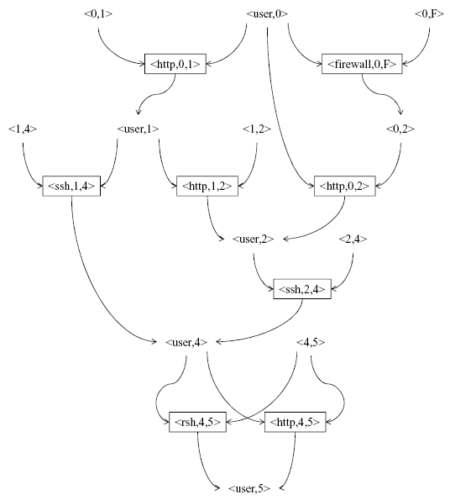
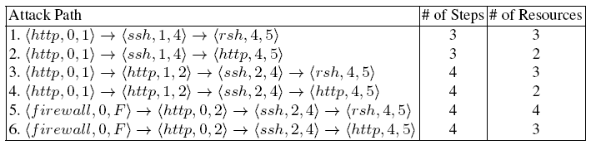
Resource Graph
Syntactically equivalent to an attack graph
Models causal relationships between
network resources (rather than vulnerabilities)
Vertices: zero-day exploits,
their pre- and post-conditions
Edges: AND between
pre-conditions, OR between exploits
What is the least diverse path?

Slide 22
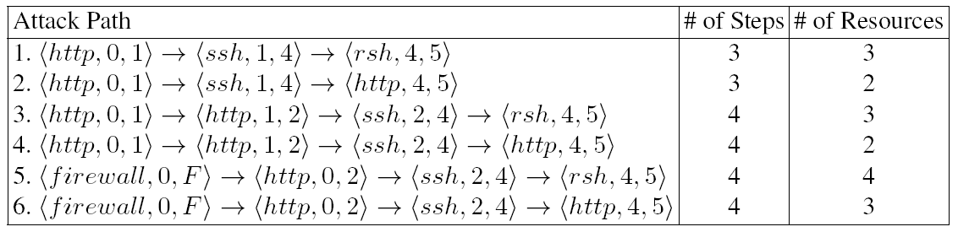
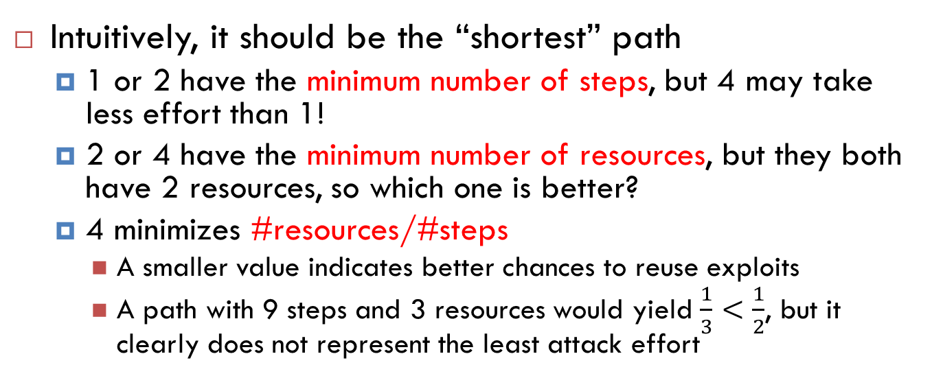
Selecting the Least Diverse Path(s)
Intuitively, it should be the “shortest” path
  1 or 2 have the minimum number of steps, but 4 may take less effort than 1!
  2 or 4 have the minimum number of resources, but they both have 2 resources, so which one is better?
  4 minimizes #resources/#steps
    A smaller value indicates better chances to reuse exploits
    A path with 9 steps and 3 resources would yield $\frac{1}{3}<\frac{1}{2}$, but it clearly does not represent the least attack effort

Slide 23
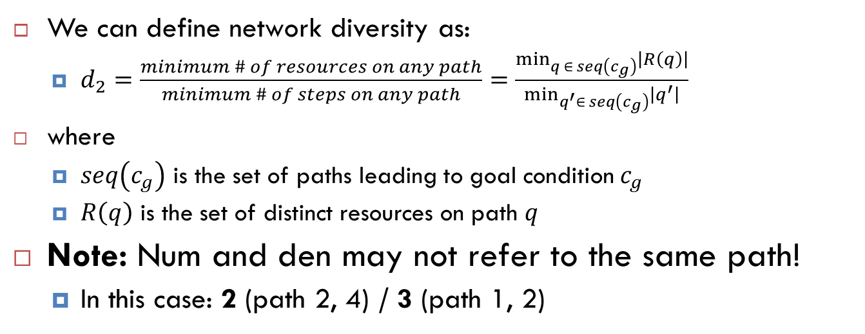
Network Diversity: Least Attack Effort
We can define network diversity as:
  $d_{2}=\frac{minimum \# of resources on any path}{minimum \# of steps on any path}=\frac{\min_{q ∈ seq\left(c_{g}\right)}\left|R\left(q\right)\right|}{\min_{q^{′}∈ seq\left(c_{g}\right)}\left|q^{′}\right|}$
where
  $seq\left(c_{g}\right)$ is the set of paths leading to goal condition $c_{g}$
  $R\left(q\right)$ is the set of distinct resources on path $q$
Note: Num and den may not refer to the same path!
  In this case: 2 (path 2, 4) / 3 (path 1, 2)

Slide 24
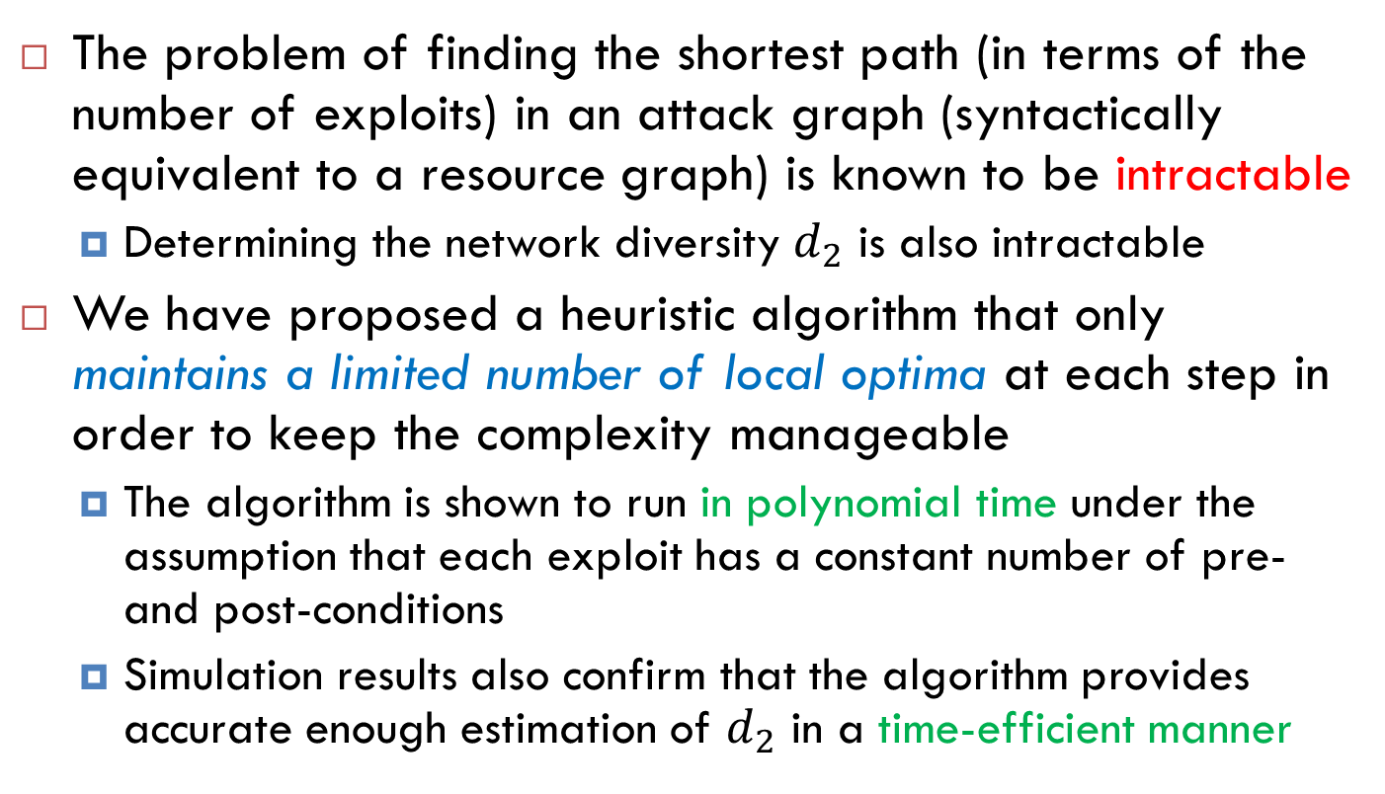
Complexity and Algorithm
The problem of finding the shortest path (in terms of the number of exploits) in an attack graph (syntactically equivalent to a resource graph) is known to be intractable
  Determining the network diversity $d_{2}$ is also intractable
We have proposed a heuristic algorithm that only maintains a limited number of local optima at each step in order to keep the complexity manageable
  The algorithm is shown to run in polynomial time under the assumption that each exploit has a constant number of pre- and post-conditions
  Simulation results also confirm that the algorithm provides accurate enough estimation of $d_{2}$ in a time-efficient manner

Slide 25
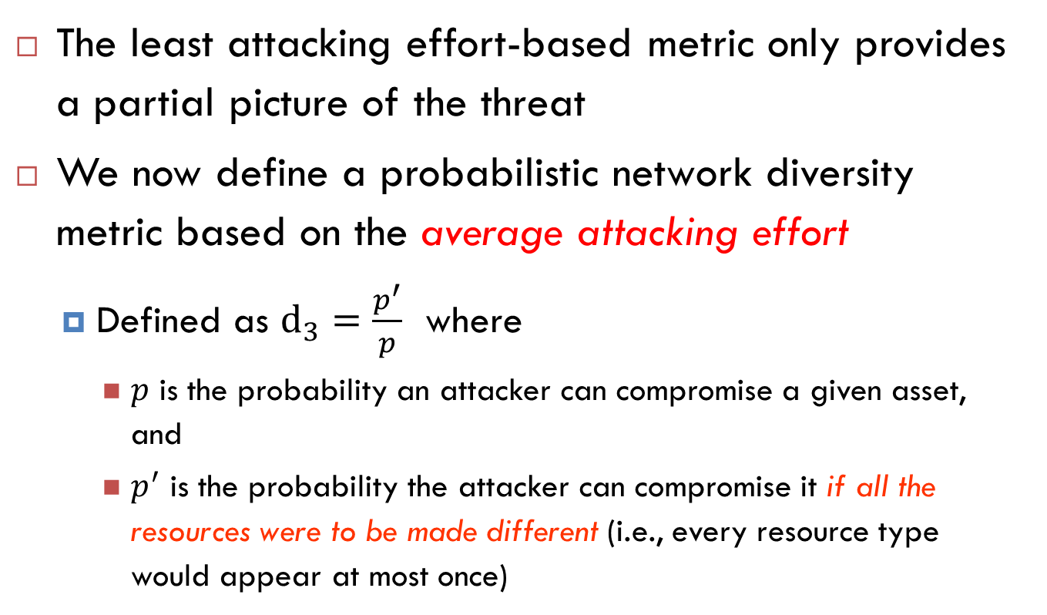
Network Diversity: Average Effort
The least attacking effort-based metric only provides a partial picture of the threat
We now define a probabilistic network diversity metric based on the average attacking effort
  Defined as $d_{3}=\frac{p^{′}}{p}$ where
    $p$ is the probability an attacker can compromise a given asset, and
    $p^{′}$ is the probability the attacker can compromise it if all the resources were to be made different (i.e., every resource type would appear at most once)

Slide 26

Effect of Reusing Exploits
$$d_{3}=\frac{0.0064}{0.9}$$
Notes:
The left-hand side represents the case in which the effect of reusing an exploit is not considered, that is, the two http service instances are assumed to be distinct. The right hand side considers that effect and models it as the conditional probability that the lower http service may be exploited given that the upper one is already exploited (represented using a dotted line). The two conditional probability tables (CPTs) illustrate the effect of reusing the http exploit (e.g., probability 0.9 in the right CPT), and not reusing it (e.g., probability 0.08 in the left CPT), respectively

Slide 27

Limitations of the $d_{3}$ Metrics
Modeling the effect of reusing exploits as a conditional probability assumes a total order over
instances of the same
resource type
The attack likelihood
will be higher if the
http exploits in the two
paths are distinct
  An attacker would
  have more choices in
  reaching the goal condition

Slide 28

A Better Model for the $d_{3}$ Metrics
What helps an attacker succeed in exploiting a previously exploited type of resources
is the knowledge, skills, or exploit
code that was previously obtained
This advantage can be modeled
as a separate event
  We can model its effect on increasing
  the likelihood of success in subsequent
  exploits as conditional probabilities
    A new parent node common to
    exploits of the same resource type
    is added to the resource graph

Slide 29
Experimental Setup
We studied the three proposed metrics by applying them to different use cases through simulations
To generate a large number of resource graphs for simulations we
  first construct a small number of seed graphs based on real networks, and
  then generate larger graphs from those seed graphs by injecting new hosts and assigning resources in a random but realistic fashion

Slide 30
Overall Trends
Comparison of Metrics (Left) and the Effect of Increasing Diversity (Right)

Slide 31
Use Case: Worm Propagation
Left: 10% exploits with initially satisfied pre-conditions
Right: 50% exploits with initially satisfied pre-conditions
$S_{1}$ is the ratio of hosts uninfected by simulated worms
Notes:
The left figure shows that, when the network is better safeguarded (with only 10% of exploits initially reachable), the effect of increasing diversity on simulated worms shows a closer relationship with the d2 metric than the other two, both of which indicate that increasing diversity can significantly increase the percentage of hosts uninfected by worms.
In comparison, the right figure shows a less promising result where both three metrics and the percentage of uninfected hosts all tend to follow a similar trend. Intuitively, in such less guarded networks where half of the exploits may be reached initially, the effect of diversity on worms is almost proportional to the richness of resources (d1), and all three metrics tend to yield similar results.

Slide 32
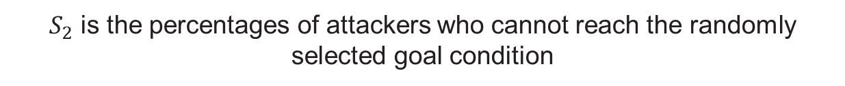
Use Case: Targeted Attack
Left: 10% exploits with initially satisfied pre-conditions
Right: 50% exploits with initially satisfied pre-conditions
$S_{2}$ is the percentages of attackers who cannot reach the randomly selected goal condition
Notes:
We simulate attackers with different capabilities (sets of resources they can compromise) and the level of such capabilities (that is, the number of resources they can compromise) follows the Gamma distribution. Similarly, we also repeat each experiment 500 times and we examine two different cases corresponding to different percentages of first level exploits.

Slide 33
Use Case: Moving Target Defense
Success rate of attacks w.r.t. frequency of changes (Left) and time (Right)

Slide 34
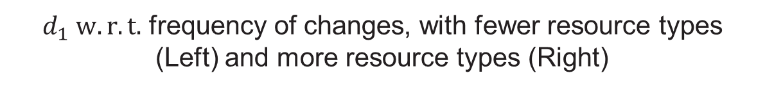
Use Case: Moving Target Defense
$d_{1} w.r.t.$ frequency of changes, with fewer resource types (Left) and more resource types (Right)

Slide 35
Cost
Notes:
For worm propagation, we assign monetary values to all hosts, with critical assets (goal conditions) having higher values, whereas
for targeted attack, we only assign a value to critical assets.
The red and green dashed lines on top of the figure shows the total value for each scenario.
Each time when worms or attackers compromise a resource, its assigned value is considered lost. Such lost value is the first part of overall cost. The other part is the cost of changing configurations in MTD (e.g., administrative cost of purchasing new software
or performance cost of delaying a client’s request).
The results show that the overall cost will first decrease and then increase. The optimal setting of frequency is about one configuration change per 5 days, which best balances the cost of changing new configuration with lost
values of compromised resources.

Slide 36
Year 6 Statistics

Slide 37
Year 6 Statistics (1)
Publications & presentations
  1 paper published in a peer-reviewed journal
  1 paper submitted to a peer-reviewed journal
  1 book chapter
    Book title: The Psychosocial Dynamics of Cyber Security
Supported personnel
  2 faculty
  1 doctoral student
  1 undergraduate student

Slide 38
Conclusions

Slide 39
Conclusions
The focus in Year 6 was on
  Integration of previous contributions
  Additional work on network diversity
    A new probabilistic model for addressing various limitations of the previous model
    A discussion on how to instantiate the metrics and in particular on collecting inputs about software diversity
    A series of simulations for analyzing the proposed metrics under different use cases

Slide 40
Questions?

