Slide 1
Models and Experimentation in Cognition-Based Cyber Situation Awareness
Michael McNeese - David Hall - Nick Giacobe
Tristan Endsley - James Reep
College of Information Sciences and Technology The Pennsylvania State University
July 9, 2015

Slide 2
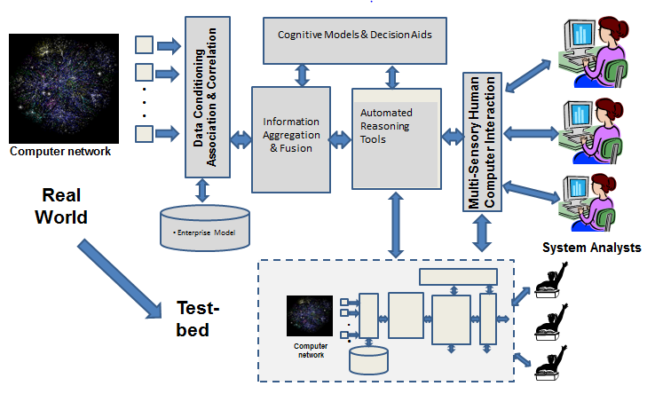
Computer-Aided Human Centric Cyber Situation Awareness: Models and Experiments in Cognition-Based Cyber Situation Awareness
M. McNeese, D. Hall, N. Giacobe
Objectives:
Understand cognitive/contextual elements of situation awareness in cyber-security domains
Implement a systems perspective to research linking real-world analysts with theory and human in the loop experiments
Utilize Multi-Modal research methodology
Focus on the human and team elements within real context applications
Accomplishments
Developed a general architecture for cyber SA: automated reasoning & hypothesis generation with human context-based reasoning
Demonstrated Complex Event Processing (CEP) and Coherence Net processing for automated analysis of semantic information related to network situational data
Acquired and utilized Tripwire Benchmark, a system for aggregating cyber-security sensor data from multiple platforms
Developed a new set of test data for calibrated human in the loop experiments
Applied the Living Lab Framework and process, to cyber security
Challenges
Rapid evolution of cyber threats and threat environments
Access to domain experts and state of the art practice
Modeling adversarial threats – integration in simulation
Scientific/Technical Approach
Living laboratory framework involving;
Ethnographic studies
Knowledge elicitation of domain experts
Development of cognitive and process frameworks and theories
Implementation of a scaled world prototype
Conduct of human in the loop experiments
Analysis and transition to real-world environments

Slide 3
Main Scientific/Technical Accomplishments (6th Year)
Motivation
Improvement in Cyber SA requires focus on the ultimate limited resource: the human cyber analyst. This in turn requires understanding of the cognitive processes, the context, limitations and issues associated with perception, cognition and decision making for cyber SA
Summary of Accomplishments
Developed a general architecture and approach for cyber situation awareness incorporating automated reasoning and hypothesis generation with human in the loop context-based reasoning
Demonstrated the use of Complex Event Processing (CEP) and Coherence Net processing for automated analysis of semantic information related to network situational data
Acquired and utilized Tripwire Benchmark, a system for aggregating cyber-security sensor data from multiple platforms
Created a new set of calibrated test data for use in human in the loop experiments
Applied the Living Lab Framework and the process, developed previously in the study of several human cognitive aspects and how they apply to cyber security
We disseminated our findings via peer-reviewed journal articles, conference papers, edited book chapters, and presentations.

Slide 4
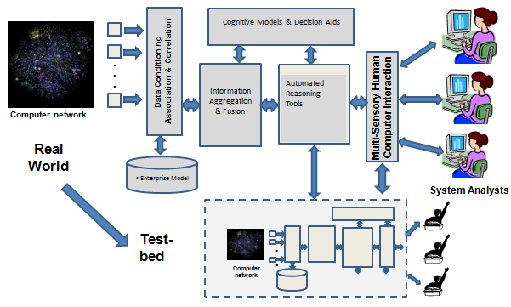
6th Year Focus and Contributions
Continued refinement of human-in-the-loop processing architecture for cyber SA
Conducted a survey of tools to assist automated analysis and information visualization
Demonstrated Complex Event Processing (CEP) and Coherence Net processing for automated ingestion of semantic information
Generation and Translation of Cyber Data Sets for Experimentation Scenarios
Proof of Concept Distributed Information Fusion CYNETS developed
Qualitative Interviews of Cyber Security Regional Challenge Problem
Coding Scheme produced to analyze data
Concept Map Models of Emerging Themes in Qualitative Data
Developed a physical test bed to allow generation of “hard” sensor data
Utilized Tripwire Benchmark, a system for aggregating cyber-security sensor data

Slide 5
6th Year Task Statistics and Summary
Students supported:
Two graduate students: T. Endsley (50%) and J. Reep (50%)
Five undergraduate students: J. Albany, C. Burns, B. Malinchak, D. Ocasio, James Rowley, and C. Signorino (approximately 15 % time)
Two faculty (D. Hall, M. McNeese) – Note: funding for all faculty provided by Penn State
Degrees awarded: None this period
Degrees in progress: Tristan Endsley (PhD), James Reep (PhD)
Note: since the 5th year review, two Ph.D. students have graduated (Vincent Mancuso is a Ph.D. ORISE Post-Doctoral researcher at the Air Force Research Lab (711th Human Performance Wing), and Dev Minotra is a Ph.D. Post-Doctoral Fellow in the Dept. of Industrial and Systems Engineering at the University of Toronto).
Publications:
Refereed journal papers - 0
Conference papers – 3
Conference presentations – 3
Books and book chapters - 2
Dissertations and Theses – 1 (M.S. thesis in revision)
Technical reports - 1
Technology Transitions:
Interactions with industry
Ethnographic studies/knowledge elicitation with network analysts working in education, military, government, and industry domains.
Briefings provided to several companies including: Deloitte, Raytheon Corporation, GE, MITRE, Computer Sciences Corporation, MIT Lincoln Laboratory and TRIPWIRE, Inc.
Interactions with government agencies
Briefings presented to representatives from the National Security Agency (NSA), Defense Threat Reduction Agency (DTRA), Office of Naval Research (ONR), Department of Homeland Security (DHS), the Department of Defense Intelligence Information Systems (DoDII), USAF Air Force Research Lab (Human Effectiveness), NAVSEA (Crane Division)
5

Slide 6
Publications, Honors and Awards Year 6
Refereed Conference Proceedings
McNeese, M. D., Mancuso, V. F., McNeese, N. J., & Glantz, E. (2015). What went wrong? What can go right? A prospectus on human factors practice. To appear in Proceedings of the 6th International Conference on Applied Human Factors and Ergonomics (AHFE 2015) and the Affiliated Conferences, AHFE, July, 2015, Las Vegas, NV
Hall, D., McMullen, S. and C.M. Hall (2015), “New perspectives on Level-5 information fusion: The impact of advances in information technology and user behavior,” accepted for the IEEE 2015 International Conference on Multisensor Fusion and Integration for Intelligent Systems, Sept. 14 – 16, 2015, San Diego, CA.
Hall, D. L., J. Graham and E. Catherman, (2015), “A survey of tools for the next generation analyst”, Proceedings of the DSS Sensing Technology and Applications Analyst: Next-Generation Analyst III, 20-24 April, 2015, Baltimore, MD
Books and Book chapters
Hall, D., G. Cai and J. Graham (2015, in press), “Empowering the next generation analyst” chapter in Information Fusion in Crisis Management, ed. By G. Ragova and P. Scott, Springer.
McNeese, M. D., and D. L. Hall, editors, The Living Laboratory: An Integrated Problem-Centric Approach to Cognitive Systems and Teamwork, (in preparation)
Technical reports
N. Giacobe and D. Hall (2015), Research Opportunities and Challenges for Cyber Systems Risk Management, June 30, 2015 (27 pages), technical report for Penn State Applied Research Laboratory
Presentations
Hall, D. L., J. Graham and E. Catherman, (2015), “A survey of tools for the next generation analyst”, Proceedings of the DSS Sensing Technology and Applications Analyst: Next-Generation Analyst III, 20-24 April, 2015, Baltimore, MD
• McNeese, M. D., Mancuso, V. F., McNeese, N. J., & Glantz, E. (2015). What went wrong? What can go right? A prospectus on human factors practice. To appear in Proceedings of the 6th International Conference on Applied Human Factors and Ergonomics (AHFE 2015) and the Affiliated Conferences, AHFE, July, 2015, Las Vegas, NV
Hall, D., McMullen, S. and C.M. Hall (2015), “New perspectives on Level-5 information fusion: The impact of advances in information technology and user behavior,” accepted for the IEEE 2015 International Conference on Multisensor Fusion and Integration for Intelligent Systems, Sept. 14 – 16, 2015, San Diego, CA.

Slide 7
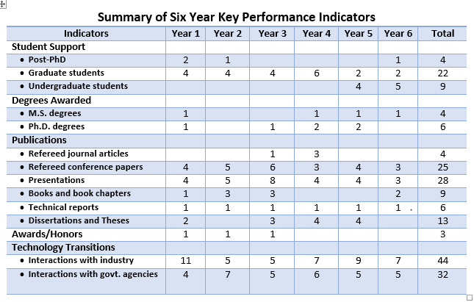
Summary of Six Year Key Performance Indicators
Note: Year 6 represents a partial year, no-cost extension beyond year 5 – Hence results are at a significantly lower level of effort than previous years

Slide 8
Dr. Michael McNeese

Slide 9
Where does SA reside in CyberWorlds?
Some say it is in the capacity to increase data availability
Some say it is in the algorithms/computers tools
The visualizations, the display, big data ?
The human mind / experience – attention, memory ? (often left out)
The team mind (often not considered)
In reality - there are multiple kinds of awareness present in the system, emergent across time and space, represented in various ways to human and agent; distributed throughout the cognitive system
This is where our research has focused and where
innovations will continue to develop

Slide 10
Application of the
Living Laboratory Framework
Field of Practice: Cyber-Security
KNOWLEDGE
ELICITATION
THEORY
SCALED
WORLDS
models
PROBLEM
BASED
APPROACH
use
ETHNOGRAPHIC
STUDY
RECONFIGURABLE
PROTOTYPES
PRACTICE

Slide 11
Scientific and Technical Overview:
Distributed Cognition Perspectives
Goal
produce / test interdisciplinary approach to understand Cyber Distributed Cognition
Foundations
Distributed Cognition - theoretical foundation
II. Human-Agent Transactions - cognitive system engineering perspective
Focus Areas:
distributed teamwork and collaboration
distributed information fusion
metacognition/intelligence – outthinking the adversary
cognitive technologies – future work

Slide 12
Underlying Theme: Framing Awareness
Opportunistic Problem Solving
Metacognitive Reflections About The Threat
Learning & Spontaneous Access Of Knowledge
An Important Issue to Study
What is it?
What problems are experienced without awareness?
How is it improved?
How does it break down,
How is it related to distributed cognition?
- problem solving - decision making - judgment - intuition
How is teamwork involved in making awareness?
What world view is being used to understand it?
PROBLEM
BASED
APPROACH

Slide 13
6th Year OVERVIEW - current work -
MURI Activity I:
Quantitative Research
MURI Activity II:
Qualitative Research
THEORY
Distributed Cognition/ SA of Info-Fusion
Security Club
Challenge
Problem
PROBLEM
BASED
APPROACH
PRACTICE

Slide 14
Applying Distributed Cognition to Cyber Security
• New Scaled World Simulation Proof of Concept - CYNETS
- Designed for distributed teamwork (synchronous)
- Involves distributed information availability
- Historical Precedence:
The MURI - NETS family
Andrew Riefers, IST Dissertation 2010
Vince Mancuso, IST Dissertation 2012
Dev Minotra, IST Dissertation 2013
Nick Giacobe, IST Dissertation 2013
• Test of Situation Awareness in Distributed Cognition with Information Fusion Problem Set
• Demo of CYNETS

Slide 15
6th Yr. Research OVERVIEW: Quantitative
Distributed Cognition/ SA of Info-Fusion
Security Club
Challenge
Problem
PROBLEM
BASED
APPROACH
Scaled World Sim Information Fusion –
Distributed Teamwork
Knowledge Elicitation
Indi./ Team Problem Solving
PRACTICE
Performance
Data Sets
Generated
Interviews
Observation
PRODUCTS
Proof of Concept
CYNETS 1
Simulation
Coding
Schema
Transcripts
Encoded
Data Analysis
Preliminary
Results
Concept
Maps
Descriptive
Models
Notes:
Unpacking the LivLab to see how problem states decompose into research activities for yr 6.
So this is how we addressed the ‘Framing awareness’ theme in this 6th year. The perspective is that of human-agent transactions as relayed through the new simulation. Framing awareness is a theme looked at in agent-agent interaction for the challenge problem as well to see what can be framed around awareness for specific cyber security problems in context.

Slide 16
Approach I - Proof of Concept Simulation – CYNETS
Develop Cyber Distributed Cognition Simulation w. Information Fusion Architecture
Applied distributed cognition theory to cyber security operations in a scaled world
Data fabricated from commercially available cyber-security tools
Data fabricated in the test lab on real systems
Active Directory (Auth), Symantec Endpoint (AV), Windows Software Update (Patch Mgmt)
Adapted to fit experiment scenarios
Network models a typical network with workstations and servers simulating high noise / low signal ratio
3 analyst roles – Anti-virus, Authentication, and Windows Updates
Responsible for reactionary machine and problem identification (by role) through analysis of the simulated logs described previously
Analyst must wade through the log files located on many machines to identify the compromised machine and then properly identify the problem associated with the compromise. (analogous to real-world Cyber Analyst tasks where the threat and compromise are unknown)
* Demonstration of the CYNETS Simulation

Slide 17
Experiment/Proof of Concept using CYNETS Simulation
Experimental Study using 3 person-teams (9 participants)
Task Focus: cyber ops with adversarial threat
Independent Variable – Distributed Hard Fusion (3 levels)
-- Anti-Virus / Authentication / Windows Update
Subjective SA measures used
NASA TLX (how complex is the interface?)
SART (how well do I think I am doing?)
Shared SA Inventory (how is my team performing?) (Endsley et al. 2009)
Preliminary Results Obtained (3 teams)
Team Performance Scores
Teams SA Measures Collected
Implications
more data needed
Notes:
FINAL PRELIM data presented in report

Slide 18
6th Year OVERVIEW: Qualitative
Distributed Cognition/ SA of Info-Fusion
Security Club
Challenge
Problem
PROBLEM
BASED
APPROACH
Scaled World Sim Information Fusion –
Distributed Teamwork
Knowledge Elicitation
Indi./ Team Problem Solving
PRACTICE
Performance
Data Sets
Generated
Interviews
Observation
PRODUCTS
Proof of Concept
CYNETS 1
Simulation
Coding
Model
Transcripts
Encoded
Data Analysis
Preliminary
Results
Concept
Maps
Descriptive
Models

Slide 19
Research Activity II Cyber Security Challenge Exercise
WHAT: Mid-Atlantic Collegiate Cyber Defense Competition
WHO: SRA Students in IST Security Club participated in the challenge
Challenge Problem: Cyber Security Activities – Adversarial Attack
The work they performed was typical cyber-defense activities. They were given remote access to two Linux and two Windows-based servers to defend from live "red-team" attackers. They were also provided dynamic injects of tasks they were asked to perform – typical systems administration tasks, account creation, database updates, etc. They had full administrative access to the systems they were defending, so they could do anything they wanted. Typical tasks included enumerating and securing accounts with administrative access (changing from default passwords), identifying and updating software with patches, modifying configuration of software to turn off unneeded services, etc. During the exercise, the students needed to identify what was wrong (configuration, patches accounts, services), figure out if attackers were utilizing those vulnerabilities to compromise systems, and turn off attacker access if they were able to locate that the attacker had gained access.
Research Activity: Interviews – Observations of SRA students
Transcribing and Encoding transcripts of interviews
Applying New Coding Scheme to Interpret Cyber Distributed Cognition Models
Initial Concept Map Modeling Representation Typology
Notes:
Note – here that one of the elements of Cyber-Cognition and the losses that occurs is metacognitive processing of a mental model of the adversarial threat. This qualitative exercise is real world oriented given by real cyber analysts and provides a problem set that generates concepts about what a threat can do, where it exists, and poses opportunistic problem solving for individuals and a team of humans. As such it is a nice ground point to see how cyber security analysts of the future respond and begin thinking about threats in light of the overall cyber security problems they address. Note too that the experimental task incorporates many of the same elements present in the challenge problem to generate consideration and thinking about cyber security operations that include threat information to begin forming threat mental models for use in their reasoning and solving the problem.

Slide 20
Approach II Coding Schema – Initial Models
Coding Scheme
Concept Map Descriptive Model Development
See next slide
Implications – Challenge Problem afforded basis for establishing intention in cyber human-agent transactions and to see how this played out in terms of cognition-problem solving-teamwork-information sharing-decision making-metacognition

Slide 21
Interview Transcripts - Encoding Schema -
Information Collection:
# of participants – 10 students
4 pre-competition interviews
6 pre- & post-
Encoding Scheme Used
Translation to Concept Map

Slide 22
Actual Screen Shot of Encoding Scheme

Slide 23
Concept Mapping Representation Typology
Used lightweight, flexible descriptive model
Declarative Map -- Overlay 1-2
In process
Procedural Map -- Overlay 3-4
Under development

Slide 24
Overlays underlying CMAP
Concept Map with goal of integrative exploration [1-2] ::: [3-4]
Overlay I: Intentions → Problems Identified/Defined/Explored
Issues/Constraints/Barriers preventing any of above
Mistakes/Failure/Slips
Overlay 2: Solution Paths (Facts, Beliefs, Affordances)
Emergent – what afforded movement towards solutions
Overlay 3: Teamwork in Evidence – Teamwork Opportunities
Shared Common Ground / Information Sharing
Overlay 4: Cognitive Processes Demonstrated
Situation Awareness – MetaCognition
Logic – Rationale – Argument – Reasoning [deductive]
Ingenuity – Creativity – Innovation [induction]
→ From these overlays – define opportunities for: 1) user needs 2) tool-technology development

Slide 25
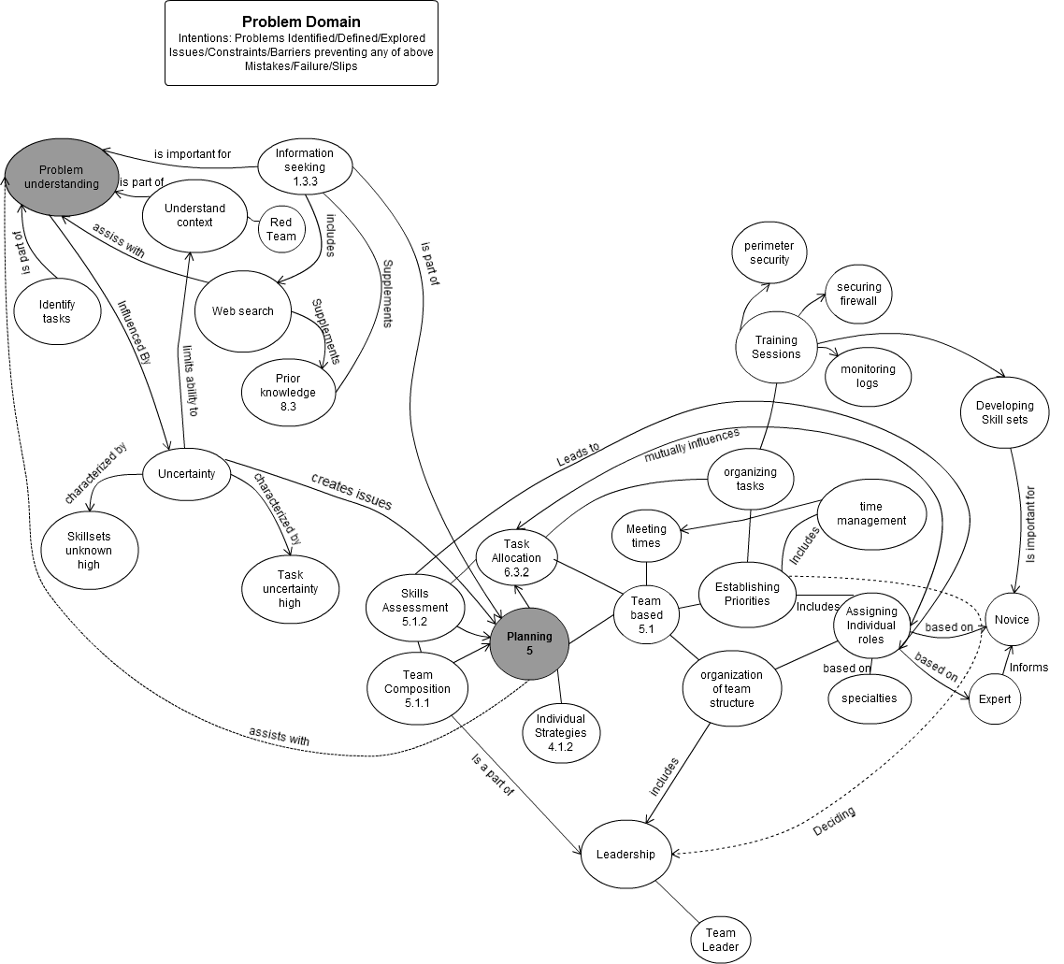

Slide 26
6th Year OVERVIEW: Integrated Results
Distributed Cognition/ SA of Info-Fusion
Security Club
Challenge
Problem
PROBLEM
BASED
APPROACH
Scaled World Sim Information Fusion –
Distributed Teamwork
Knowledge Elicitation
Indi./ Team Problem Solving
PRACTICE
Performance
Data Sets
Generated
Interviews
Observation
PRODUCTS
Proof of Concept
CYNETS 1
Simulation
Coding
Schema
Transcripts
Encoded
Data Analysis
Preliminary
Results
Concept
Maps
Descriptive
Models

Slide 27
Future Work
CYNETS Simulation – Full Scale Testing using:
Potential PSU ROTC students
Greater n possible
B) Potential SRA 400 level course
Expanded # of Participants (18 teams)
Longitudinal Learning Study
Comparisons w ROTC students
Expansion of models – Cognitive Systems
Abstraction Hierarchy
Cognitive Decision Ladder
Human-Agent Transactions
A) Decision support systems explored and enabled via CYNETS
B) Use of CYNETS to explore innovation learning / training strategies
-

Slide 28
Summary of 6th Year Efforts and Accomplishments
Foundations for Cyber Distributed Cognition Set in Motion
Proof of concept simulator developed and tested
Explored through Quantitative/Qual Research Methods
Preliminary research data and results
Initial Coding and Models under development
Teams of Student Cyber Analysts Utilized for Study

Slide 29
Problems / Issues in Cyber Distributed Cognition
PROBLEM
BASED
APPROACH
Missing pieces: often only unary, limited views or understanding leading to shallow understanding – shallow solutions that can be side tracked by
Missing time: many adversarial processes are lightning quick, involve jinxing, and deception hence producing significant lag times in response
Missing places: Cyber SA – is illusive and very much coupled with contextual change both within cyber-technology and physical cyber infrastructure
Missing people: Cyber SA – often only addressed with the unary, individual person but in reality - like much distributed work - it requires distributed teamwork
Missing information: perhaps one of the biggest downfalls to identifying, defining, and solving problems – information fusion often is slight, partially developed and processed, and typically information sharing is an afterthought
Missing technology: intelligent technology has not been: a) intelligent technology has not been intelligent enough to discern context / detect change of context of adversary, b) coupled to human cognitive in a meaningful and useful way (human-computer interaction/visual analytics need vastly improved) c) developed with distributed cognition in the forefront

Slide 30
CYNET Simulation

Slide 31
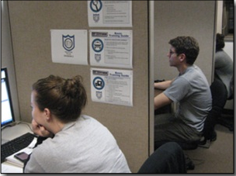
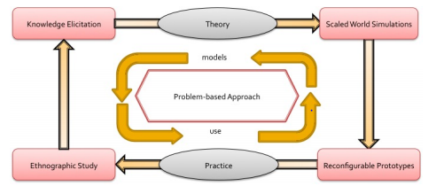
Application of Living Laboratory Framework
Focus of Human-Centric Research
Understand issues related to human component of cyber SA
Exploration of both individual and team performance / problem solving
Modeling & test different distributed cognition concepts via humans in the loop experiments
Determine the impact of distributed information fusion (hard-soft data
Proof of Concept Experiment
Development of new CYNETS simulation to explore 2 types of distributed information fusion concepts
Derived from Tripwire data use for experimental manipulation
Extension and refinement of the experimental test frame
•• Qualitative Interviews
Regional Cyber Security Challenge Problem –IST students involved in problem solving and dec making
Coding of Transcripts to Analyze use of SA, Cognition, and Teamwork
Formulated Initial Concept Map Models to reveal major themes of human-agent interactions.

Slide 32
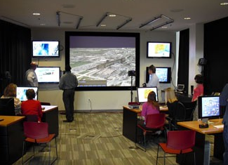
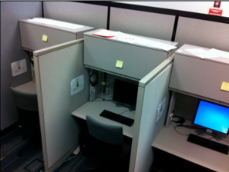
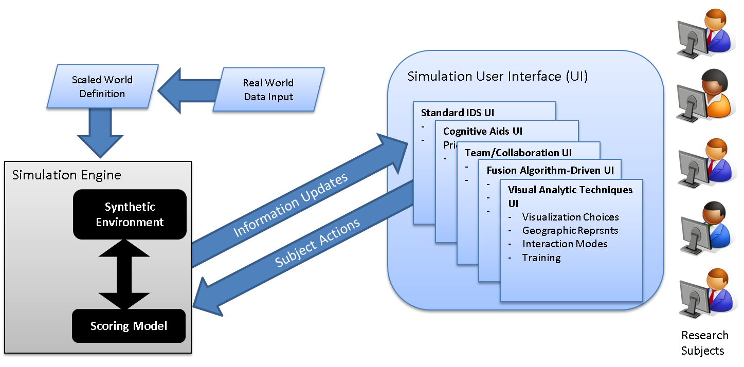
Test and Evaluation Environment
Three Laboratories in the Penn State College of Information Sciences and Technology enable human in the loop experiments with cyber situational awareness in individual and team environments
The Multidisciplinary Initiatives in Naturalistic Decision Systems (MINDS) Laboratory
The Extreme Events Laboratory
NC2IF Cyber Laboratory

Slide 33
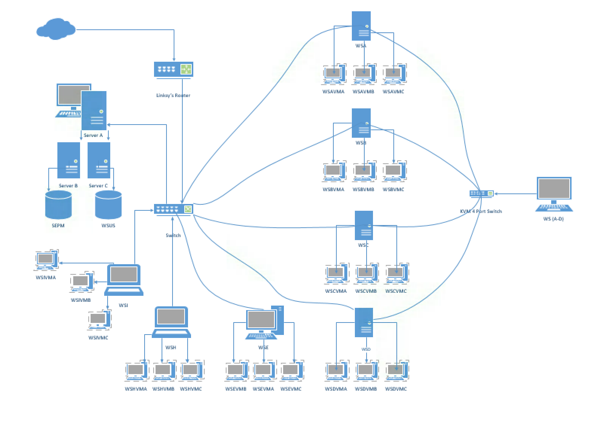
Testbed Network

Slide 34
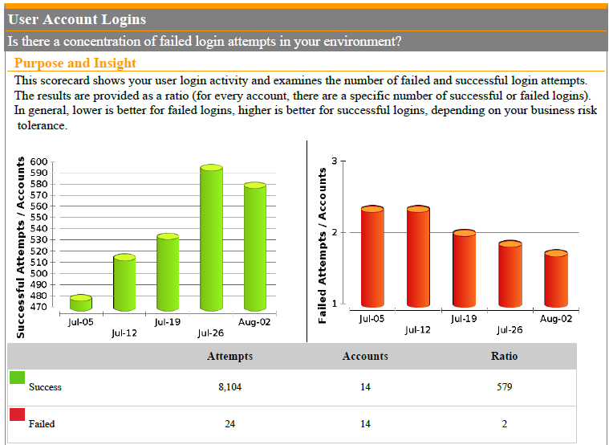
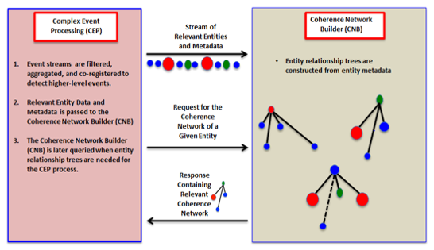
Physical Testbed for Generation of Hard Data
Scripted User Interaction
Tripwire Benchmark
“normal” behavior
Server A
Authentication
Logs
unauthorized access
Server B
Antivirus
Logs
Server C
Off-line machine
Open source
Blog & RSS Feed Data
Patch Logs
Access to risky web sites

Slide 35
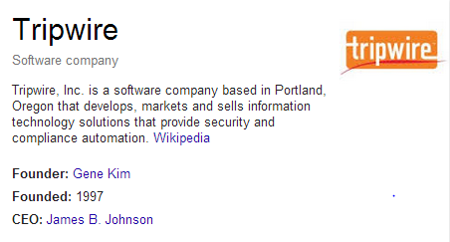
Example of Tripwire Benchmark for Successful & Failed Authentication
Acquired the Tripwire Benchmark product
Collects, aggregates and assesses cyber-security data from centralized servers
Provides high-level scorecards to compare results with similar organizations (from an evolving community database)
Investigations
Exploration of utility of scorecards
Development of alternative representations & visualizations
Exploring the fusion of data across siloes (using the SKRM reference model)
Example of Tripwire Benchmark for Successful & Failed Authentication

