Slide 1
Enterprise-Level Cyber Situation Awareness
Peng Liu
Penn State University

Slide 2
Research Assistants
Jun Dai, PhD dissertation, California State Univ.
Robert Cole, PhD dissertation, Raytheon
Xiaoyan Sun, PhD student
Gaoyao Xiao, PhD student, Microsoft
Eunjung Yoon, PhD student
Chuangang Ren, PhD student

Slide 3
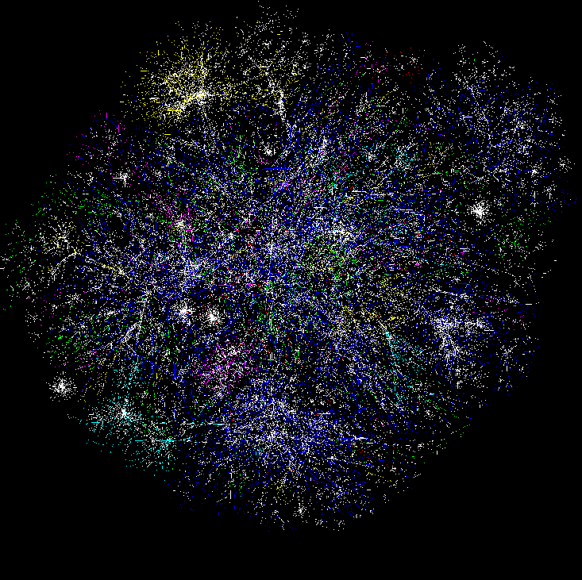

Cognitive Models & Decision Aids
Instance Based Learning Models
Simulation
Measures of SA & Shared SA
Software
Sensors, probes
Hyper Sentry
Cruiser
Information Aggregation & Fusion
Transaction Graph methods
Damage assessment
Automated
Reasoning
Tools
R-CAST
Plan-based narratives
Graphical models
Uncertainty analysis
Data Conditioning
Association & Correlation
Multi-Sensory Human Computer Interaction
Computer network
Enterprise Model
Activity Logs
IDS reports
Vulnerabilities
Real World
System Analysts
Test-bed
Computer network

Slide 4
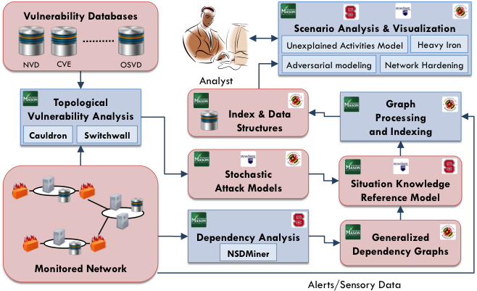
Theme A

Slide 5
Cyber SA in Enterprises
2013: operating point estimation via Bayesian modeling
2014: cross-layer BN analysis of stealth bridges in cloud
2015: probabilistic zero-day attack paths
2010: BN analysis of attack graphs
Uncertainty analysis
2015: Petri-net based SA
2014: discover service dependencies via SODG
2011: SKRM
2012: zero-day attack paths
2015: X-ray style SA system
Cross-layer cyber SA
Notes:
2015 work B: petri-net
2015 work A: Xiaoyan BN
2015 work C: X-Ray system

Slide 6
Part 1
Research Highlight:
2015: X-ray style SA system

Slide 7
Motivation
There is a gap between Alerts and Policy Violations
  Many-to-one mapping
When security analysts are working on the alerts, a main purpose is to answer:
  Which policy has been violated?
  Why was this policy violated?
Nowadays, this is usually done through manual effort
  Alert correlation offers quite limited help
  DTA in theory can help a lot, but not very practical

Slide 8
Our Goal
Alerts from Sensor 1
A violation “view” for Policy A
… …
X-ray style SA system
Alerts from Sensor K
… …
A violation view for Policy B
Policy A
Policy B
Side benefit: alert fusion

Slide 9
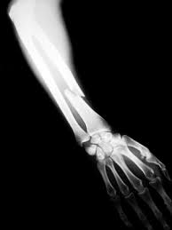
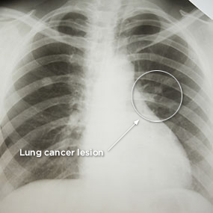
X-ray analogy
Policy A violation: Broken arm
Policy B violation: lung tumor
Notes:
Let’s look at a problem called …
When a Client requests web service from Web Server, the Web Server usually depends on the Authentication Server to verify whether the Client is an authorized user. During authentication, the Authentication Server further depends on Database Server 2 to access user data about privileges. If the authentication is passed, the Web Server further relies on the Database Server 1 to access data required for the final output to the Client.
Understanding the dependencies between network services essentially benefits the enterprise cyber security defense. The discovery of network dependencies enables several capabilities that can be used to facilitate the diagnosis of the well-being of an enterprise network in the presence of network attacks or failures.

Slide 10
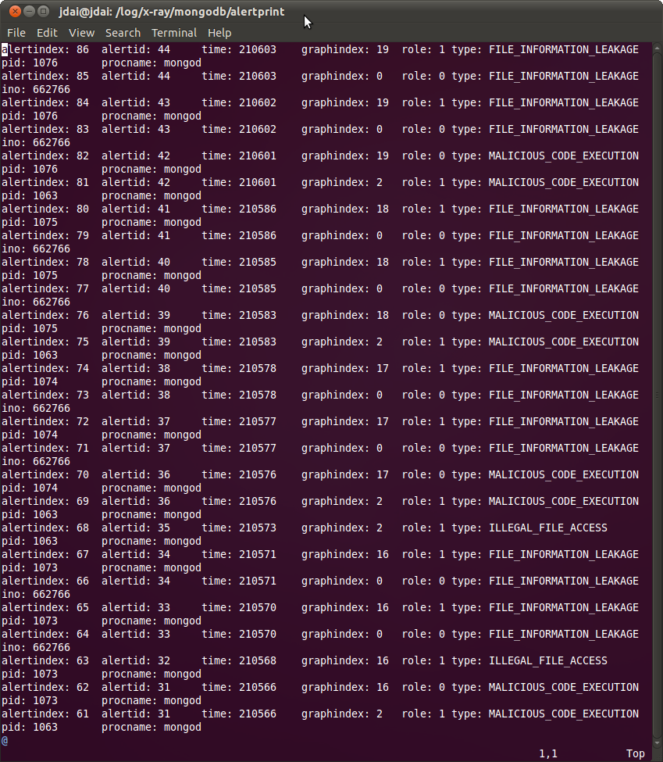
The alerts belong to the same attack
Notes:
MongoDB nativeHelper.apply Remote Code Execution Attack
Not all the alerts will get reflected in other security sensors
Even if they all can be detected, it’s not self-explained

Slide 11
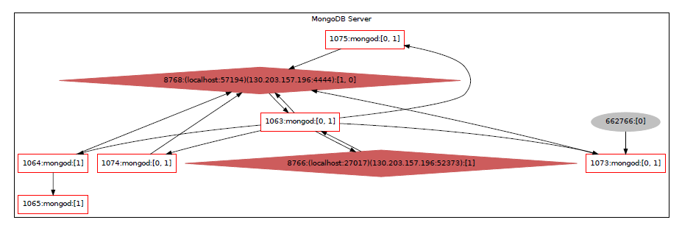
X-ray view of this attack
~/secret_file
Information leakage attack

Slide 12
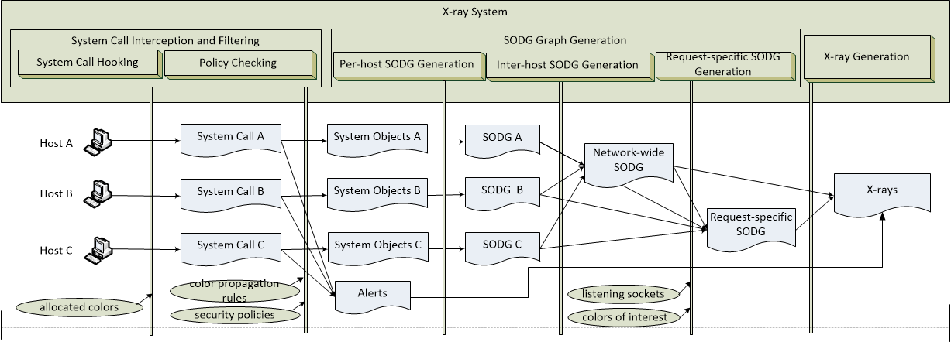
The X-ray System
System Call Interception
SODG Generation
X-ray Generation
Notes:
What is different between X-ray and Snake is that:

Slide 13
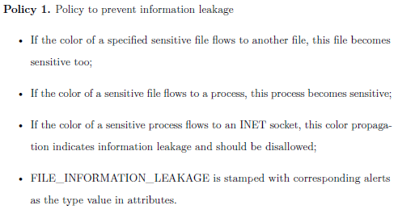
Policy Checking – Example Policies
Notes:
Since most system modules have been covered in Snake, such as system call interception and SODG generation, including request-specific SODG generation. This means Snake’s data structures and algorithms can be reused or tailored to implement X-ray.
We now focus on the different parts: policies and policy enforcement.
Regulate color flow directions
Server-side
Policy checking modules

Slide 14
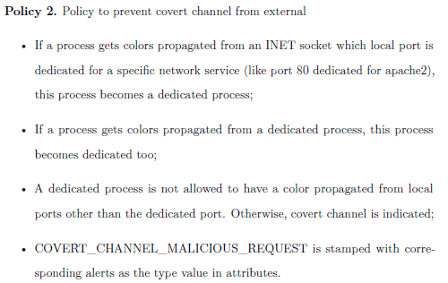
Policy Checking - Example Policies

Slide 15
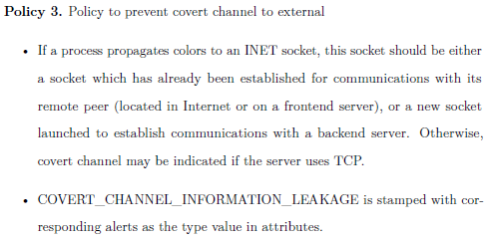
Policy Checking - Example Policies

Slide 16
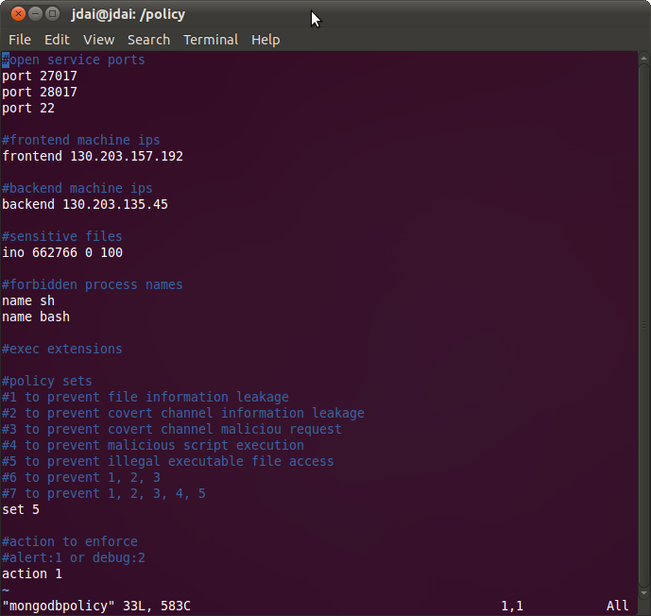
Policy Checking – Policy File
Notes:
Flexible to enable/disable
Configure the parameters

Slide 17
Implementation
Data structures and algorithms of Snake are reused or tailored by X-ray
New data structure for alerts
    struct alert_node * list_alert
    interconnected with other data structures (objects)
  New code for security policy checking
  New code for X-ray generation

Slide 18
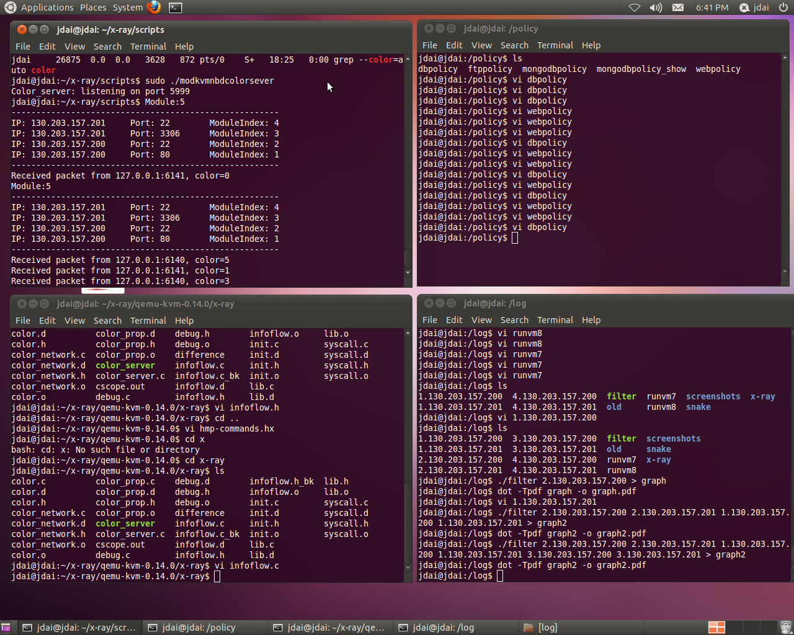
System running (1)

Slide 19
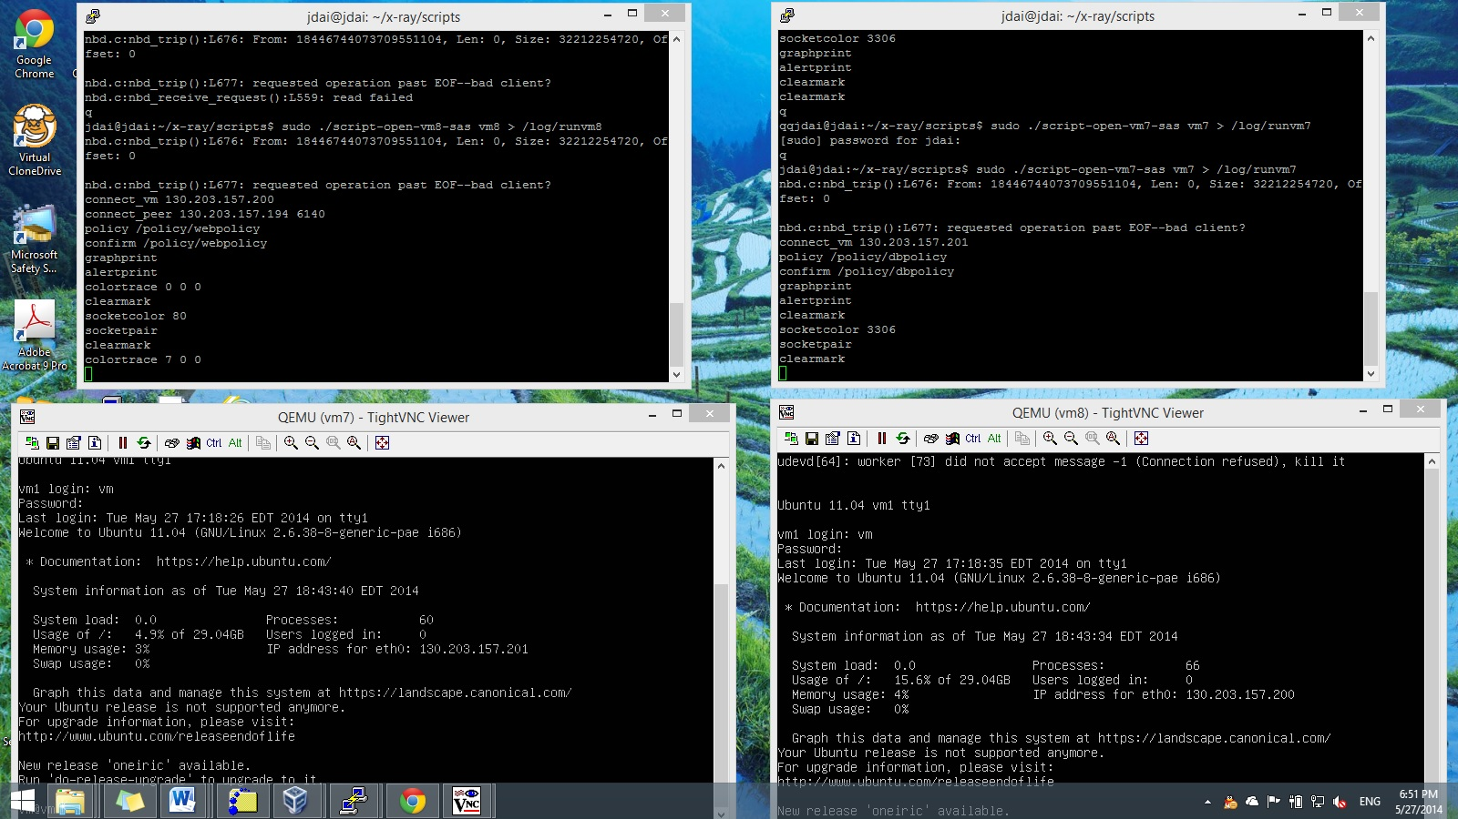
System running (2)

Slide 20
Evaluation (1) - Benign Workloads
Few false positives
  RUBiS 1.4.3 default transactions
  Tikiwiki 1.9.5 normal operations

Slide 21
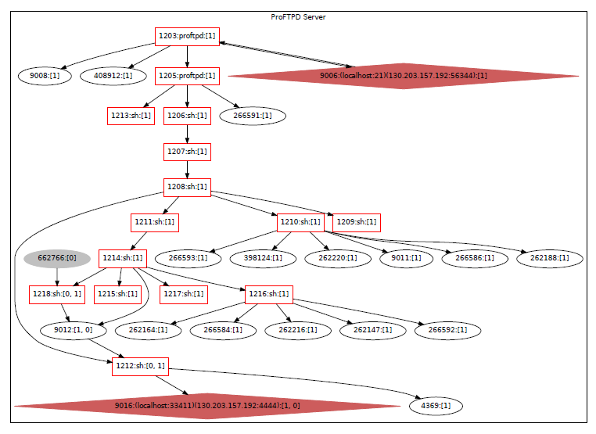
Evaluation (2) - ProFTPD 1.3.3c
~/secret_file
Backdoor attack
Notes:
ProFTPD Backdoor Command Execution Attack

Slide 22
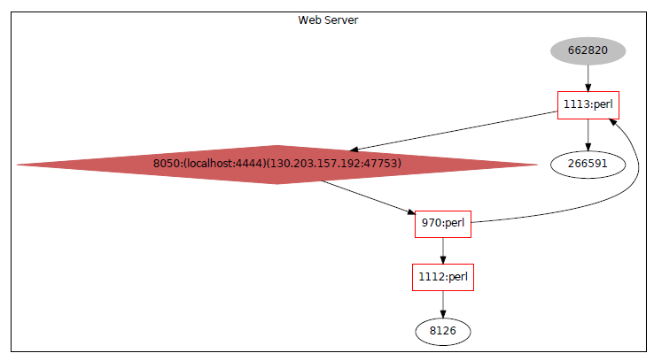
Evaluation (3) - tikiwiki 1.9.5
~/secret_file
Graph_formula_exec attack
Notes:
Tikiwiki_graph_formula_exec Attack

Slide 23
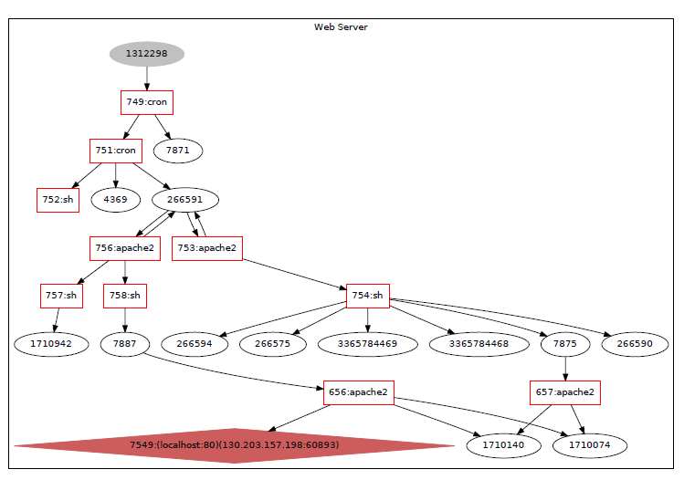
Evaluation (4) - DVWA 1.0.8
/etc/passwd
Command Injection Attack
Notes:
DVWA Command Injection Attack

Slide 24
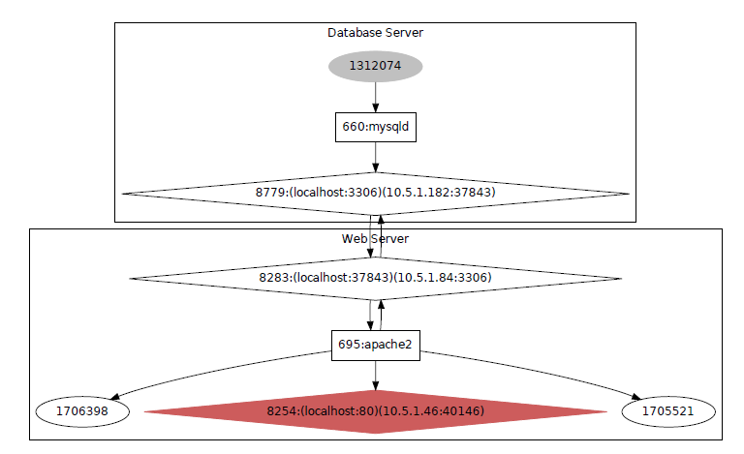
Evaluation (5) - DVWA 1.0.8
SQL injection attack
/etc/passwd
Notes:
DVWA SQL Injection (BLIND) Attack

Slide 25
Evaluation (6) –
Performance Overhead
Apache Bench
  37.5%
RUBiS
  24.2%

Slide 26
Part 2
Research Highlight:
2015: probabilistic zero-day attack paths

Slide 27
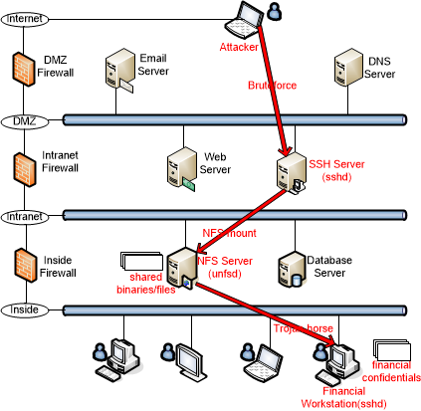
A zero-day attack path
Each zero-day attack path is a kill chain that leverages at least one zero-day exploit.

Slide 28
How attack paths become “known”
Offline analysis:
Attack graphs identify attack paths: “known”
Testing:
Penetration testing uses real exploits:
-- rule out speculated paths
Human intelligence: red teaming
Runtime analysis:
-- Alert correlation reveals attack paths
-- Combining attack graphs with alerts
-- Human intelligence: security analysts

Slide 29
Review of the Patrol System (2012)
Idea:
  -- Step 1: find graph G that “contains” zero-day paths
  -- Step 2: inside G, separate zero-day attack paths from benign ones
Observation: many zero-day attack paths are showing themselves in the network-wide SODG (system object dependency graph)
  -- SODG is attack neutral: knowledge of “us”

Slide 30
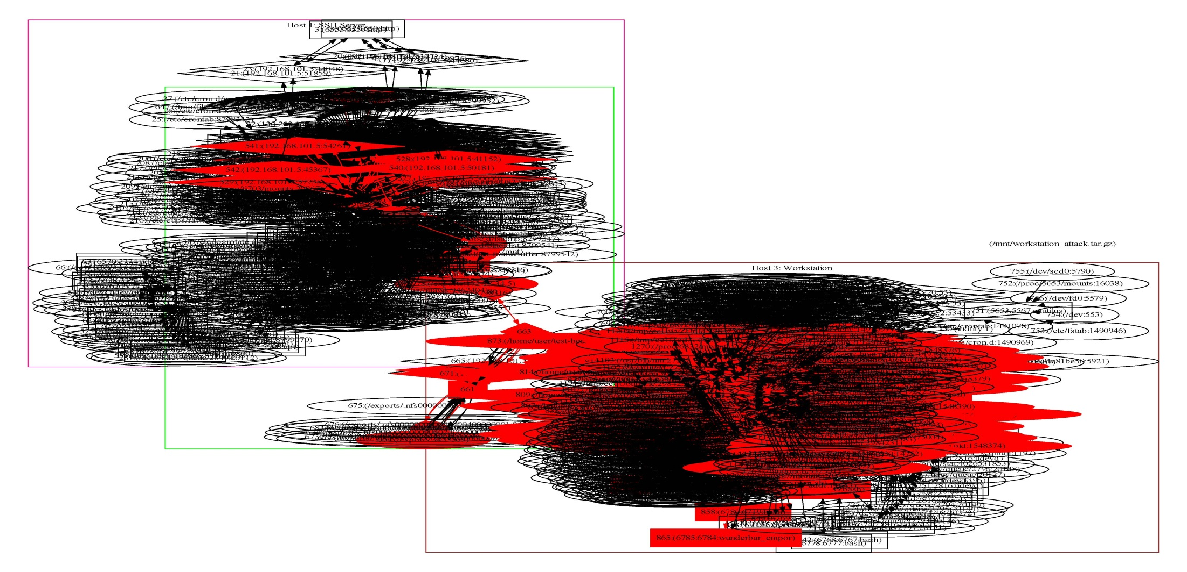
An Example Network SODG
3 hosts; 15 minutes; 52,000 system calls
A node is a system object: process, file, socket
An edge is a dependence (sys call): read, write, create

Slide 31
Limitations of the Patrol System
Patrol relies on shadow indicators to distinguish zero-day attack paths from other suspicious paths. Without shadow indicators, the suspicious paths are too many and complicated to be manually verified.
However, crafting shadow indicators requires manual effort.

Slide 32
The new approach
The new approach solely relies on the collected intrusion evidence.
The system objects with relatively high probabilities of being infected will reveal themselves on graph G’ and form a path.

Slide 33
New Approach
Build a different dependency graph G’
SODG → SOIDG
Build a Bayesian Network atop G’
Belief-based probabilistic (infection propagation) relationships between system object instances.

Slide 34
SOIDG
In SODG, each node is a system object, which is a type. In contrast, in SOIDG, each node is a particular instance (i.e., a version) of a system object.
In SOIDG, each attack path is a time-ordered straightline chain (or tree) of system object instances. No loop.

Slide 35
Bayesian Network
Prediction Analysis
Pr(symptom|cause = True)
E.g. Pr(IDSalert|exploitation = True)
Diagnosis Analysis: “backward” computation
Pr(cause|symptom =True)
E.g. Pr(exploitation|IDSalert = True)
Our work: Diagnosis Analysis

Slide 36
Causality Model
System object X depends upon Y
  -- e.g., process Y writes data into file X
1: how to handle a dependence
Pr(Y=“Infected”|X=“Uninfected”)
Pr(Y[i]=“Infected”|X[i]=“Uninfected”&
X[i+1]=“Infected”)
2: how to handle an alarm
Notes:
SINK depends on SRC
X – SINK
Y – SRC

Slide 37
System Architecture

Slide 38
Experiment: Attack Scenario
Step 1: compromise SSH Server
Step 2: upload a malicious executable file to NSF Server
Step 3: compromise the workstation
3 hosts; 15 minutes; 52,000 system calls.

Slide 39
The collected evidence

Slide 40
An example output
Although no evidence is provided on NFS Server, the identified attack path can still demonstrate how NFS Server contributes to the attack plot.
Notes:
Path size: 77 objects
Patrol: 155 objects

Slide 41
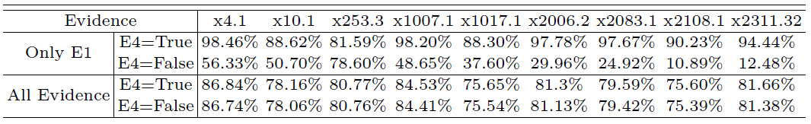
Influence of false alarms
The impact of false alarms may be reduced substantially if there are sufficient amount of true positive intrusion evidence.
Notes:
Change 0.9 to 0.8 of the value of \tao, no major impact on the output.
Change from 0.9 to 0.5, big impact on output.

Slide 42
Part 3
Research Highlight:
-- Joint work by ARL, GMU, and PSU
2015: Petri-Net based SA

Slide 43
Motivation
Objective: conduct accurate attack impact assessment to the attack
We develop a new attack assessment technique using non-intrusive cognitive tracing and Petri-net modeling
We implement the technique as a toolkit

Slide 44
ARL Petri Net Model
TFP
PS-UN
TDETECT
PB
TRESET
PG
TCOMPROMISE
TDETECT
TRECOVER
PS-US
PEV
Place
TMISSION-NEED
TM-IMPAIR
PM-IMPAIRED
Transition
Token (a machine with unique IP address)

Slide 45
Places and Transitions
PG : Initial place
PS-UN : Machine compromised but has not been used (has not appeared in firewall log)
PS-US: Machine compromised and is used in mission (appear in firewall log after being compromised)
PB: Unused machines detected as compromised by the IDS system (include true positive and false positive)
PEV: Compromised and used machine that is later detected as compromised by IDS
TFP: A asset being incorrectly detected as compromised by a false alert
TCOMPROMISE: An asset being compromised
TDETECT: A compromised machine being detected by the IDS
TMISSION-NEED: A compromised machine being used (appear in firewall log)
Notes:
TRESET: Transition to model an asset being reset to its original operational
state after being detected as compromised.
For one example, when a Type D event is identified by alert x, we can search the cognitive trace and find the hypotheses “triggered” by alert x. If these hypotheses conclude that alert x is a false alarm (i.e., false positive), we should let the Petri net “reject” the identified event.

Slide 46
Set-aside Project Overview
ARL
Notes:
For one example, when a transition is triggered by alert x, we can search the cognitive trace and find the hypotheses “triggered” by alert x. If these hypotheses conclude that alert x is a false alarm (i.e., false positive), we should let the Petri net “reject” the identified event.

Slide 47
Experiment Overview
A regional bank network is attacked by a botnet: able to spread internally and exfiltration data to C&C servers
Objective: accurate attack impact assessment
Comparative study:
  Baseline: attack impact assessment using firewall log and IDS logs
  Our method: using security analysts’ cognitive trace in addition to baseline

Slide 48
Experiment Details
Bank network and attack information:
  # of machines: 3,029
  Total # of machines compromised: 400
  Attack time length: 13 days
  Logs from bank network
    Firewall Log
    IDS logs
Cognitive trace
  Collected from security analysts (against 15 minutes of data)
  Incorporate analysts’ observations and hypotheses into the Petri-Net

Slide 49
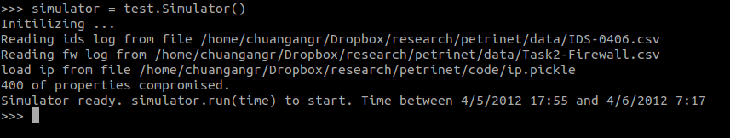
Toolkit
Command line tool implemented in Python
  389 lines of code
  Dependent on Snakes library (Petri-Net framework)
Screenshot after opening the toolkit
(Time frame: 4/5/2012 17:55 to 4/6/2012 7:17)

Slide 50
Toolkit
Start petri net transitions by specifying a specific stop time
The markings of Petri Net (each number indicates the number of assets in each place)
Start Petri-Net transitions till the end of the log traces
From the screenshot:
Totally 133,040 log events
438 Petri -Net transitions

Slide 51
Result
 | # of FP Assets | # of FN Assets | # of FP Transitions (TFP)
Baseline | 21 | 8 | 148
Analyst 1 | 11 | 8 | 24
Analyst 2 | 18 | 8 | 46
Analyst 3 | 15 | 8 | 40
Security analyst trace is very helpful in reducing the false positive of compromised assets, and also the FP transitions.

Slide 52

Questions?
Thank you!

Slide 53
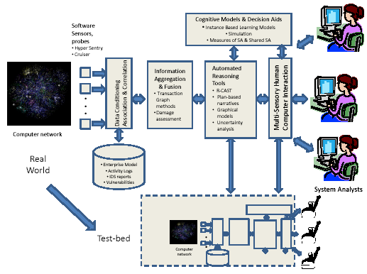
SKRM Inspired Cyber SA Analytics
Penn State University (Peng Liu)
Tel. 814-863-0641, E-Mail: pliu@ist.psu.edu
    Objectives: Improve Cyber SA through:
    A Situation Knowledge Reference Model (SKRM)
    A systematic framework for uncertainty management
    Cross-knowledge-abstraction-layer SA analytics
DoD Benefit:
Innovative SA analytics lead to improved capabilities in gaining cyber SA
Scientific/Technical Approach
Leverage knowledge of “us”
Cross-abstraction-layer situation knowledge
integration
Network-wide system level dependency analysis
Probabilistic graphic models
Accomplishments
A suite of SKRM inspired SA analytics
A Bayesian Networks approach to uncertainty
A method to identify zero-day attack paths
A method to gain context-aware SA against intrusions
Challenges
Systematic evaluation & validation

