Slide 1

Refining Security Policy
by Learning from User Activity
Douglas Reeves
ARO MURI Meeting
U. Maryland, 2015-07-08
Notes:
Thank you for being here for my oral exam. My thesis topic is “Automated Generation, Refinement and Verification for Security Policies”

Slide 2





Research Funded by this MURI
Network Service Discovery: NSDMiner
Automatic Signature Generation: Metasymploit
Security Policy Refinement and Generation: EASEAndroid
Notes:
Specifically, we focus on three tasks in security policy development.
We will first briefly present our previous work about policy generation: MetaSymploit
Then we will focus on our recent work about policy refinement: EASEAndroid
Finally, we will discuss our research plan about policy verification.

Slide 3
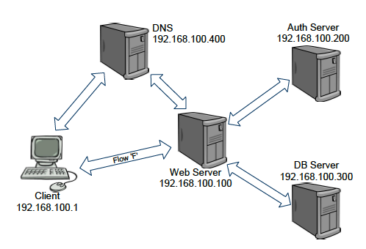
Network Service Discovery
Infocom 2012
1
Automated discovery of network service dependencies, based on passive observation of network traffic
Essential for defending, configuring, and maintaining networked services
Notes:
I'd like to start with a project that I joined after it was already under way. This is a MURI project funded by ARO, led by Penn State, and involving NC State. This project is on cybersituational awareness, or helping analysts and users protect their sytems and understand threats better. The first work that was done on that project, before I began, was led by Peng Ning, and addressed detection of services in networks.
The first project conducted under this program was an effort to automatically discover network service dependencies. Detecting such dependencies is essential for configuring networks properly, and for distinguishing normal traffic from unusual (possibly attack) traffic.

Slide 4

Automated Signature Generation
Usenix Security 2013
Challenge for defenders: zero-day exploits
Partial solution: day-one defenses from exploit scripts
Attack Scripts
IDS Signatures
MetaSymploit
Automatic generation of high quality signatures that are easy to understand
Notes:
The next part of the MURI research addressed an unfortunate reality: attackers seem to move, and adapt, at a much faster rate than defenders. This is partly due to the widespread use exploit frameworks, or development kits. Such frameworks are highly automated environments for generating fully operational malware, with rich libraries for useful functions. Once a vulnerability is found, using one of these kits it is a relatively simple matter to create and launch obfuscated malware that is capable of infecting unprotected systems.
Until now, it would typically take substantial time for defenders to analyze newly-detected malware and manually develop effective signatures that could be used in intrusion detection and prevention systems. By quite awhile, think 6 months from exploit to release of signature.

Slide 5
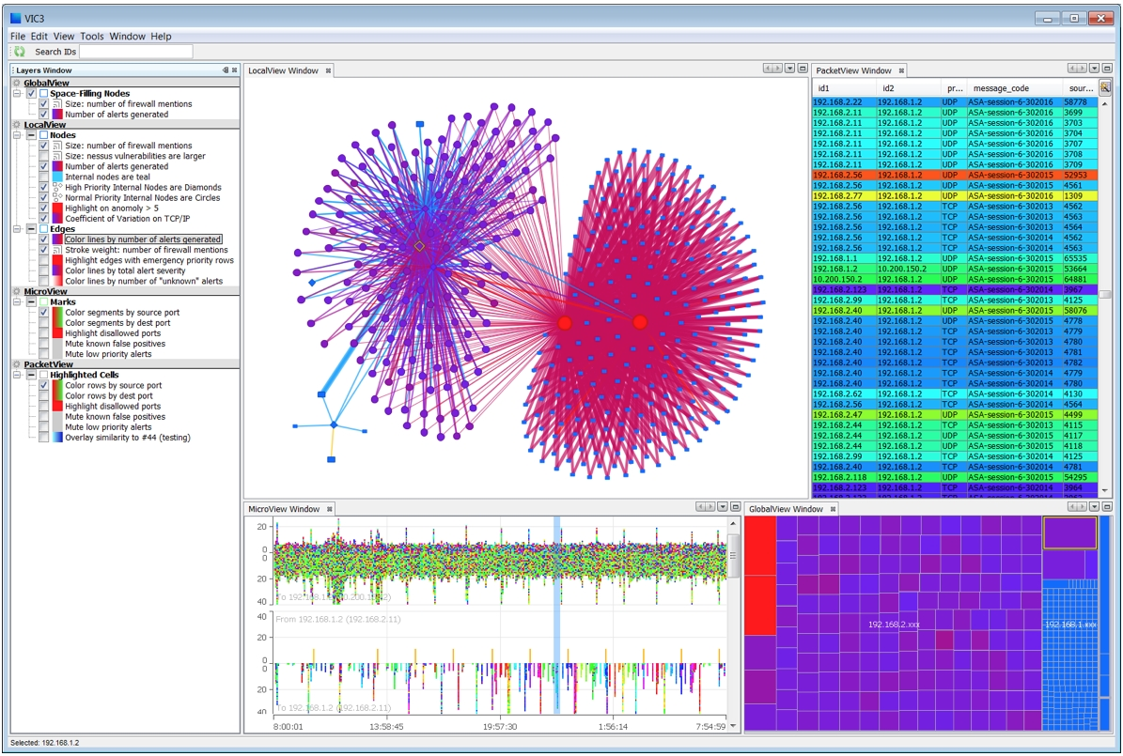
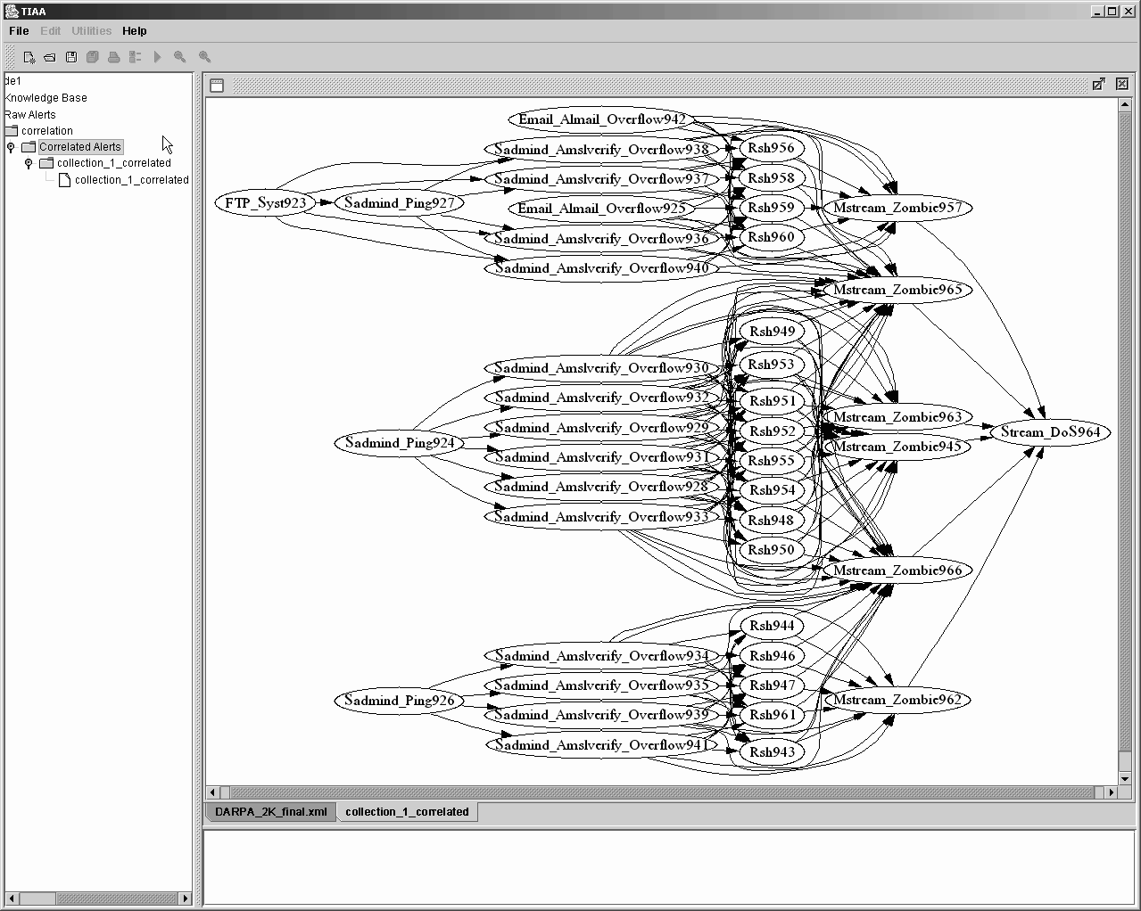
Cyber Situational Awareness
Our goal:
(1) Data → (2) Insights → (3) Protection
Examples
http://data-informed.com
http://discovery.csc.ncsu.edu

Slide 6
Security Policy From User Activity accepted for presentation at Usenix Security 2015
(1) Data = audit logs of user activities
(2) Insight = security policy rules
(3) Protection = Mandatory Access Control

Slide 7
(3) Protection:
Mandatory Access Control (MAC)
Specify and enforce what accesses are, and are not, allowed
When combined with discretionary access control, provides stronger protection (against, for instance, privilege escalation)
Example: SEAndroid
  announced by NSA, 2012
  incorporated in Android 4.3, 2013
  full enforcing mode in Android 5.0, 2014

Slide 8
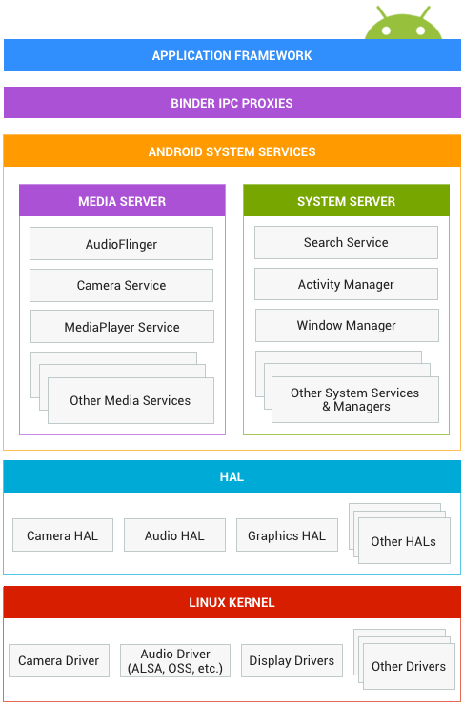
Android Security Model
Android Permissions
Linux UID/GID Sandbox
Discretionary Access Control
Since Android 4.3
Security Enhanced Android (SEAndroid)
Mandatory Access Control (MAC)
https://source.android.com
Notes:
Android architecture.
Previously,
People feel not enough. Apps over-claim unnecessary permissions. UID/GID is DAC not a strong security protection mechanism.
SEAndroid a porting of SELinux from desktop Linux

Slide 9
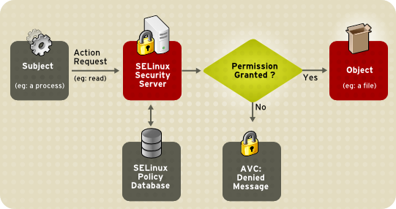
(2) Insight: Security Policy
http://pocketnow.com

Slide 10
Security Policies
Qualities of a good policy
  perfection achievable?
Drawback: difficulty of writing security policies
  particularly for smartphones
  Defcon’13: “Vendors don’t know how to write [security] policies”
http://pocketnow.com

Slide 11
Examples of Policy Rules
Security labels <=> Concrete Subjects/Objects
app_data_file <=> /data/data/.*
Allow rules permit non-attack operations
allow appdomain app_data_file:file
{read write execute}
Neverallow rules prevent privilege escalation
neverallow untrusted_app init:file {read}
Notes:
Before we explain why writing policy is challenging, first, we need to show what a policy looks like.
A mapping between security labels and concrete sbj/obj
Then we use labels to define allow rules/neverallow rules
Allow rules are the major part in a policy during runtime. Every system operation will be checked to see if there is an allow rule explicitly allow the operation’s permissions.
This means Policy analysts need to write a lot of allow rules.
Inexperience policy analysts/IT admins tend to write coarse-grained/permissive allow rules
Allow unnecessary/coarse-grained/even mistakenly attack patterns
Neverallow policy invariants capture known attack patterns. In practice, Google provides a set of neverallow rules that vendor’s policy must comply with.

Slide 12
Deriving Security Policy
Requires expert knowledge
  block attack accesses
  allow non-attack accesses
Requires continuous refinements
  New devices
  New APIs
  New Android releases
  New attacks
Too much data!
Notes:
We can see that define those labels and allow/neverallow rules are non-trivial. When it comes to SEAndroid, we have several more requirements
There is a new challenges in SEAndroid, it is also our major focus in this work.

Slide 13
(1) Data: Audit Logs
Collected continuously (using audit2allow)
  attack data is modest
  non-attack data is gargantuan! useful?
Communicated to central site for aggregation/analysis

Slide 14
Learning from User Activities: the Audit Log
  Audit Log
  Log access events not matched with allow rules or required by auditallow
  Must then classify as attack or non-attack
Three entries in one access event
  AVC Entry
  Syscall Subject Entry
  Syscall Object Entry
Notes:
The major way to refine a policy is to analyze audit logs
Policy analysts go through the access events in the audit logs and determine whether each event is benign/malicious, whether the policy needs to be refined. If benign, we need to add new rules. If malicious, we need to understand what kind of attacks, create neverallow rules to document attack patterns.

Slide 15
Audit Log Example (AVC)
type=1400 msg=audit(14580641.671:14): avc: denied { entrypoint } for pid=285 comm="init" path="/system/etc/install-recovery.sh" dev="mmcblk0p16" ino=3799 scontext=u:r:init:s0 tcontext=u:object_r:system_file:s0 tclass=file
    <init, system_file, file, entrypoint>
    => allow init system_file:file {entrypoint}
Notes:
We don’t need to care the name AVC. What we need to know is that the AVC entry contains the security labels related to the denied operation. These labels can be used to create a new allow rule. But in practice, we need to determine whether the label is the right one, or we need to create new labels.

Slide 16
Audit Log Example (Syscall Sbj)
type=1300 msg=audit(14580641.671:14): arch=40000028 syscall=11(execve) per=800000 success=no exit=-13 items=1 ppid=1 pid=285 auid=4294967295 uid=0 gid=0 euid=0 tty=(none) ses=4294967295 comm="init" exe="/init" subj=u:r:init:s0 key=(null)
Notes:
Subject process info

Slide 17
Audit Log Example (Syscall Obj)
type=1302
msg=audit(14580641.671:14): item=0 name="/system/etc/install-recovery.sh" inode=3799 dev=b3:10 mode=0100755 ouid=0 ogid=0 rdev=00:00 obj=u:object_r:system_file:s0
    Access Pattern Definition:
    <init, “/init”, entrypoint, file, system_file,
    “/system/etc/install-recovery.sh”>
Notes:
Also file object, file path full name
As we can see just one access event encodes a lot of information. A policy analyst needs to understand these information and based on his experience/knowledge to make a decision, which is really heavy.

Slide 18
Overview: Data to Insight to Protection
Audit
Logs
Machine Learning
Suggested Policy Modifications
Reviewed by Security Analysts
Policy
Database

Slide 19
EASEAndroid
Elastic Analytics of SEAndroid
  The first large-scale analytic platform for automated policy refinement
Goals
  Analyze audit logs at a large scale
  Classify new access patterns as attacks or non-attacks
  Propose new security labels and create new policy rules
Notes:
We have three goals for EASEAndroid.
Our novelty is we have a key insight. We found that policy refinement process can be modeled and automated as a semi-supervised learning.

Slide 20
Semi-Supervised Learning
Identify the feature set
Define reasonable similarity/distance metrics
Correlate access patterns and policy rules
Use multiple classifiers to enhance confidence
Notes:
In early trials, we tried various common distance metrics, but not find a suitable one that can capture the intrinsic nature.

Slide 21
Architecture
Notes:
The architecture uses three machine learning algorithms that consider three different perspectives to find semantic correlations in the knowledge base and audit logs, and classify new access patterns to determine whether benign/malicious.
The output of these algorithms is fed into a combiner that combines and appends the new knowledge into the knowledge base. This learning process is iterated multiple times. Finally, the policy generator suggests refinements.

Slide 22
Nearest-Neighbor (NN) Classifier
Possibilities
  Known subjects appear in new access patterns
    E.g., apps updated with new features
  New subjects appear in known access patterns
    E.g., new exploits share attack behaviors
NN Classifier: classify based on proximity to previously-classified access patterns
Notes:
Known sbj/pattern and new pattern/sbj become neighbors.

Slide 23
Pattern-to-Rule Distance Measurer
Classify based on distance from access pattern to policy rule
  Closest to an allow rule?
  Classify as non-attack
  Closest to a neverallow rule?
  Classify as attack
Notes:
The intuition here is we want to know how far/close

Slide 24
Co-Occurrence Learner
Proximity in time often indicates relationship between access events
Classify new access patterns based on previously-classified patterns if…
  they occur close enough together in time,
  a sufficient number/fraction of times
Notes:
In fact, co-occurrence is popular in natural language processing and knowledge extraction. For example, it is used for finding words that are frequently used together in a specialized domain

Slide 25
Learning Balancer & Combiner
Adjust thresholds of each learner
  to balance precision and coverage
Combine classification results
Approaches
  strict threshold (high precision)
  relaxed thresholds with Majority Vote (high coverage)
Add results back to knowledge base

Slide 26
Policy Refinement Generator
Suggest new security labels and rules
Group sbjs / objs together based on existing coarse-grained labels
Infer fine-grained labels and encode into rules
Notes:
We want to infer fine-grained labels, to more precisely represent the patterns, and avoid mistakenly involving irrelevant sbj/obj

Slide 27
Evaluation
Audit Log Dataset
  1.3M audit logs from real-world Samsung devices with Android 4.3 over the entire 2014
  14M access events, 145K unique ones, generalized into 3530 access patterns
Initial Knowledge
  early 2014 Samsung (manually written) policy
  + 9 confirmed exploit kits
Ground Truth
  early 2015 Samsung (manually written) policy
  + review by experienced security analysts
Notes:
8-node Hadoop Cluster, 256 GB Memory.
Distributed SQL on HDFS.
SLOC: 10K Java + 5K SQL

Slide 28
Results of Naïve Matching
Notes:
To show the effectiveness of EASEAndroid, we need a baseline to compare with. We use the naïve matching as our baseline, which does not have learning capability, just matching the 9 exploit kits.
We divide the entire year at a rate of every two month. The audit logs we analyze are accumulated from Jan 2014 to the current month. This is consistent with the real-world challenge as more audit logs continuously collected.

Slide 29
Results of EASEAndroid
Notes:
The FP/FN are caused by the relaxed thresholds. One limitation of semi-supervised learning is the error propagation. Early error will propagate to later iterations. In practice, policy analysts can be involved to check classification results from relaxed threshold

Slide 30
Refinement Example
<surfaceflinger, open, file, /data/misc/zoneinfo/*, system_data_file>
<dhcpcd, open, file, /data/misc/zoneinfo/*, system_data_file >
<pppd, open, file, /data/misc/zoneinfo/*, system_data_file >
<vendor_daemon, open, file, /data/misc/zoneinfo/*, system_data_file >
=>
/data/misc/zoneinfo/* ⬄ u:object_r:zoneinfo_file:s0
attribute access_zoneinfo_domain;
typeattribute surfaceflinger access_zoneinfo_domain;
...
allow access_zoneinfo_domain zoneinfo_file:file {open};
Notes:
Then we show how a policy refinement is actually generated.

Slide 31
Comparison with 2015 Policy
336 non-attack access patterns =>
51 policy rules
All rules semantically match manually written rules
EASEAndroid: Fine-grained + Evidence
  allow access_zoneinfo_domain zoneinfo_file:file {open};
Human: Coarse-grained + Macro
  allow system_domain zoneinfo_data_file:file rw_file_perms;
Notes:
This is expected because human analysts trying to be more general. But there is a possibility of over-granting unnecessary permissions to irrelevant system daemons.

Slide 32
Evaluation
Malicious Access Patterns
1. {read,write} files on /dev/graphics, /dev/block, /dev/exynos-mem, /dev/mem, /dev/android_adb, /dev/s3c-mfc
2. {dac_override,chown,fsetid} capability on /data/data, /data/local, /data/misc, /data/system, /sdcard
3. {create,write,unlink} files on /system/app, /system/bin, /system/xbin, /system/etc
4. {read,write} files on /sys/block, /sys/devices, /sys/fs, /sys/kernel
5. {kill,sys_admin,sys_ptrace,sys_chroot,setuid,setgid} capability
6. {transition,dyntransition} process
7. {read,write} files on /proc/sys, /proc/app_pid/cwd|environ|exe|mem|mounts
8. {connectto} unix domain sockets of privileged daemons directly
Notes:
As far as we know, this is the first study of Android system-level attack patterns in real-world devices

Slide 33
Confirmed Previously-Unknown
Attacks against SEAndroid
{read,write} files under /sys/fs/selinux
  SuperSU: supolicy
  Directly inject allow rules into
  /sys/fs/selinux/policy
  Source: https://bitbucket.org/joshua_brindle/sepolicy-inject, http://su.chainfire.eu
{transition,dyntransition} process
  Kingroot exploit/misuse 2 vendor system daemons
  Source: http://forum.xda-developers.com/galaxy-s6/general/root-pingpongroot-s6-root-tool-t3103016

Slide 34
Insights
Logging non-attacker behavior is useful
Machine learning is effective at aggregating and discriminating attack / non-attack behavior
Iterative refinement with analysts “in the loop”…
  produces high quality results,
  incorporates real-world constraints,
  greatly reduces analyst effort

Slide 35
Some Difficulties
Ambiguity about attacks and non-attacks
  Your attack is my app?
Data poisoning attacks against the classifier
Remaining unclassified access patterns
  Clustering with extra knowledge (more access patterns, other knowledge)

Slide 36
Future Work
Compatibility Test Suite
Testing and
Static Analysis
Test / S.A.
Results
Audit
Logs
Machine Learning
Suggested Policy Modifications
Reviewed by Security Analysts
Policy
Database

Slide 37
Generalization of Approach
Audit
Logs
System
Audit
Logs
Machine Learning
Suggested Policy Modifications
Reviewed by Security Analysts
Security
Configuration
Database
Policy
Database
Not just Android
Not just MAC
Not just smartphones

