Slide 1




Cyber Situation Awareness from a Cyber Security Perspective
Sushil Jajodia, Massimiliano Albanese
George Mason University
Peng Liu
Pennsylvania State University
Doug Reeves, Peng Ning, Christopher Healey
North Carolina State University
V. S. Subrahmanian
University of Maryland
ARO-MURI on Cyber-Situation Awareness Review Meeting Phoenix AZ, 2013

Slide 2



Sample Scenario: Enterprise Network
Current situation. Is there any ongoing attack? If yes, where is the attacker?
Impact. How is the attack impacting the enterprise or mission? Can we assess the damage?
Evolution. How is the situation evolving? Can we track all the steps of an attack?
Behavior. How are the attackers expected to behave? What are their strategies?
Web Server (A)
Forensics. How did the attacker create the current situation? What was he trying to achieve?
Catalog Server (E)
DB Server (G)
Information. What information sources can we rely upon? Can we assess their quality?
Internet
Local DB Server (B)
Mobile App Server (C)
Order Processing Server (F)
Prediction. Can we predict plausible futures of the current situation?
Local DB Server (D)
Scalability. How can we ensure that solutions scale well for large networks?

Slide 3
Desired CSA Capabilities
Aspects of cyber situational awareness that need to be addressed in order to answers all the previous questions
  Be aware of current situation
    Identification of past and ongoing attacks
  Be aware of the impact of the attack
    Damage assessment
  Be aware of how situations evolve
    Real-time tracking of attacks
  Be aware of adversary behavior
    Integration of knowledge of the attacker’s behavior into the attack model
  Be aware of why and how the current situation is caused
    Forensics
  Be aware of quality of information
    Information sources, data integration, quality measures
  Assess plausible futures of the current situations
    Predict possible future and recommend corrective actions

Slide 4




System Architecture
Vulnerability Databases
Scenario Analysis & Visualization
h_{S}, f_{s}
h_{G}
10
h_{T}, f_{s}
v_{A}
7
0.8
Unexplained Activities Model
Heavy Iron
Local DB Server (D)
Adversarial modeling
Network Hardening
{(2,7),0.2}
CVE
h_{A},f_{s}
NVD
{(1,3),0.8}
f_{d}
OSVD
v_{C}
f_{s}
f_{s}
8
f_{d}
h_{C}, f_{s}
1
7
Analyst
Mobile App Server (C)
{(3,10),0.7}
{(1,9),0.3}
Index & Data Structures
Topological Vulnerability Analysis
0.7
h_{E}
h_{F}
Graph
Processing
and Indexing
v_{B}
h_{B}
1
DB Server (G)
h_{D}
{(1,7),1}
0.7
h_{B}, f_{d}
Cauldron
Switchwall
Order Processing
Server (F)
5
h_{E}, f_{s}
7
1
h_{F}, f_{s}
v_{E}
f_{s}
0.8
f_{s}
7
h_{D}, f_{d}
0.3
Stochastic
Attack Models
5
v_{B}∨ v_{C}
v_{F}
Situation Knowledge Reference Model
Monitored Network
{(1,8),1}
h_{A}
0.7
h_{C}
{(1,3),1}
v_{D}
0.7
No information about the impact on missions of different courses of actions
h_{G}
{(3,7),1}
Dependency Analysis
8
v_{G}
1
Generalized
Dependency Graphs
f_{s}
f_{s}
v_{D} ∨ v_{E} ∨ v_{F}
Online Shopping
NSDMiner
Mobile Order Tracking
Alerts/Sensory Data
Notes:
f_s: all the entities need to be fully operat
f_r: at least one of the entities it depends on is fully operational.
f_d: average
Across-graph edge = the percentage reduction in the performance of an entity caused by an exploit

Slide 5
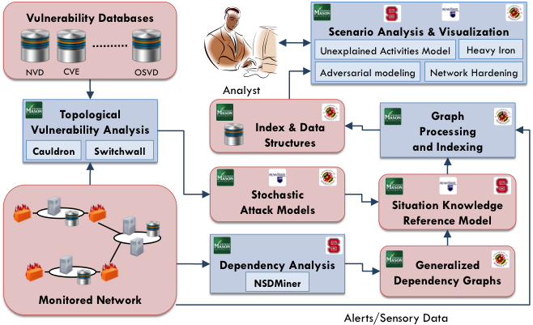
System Architecture – Cyber Security Perspective

