Slide 1
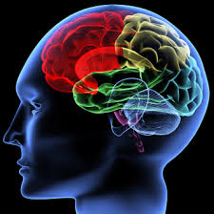
Mining Analysts’ Operation Traces to Automate Data Triage for Cyber Attack Analysis
Annual Review
ARO MURI on Computer-aided Human-centric Cyber SA
July 9, 2015
Pennsylvania State University
John Yen
Chen Zhong
Gaoyao Xiao
Peng Liu
Army Research Laboratory
Robert Erbacher
Steve Hutchinson
Renee Etoty
Hasan Cam
Christopher Garneau
William Glodek

Slide 2


Cognitive Models & Decision Aids
Instance Based Learning Models
Simulation
Measures of SA & Shared SA
Software
Sensors, probes
Hyper Sentry
Cruiser
Information Aggregation & Fusion
Transaction Graph methods
Damage assessment
Automated
Reasoning
Tools
R-CAST
Plan-based narratives
Graphical models
Uncertainty analysis
Data Conditioning
Association & Correlation
Multi-Sensory Human Computer Interaction
Computer network
Enterprise Model
Activity Logs
IDS reports
Vulnerabilities
Real World
System Analysts
Test-bed
Computer network

Slide 3
A Motivating Story
In an security operations center (SOC), a group of analysts are analyzing the data senses generated from different sensors on the same network, but in different time windows.
  E.g. IDS alerts, firewall logs.
When an analyst Bob is working on his shift, he currently needs to manually conduct data triage (with very little automated aids) including:
  Examining the details of a variety of data sources (e.g., IDS alerts, firewall logs, OS audit trails, vulnerability reports, and packet dumps)
  Weeding out the false positives
  Grouping the related indicator data entries so that incidents of attack can be reported (through Incident Reports)
  Separating different attack campaigns (i.e., attack plots) from each other.

Slide 4
Analyst’s Needs for Automating the Repetitive Work in Data Triage
To reduce some repetitive works
  Triage the coming data using the same triage criteria/conditions he has used previously.
To improve both the quality and the quantity of his/her incident reports.
  Once the repetitive work is reduced, he/she can focus on more complicated intrusion detection tasks.
To track the data sources indicating the same incident.
  One attack campaign may cross two or more time windows.
  An analyst sometimes may want to keep an eye on the network connections inside a past time window (i.e., already analyzed during the last shift), as well as the events in his/her time window.

Slide 5
Existing Techniques
Alert correlation
  use heuristic rules (a simple form of automaton) to correlate alerts.
  Uses only one data source (i.e., IDS alerts) while security analysts must analyze across multiple data sources in most cases.
  High false negative rate.
SIEM systems (e.g., ArcSight)
  Focus on security event correlations across multiple data sources. Generate more powerful data triage automation.
  However, it requires manual efforts of experts, hence is costly.
    SIEM systems require expert security analysts to spend dedicated manual effort for developing the data triage automatons.

Slide 6
Our Goal
Automate the human-centric data triage analysis without the need to spend manual efforts for generating data triage automatons.

Slide 7
Key Concepts Used in the Approach
Cognitive
Trace
A time window of two attack chains, the corresponding evidence in the data sources and an analyst triage analysis process.

Slide 8
Key Concepts
Multiple Network Data Sources
  Static data (e.g., network topology)
  Dynamic data sources (e.g., IDS alerts, firewall logs, vulnerability reports).
B/T/D Network Connection Event (“Event”)
  e= <time, conn, src, dst, prot, serv_{src}, serv_{dst}, msg>
  conn: type of connection events (i.e., Build, Teardown, Deny)

Slide 9
Trace-based Automated Data Triage
Cognitive Trace
FSM of Suspicious Event
Sequences
New Alerts
FSM-based
Recognition of Suspicious Event Sequences
Suspicious Event Sequences
New Firewall Logs

Slide 10
An Example of Cognitive Trace File
Action
Observations
Observations
Hypothesis

Slide 11
Cognitive Trace of Analysts
Analysts’ F/S/H Operations (Actions)
  FILTER
    Filter the B/T/D connection events Din based on a condition C on the attribute values of the B/T/D connection events and result in a subset D_{out}.
  SEARCH
    Search the B/T/D connection events D_{in} for a subset of events D_{out} whose attribute values contain a keyword C.
  HIGHLIGHT
    Highlight a subset of B/T/D connection events Dj with a characteristic C in Di as suspicious events.
F/S/H Operations filter the events based on a condition, named Characteristic Constraint:
  represented in disjunctive normal form

Slide 12
ARSCA: Auditing Analysts’ Operations during their Analysis Processes

Slide 13
Build FSM of B/T/D Connection Events Based on Previous Operations of Analysts in ARSCA logs
ARSCA Traces
Finite State Machine of
Suspicious Event
Sequences

Slide 14
An Example: F/S/H Operations in an ARSCA trace
Analyst’s Gradual
Narrowing of Focus
Filter (Firewall log,
Port = 6667)
Filter (Firewall log,
Port != 6667)
Filter (Firewall log,
Port !=6667 and port != 21)
Filter (Firewall log,
Port = 21)
Filter (Firewall log,
Port !=6667 and port != 21 and port != 80)
Filter (Firewall log,
Port = 22)

Slide 15
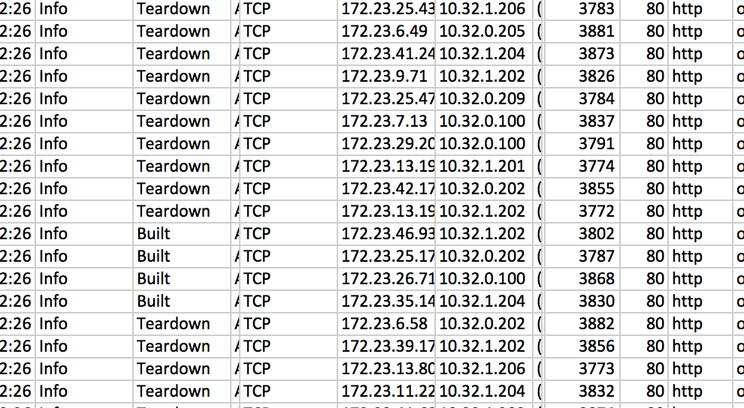
Data Triage State Machine
Connection Event Sequence
S1:events satisfy the condition
C1: Port = 6667
Network Connection Events
S2: evens satisfy the condition
C2: Port = 21
S3:events satisfy the condition
C3: Port = 22

Slide 16
The Approach
Construct the Characteristic Constraint (CC) Graph
Mine the CC Graph
Construct the FSM by Connecting States
Filtering conditions of analysts provide the basis of generalization from connection event instances.
Instead of mining “event instances”, our approach mines the graphs of characteristic constraints.

Slide 17
Step 1: Construct the Characteristics Constraint (CC) Graph
Node: F/S/H Operations
Edges: Relationships

Slide 18
An Example of CC Graph
O1 (Firewall, DstPort=6667)
Is_sub
is_com
O2 (Firewall, DstPort = 6667 AND SrcIP= internal AND DstIP = external)
O3 (Firewall, DstPort != 6667)
Characteristics Constraint Graph

Slide 19
Step 2 Mine the CC Graphs

Slide 20
Step 2.1 Identify Candidate States
Get the terminate nodes of the subsumption tree of F/S/H operations
  A chain of is-subsumed-by conditions indicates the analyst’s process of gradual refinement of focus.
  Each “terminate node” of the subsumption tree represents the final focus that includes suspicious connection events.
  They are the “candidate states” of the FSM
subsumedBy

Slide 21
Step 2.2 Refine the States of FSM
Remove the overlap among candidate states
  (1) Find the largest clique among “isCom” subgraphs
  (2) Refine the candidate states not in the clique so that they are disjoint with the clique.
    After adjusting all the candidate states, we have a set of states which are mutually disjoint.

Slide 22
An Example of Result from Step 2.2
S1:events satisfy the condition
C1: Port = 6667
S2: evens satisfy the condition
C2: Port = 21
S3:events satisfy the condition
C3: Port = 22

Slide 23
Step 3 Construct Finite State Machine
Connect states with temporal relationships based on the connection event data
Ex: port=6667(C1) “can-happen-before” port=21(C2)
  If C1 and C2 are two states, E1 and E2 are two connection events, and
    E1 satisfies C1, E2 satisfies C2
    E1 occurred before E2
  then we say C1 “can-happen-before” C2.
  Implication: If a sequence of connection events include one satisfying C1 followed by another event that satisfies C2, this connection event sequence indicates something suspicious.

Slide 24
Trace Collection
  29 ARSCA traces have been collected in a previous experiment:
    A 60-minute cyber analysis task involving two data sources (IDS alerts and Firewall logs)
    Collaborated with ARL in recruiting 30 full-time professional cyber analysts
    Used ARSCA to audit the subjects’ data triage operations
    Task Design
      Used data from 10-minute time window of VAST Challenge 2012
      Subjects need to analyze 239 IDS alerts and 115,524 firewall logs, reporting malicious network connection events that happened in the 10-minute time window.

Slide 25
Evaluate the Feasibility of the Data Triage Automation Approach
Test Data Set:
  Entire data sources provided in VAST Challenge 2012
    23,595,817 firewall logs and 35,709 IDS alerts
    Events collected over a period of 40 hours
    Average number of IP addresses involved per hour is 27193.
Evaluation:
    Can we build the FSM based on traces from the 10-minute window?
    Can we apply the FSM to data from 48 hours?
    What is the false positive rate?

Slide 26
Ground Truth: the B/T/D events in two attack chains

Slide 27
  Evaluation A: Can we build the FSM?
29 characteristic constraint graphs are constructed.
ARSCA Trace Analysis:
  1181 log items are processes, resulted in 457 F/H/S operations.
  We selected 10 pieces of ARSCA logs and had two persons manually tag the F/S/H operations by reading through the log.
    395 log items were manually analyzed and 202 F/S/H operations were tagged (consistent rate is 88.6%).
  Average precision is 0.9273 and average recall is 0.8426.

Slide 28
Evaluation A: Generate State Machine from the Traces
State Machine:
  39 Vertices, 168 Edges
This State Machine leverages analysts operations of analyzing events (generated in 10 minutes)
  23,595,817 firewall logs and 35,709 IDS alerts

Slide 29
Evaluation B: Run the State Machine on a Large Dataset
ARSCA Traces of 10-minute-time window
State Machine
Network connection events n a 40-hour time window
Attack incidents in 40 hours:

Slide 30
Evaluation C: False Positive Rate
Figure 1. Number of events involves in the ground truth per hour and number of events identified by the state machine
Figure 2. False positive rate of the state machine over the 40 hours.

Slide 31
Technology Transition:
Shift-Transition Study
Goal: To study the impact of linking incident reports to relevant observations and “hypotheses” for analysts in the next shift to perform intrusion detection tasks.
Collaborated with ARL (Rob Erbacher, Steve Hutchinson) in the design of the task and the extension to ARSCA (for linking to incident reports).

Slide 32
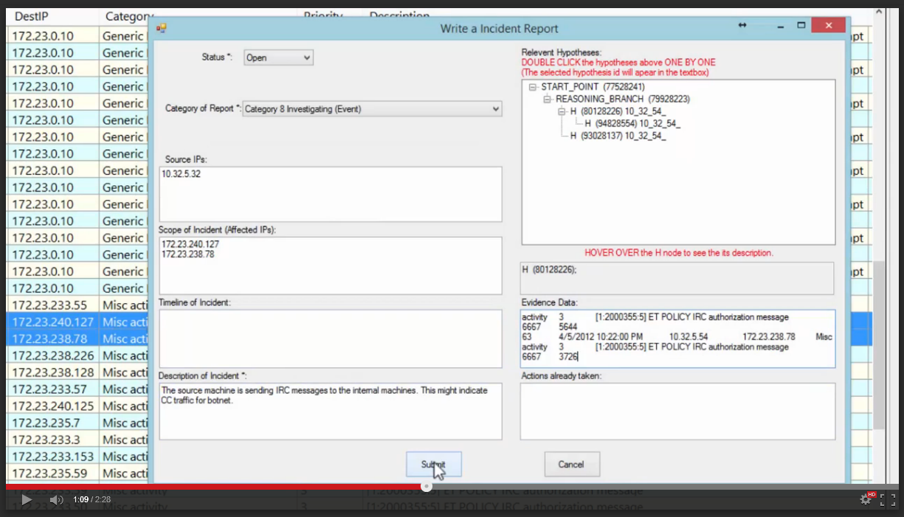

Slide 33
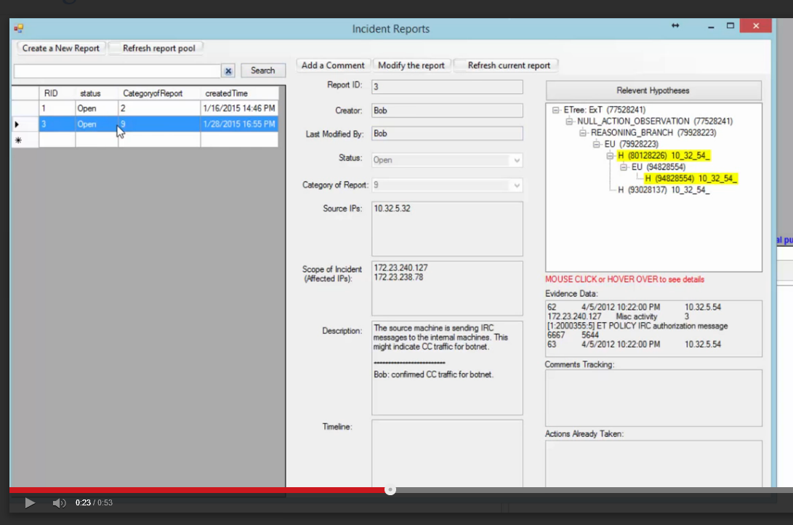
Enables Analysts to View Incident Reports (IR) from Previous Shifts together with Relevant Observations & Hypotheses

Slide 34
Technology Transition: Training of Cyber Analysts
Goals: To investigate the feasibility of a pilot study for enhancing the training of cyber analysts through improved understanding about the impacts of his/her cognitive, visual, and neural processes as well as visualization displays on the performance of network analysts.
Collaborated with ARL (Rob Erbacher, Christopher Garneau) in the design of a concurrent EEG and fMRI task for a network security
Leveraged a previous visualization study of analysts independently developed by Dr. Erbacher.
Implemented the protocol using Eprime at the fMRI Facility of Hershey Medical Center.
9 subjects recruited from Penn State graduate students with background in cyber security

Slide 35
Computer-Aided Human Centric Cyber
Situation Awareness
J. Yen, C. Zhong, G. Xiao, P. Liu,
R. Erbacher, S. Hutchinson, R. Etoty, H. Cam, C. Garneau, W. Glodek
Objectives:
Understand the cognitive process of cyber analysts
Non-intrusive capture of the cognitive process of cyber analysts
Automated analysis of the cognitive traces
Design training procedure based on an improved understanding about the cognitive process
Design data triage cognitive aids by mining the cognitive process of analysts.
FSM-based
Data Triage Automation
Scientific/Technical Approach
  Developed a general framework for capturing cognitive traces based on Action-Observation-Hypothesis (AOH) model.
  Extended Analytical Reasoning Support Tool for Cyber Analysis (ARSCA) to integrate with incident reports.
  Designed experiments for studying the potential benefits of linking incident reports to relevant cognitive traces.
  Introduced a novel FSM-based Representation of suspicious connection events.
  Developed and evaluated a FSM-based automated data triage assistant by mining cognitive traces.
Accomplishments
Conducted additional experiments, in collaboration with Army Research Lab, involving CNDSP analysts
Initial trace analysis suggest relationship between characteristics of traces and performance
Initial evaluation of FSM-based data triage automation indicates promising scalability.
Opportunities
Technology Transition: Support shift transition among analysts
Technology Transition: Cognitive/neural process-based training
Enhance cognitive aids for analysts through FSM-based suspicious event

Slide 36
Recent Accomplishments at a Glance
Publications:
C. Zhong, D. S. Kirubakaran, J. Yen, P. Liu, S. Hutchinson, H. Cam, “How to Use Experience in Cyber Analysis: An Analytical Reasoning Support System,” in Proc. 2013 IEEE Conference on ISI, 2013.
C. Zhong, M. Zhao, G. Xiao, J. Xu, “Agile Cyber Analysis: Leveraging Visualization as Functions in Collaborative Visual Analytics,” in Proceedings of IEEE VAST Challenge 2013 Workshop of IEEE 2013 Visualization Conference.
C. Zhong, D. Samuel, J. Yen, P. Liu, R. Erbacher, S. Hutchinson, R. Etoty, H. Cam, and W. Glodek, “RankAOH: Context-driven Similarity-based Retrieval of Experiences in Cyber Analysis,” to appear in Proceedings of IEEE CogSIMA Conference, 2014.
Yen, R. Erbacher, C. Zhong, and P. Liu, “Cognitive Process”, in Cyber Situation Awareness, A. Kott, C. Wang, R. Erbacher (ed), in press.
Technology Transfer:
Deep collaborations with ARL researchers
Brought the ARSCA toolkit to Adelphi site
  20 ARL security analysts participated
  Weekly teleconferences
  Joint work on a series of papers
Shift Transition
Cognitive/neural process-based Training Procedure
Integration of ARSCA and CAULDRON through Petri Nets
Awards:
Chen Zhong: Grace Hopper Celebration of Women in Computing Scholarship.
Chen Zhong, Honorable Mention, VAST Challenge 2013, Mini-Challenge 3 (Visual Analytic for Cyber SA)
Students:
Chen Zhong, PhD
Gaoyao Xiao, PhD
Tools:
ARSCA

Slide 37

Q & A
Thank you.

Slide 38
No2: Can we re-implement alert correlation? So we can compare with alert correlation.
  Comparison focused on false negative.
No3: The current false negative rate is high.
  Review concern: bob can do much better than the state machine.
  Our response: your concern is not valid. Reason1: we only used the tiny 10-minute time window, and we analyzed 40-hour time window. The ratio 10/40*60 1/240 actually indicates 60% is surprisingly good result.
  We did two-window experiments and we observed this false negative rate decrease from 60% to XXX.
  What if we get 36-hour F/S/H operation and we apply state machine to the last 4 hour (real world case) [large scale evaluation]. We can’t do the experiment because we don’t have the human subjects to do the experiment but we can simulate the experiment
    Simulation: We have 10-minute 10-minute neighbour, and build the state machine, apply the state machine to the next 10-minute, next 20-minute, … (parameter)
    We argue the false negative in this experiment is more representative.
No4: Review concern: you generate too many false positives. Bob is tired of looking at them.
  Our response: our 10m experiment should not measure precision or recall. The only purpose of the 10m experiment is scalability. For precision and recall, we should run different experiment.
Future work: once the work is deployed, we will get the trace for every time window (continuous tracing).

