Slide 1

Information Pooling Bias in Collaborative Cyber Forensics
Nancy J. Cooke, PhD
Prashanth Rajivan, PhD
Verica Buchanan
Jessica Twyford
November 18, 2014
This work has been supported by the Army Research Office
under MURI Grant W911NF-09-1-0525.

Slide 2

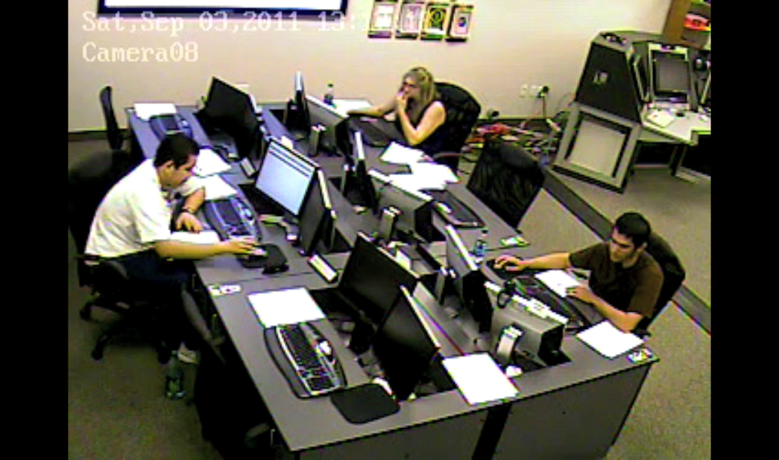
ASU Project Overview
    Objectives:
    Understand and Improve Team Cyber Situation Awareness via
    Understanding cognitive /teamwork elements of situation awareness in cyber-security domains
Implementing a synthetic task environment to support team in the loop experiments for evaluation of new algorithms, tools and cognitive models
Developing new theories, metrics, and models to extend our understanding of cyber situation awareness
Department of Defense Benefit:
Metrics, models, & testbeds for assessing human effectiveness and team situation awareness (TSA) in cyber domain
Testbed for training cyber analysts and testing (V&V) algorithms and tools for improving cyber TSA
Scientific/Technical Approach - Year 5
Explore and mitigate information pooling bias in cyber forensics through
  Empirical work in CyberCog testbed
  Prototype visualization
  Agent-Based Modeling
Year 5 Accomplishments
Found possible collaboration bias
Developed prototype tool for mitigating bias
Demonstrated tool utility in experiment
Replicated this benefit in an agent-based model
Challenge
Struggle to maintain realism in testbed scenarios while allowing for novice participation and team interaction – now addressing with CyberCog and Dextar

Slide 3
Summary of FY 14 ASU Accomplishments
PUBLICATIONS
Rajivan, P. & Cooke, N. J., (under revision). A Methodology for Research on the Cognitive Science of Cyber Defense. Journal of Cognitive Engineering and Decision Making: Special Issue on Cybersecurity Decision Making.
Champion, M., Jariwala, S. Ward, P., & Cooke, N. J. (2014). Using Cognitive Task Analysis to Investigate the Contribution of Informal Education to Developing Cyber Security Expertise. Proceedings of the 57th Annual Conference of the Human Factors and Ergonomics Society, Santa Monica, CA: Human Factors and Ergonomics Society
COLLABORATION
Sushil Jajodia & Max Albanese– DEXTAR
Several MURI partners on an ARL proposal
Neville Stanton – EAST Modeling
TECH TRANSFER
Working with Charles River Analytics and AFRL on team measures of cyber defense
Presentation to ASU Information Assurance
Boeing interest in testbed
PROJECT: Information Pooling Bias in Collaborative Cyber Forensics
STUDENTS SUPPORTED
Prashanth Rajivan (PhD)
Verica Buchanan (MS)
Jessica Twyford (MS)
Ethan Cornell (HS)
David Owusu (HS)
Anirudh Koka (HS)
Adriana Stohn (HS)
AWARD
Human Factors and Ergonomics Society Alphonse Chapanis Student Paper Award:
Rajivan, P., Janssen, M. A., & Cooke, N. J., (2013). Agent-based model of a cyber security defense analyst team. Proceedings of the 57th Annual Conference of the Human Factors and Ergonomics Society, Santa Monica, CA: Human Factors and Ergonomics Society.

Slide 4
Overall ASU Contributions
Over the course of This MURI ASU Team has:
Conducted Cognitive Task Analyses
Developed Cyber Testbeds & Performance Metrics
Conducted Experiments in Cyber Testbeds
Developed EAST and Agent-based models
And has Found
Cyber analysts do not collaborate
Collaboration is essential for cyber situation awareness
Most recent work (presented today):
Asks if collaboration could be biased
Demonstrates value of intervention based on cognitive analysis of problem

Slide 5
Cyber attacks have evolved
Multi-step, Advanced Persistent Threats (APT) & Stealth attacks
Detecting multi-step and stealth attacks
  Requires advanced forensics tools
  Requires efficient information sharing

Slide 6
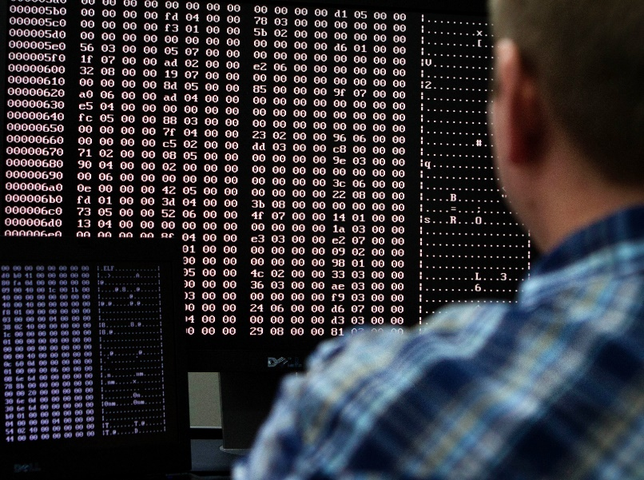
Cyber Defense - Forensics Analysis
Analyze past evidences
Detect a larger story

Slide 7
There is a lack of Context
Raytheon’s recent survey revealed:
  “69 percent of the professionals surveyed said their security tools don't provide enough contextual information to determine the intent behind reported incidents”
Currently:
  Isolated analysis
  Tools don’t offer cohesiveness or context
  Analysts blinded and tunneled

Slide 8
Solution - Machine Learning and Data analytics ?
Human perfect context computing ?
Humans survival mechanism
Why don’t we use humans teams themselves

Slide 9
Cyber Defense Lacks Teamwork
Low Information exchange
Low understanding of how analyst team works and exchange information
Existing collaboration tools: Emails, chat systems and wiki
Sitting together in a office and using chat clients is not teamwork

Slide 10
Problem Statements
With growing attack sophistication there is a need for timely knowledge sharing between cyber analysts
There is a lack of understanding about team work and information sharing in analyst teams
  Can’t simply ask analysts to work as a team and expect miracles
Lack of tailor made collaboration tools for cyber defense analysts
  Lacks global view of the attacks

Slide 11
Human Cognitive Biases
Intelligence Analysis
  Very similar to cyber defense
Decision making is plagued with biases (kahneman & Klein 2009)
  Information Load
  Loss in communication and team process
Team level biases
  CKE and Confirmation bias

Slide 12
Explored Social Psychology
Stumbled on Information Pooling Bias – Intrigued !
Expectation of a team: Work together, share all knowledge, build optimal decisions
Different information distributions in a team can lead to different information sharing behavior.
Information sharing is biased on shared information than unshared (or unique) information (Strasser & Titus 1985)

Slide 13

Information Pooling Bias
Candidate A = 4
Candidate B = 6
A1 A2 A3 A4
B1 B2
A1 A2 A3 A4
B3 B4
Attributes of Candidate A will be repeatedly discussed
Attributed of Candidate B will be mentioned few times
A1 A2 A3 A4
B5 B6
Candidate A will be chosen

Slide 14
Information Pooling Bias
Groups with unequal information distribution were found to be eight times less likely to find the solution than were groups having full information (Lu et al., 2012).
It is impossible for every team member to know all the information (rely on others expertise)
So simply asking cyber defense analyst to setup meetings and conduct forensics will not help.

Slide 15
Resemblance to APT and multi-step
Evidence for the attack is uniquely available with different members of the team
There are evidences of attacks that most of them are observing
Fails to detect APT early on
  Information Pooling Bias ?

Slide 16
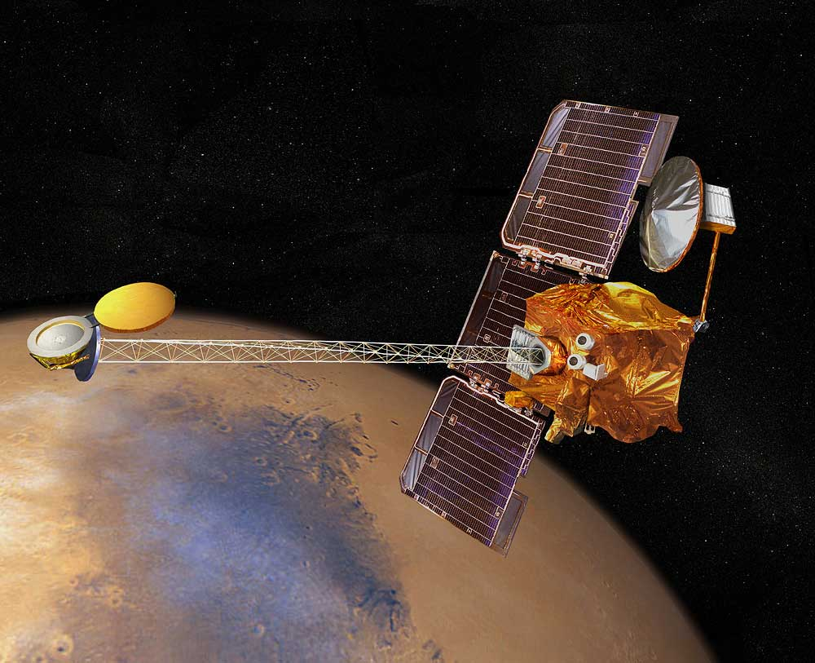
Effect of inefficient Information Sharing
The 1999 mars climate orbiter disintegrated after entering the upper atmosphere of mars.
Cost of the mission was $327.6 million !

Slide 17
A Quick Review
Effective information sharing is paramount to detecting advanced types of attacks
Teams in other domains have demonstrated the information pooling bias
It is imperative that such a bias is investigated and understood in the cyber defense context
Develop tool & interventions to mitigate the bias

Slide 18
Research Question 1
Does information pooling bias affect cyber forensic analyst team discussions and decisions?

Slide 19
Research Question 2
Does a tailor made collaboration tool lead to superior analyst performance compared to using off-the-shelf collaboration tool such as wiki software?

Slide 20
Procedure
30 teams of 3 = 90 participants
Trained on cyber security concepts
Practice mission
2 main missions
Attack evidences distributed
Pre-discussion reading and discussion
Goal – Detect large scale attacks

Slide 21
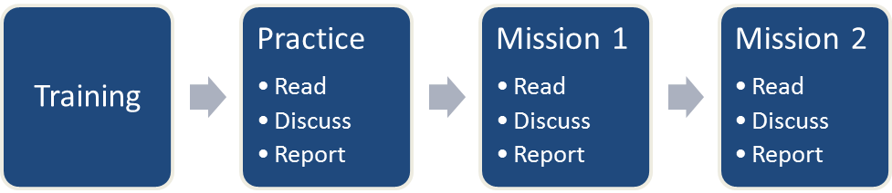
Procedure

Slide 22
Attack Kinds
Shared – large scale but seen by most
Unique – large scale distributed evidences
Isolated – Isolated attacks

Slide 23
Attack Data Distribution in Missions
Unique A1
Unique A2
Unique A3
Unique B1
Unique B2
Unique B3
Isolated 1
Isolated 2
Isolated 3
Isolated 4
Isolated 5
Isolated 6
Shared 1
Shared 2
Shared 3
Shared 4
Shared 5
Attacks
Analyst 1
Analyst 2
Analyst 3
Shared 1
Shared 1
Shared 1
Shared 2
Shared 2
Shared 2
Shared 3
Shared 3
Shared 4
Shared 5
Shared 4
Shared 5
Unique A1
Unique A2
Unique A3
Unique B1
Unique B2
Unique B3
Isolated 1
Isolated 3
Isolated 5
Isolated 2
Isolated 4
Isolated 6

Slide 24
Information distribution Used
-Similar to earlier studies-
Candidate A = 4
Candidate B = 6
A1 A2 A3 A4
B1 B2
A1 A2 A3 A4
B3 B4
A1 A2 A3 A4
B5 B6

Slide 25
Experiment Design
 | Mission1 - Baseline | Mission 2
Tool Type | Slide Based | Slide Based
 | Slide Based | Wiki
 | Slide Based | Collaborative Visualization

Slide 26
Collaborative Visualization Tool
Collaborative visualization tool designed from a cognitive engineering perspective
  Cognitive Friendly Visualizations
To mitigate the information pooling bias in cyber defense analysts
Improve information sharing and decision making performance

Slide 27
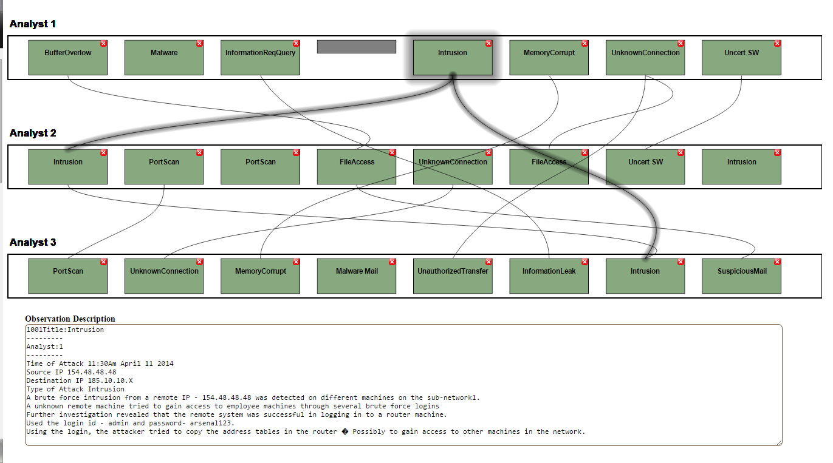

Slide 28
Measures
Communication coding
  Discussion Focus
  Number of mentions of each attack type
Decision quality
  All large scale attacks detected ?
Workload & Demographics

Slide 29
Expected Results
Amount of mentions of shared attacks is significantly more than the unshared attacks in baseline condition
  1 or 2 standard deviation more
Decision quality is hampered by the bias
Information coverage & decision quality is higher in collaborative visualization condition
Lower workload in the condition using collaborative visualization tool

Slide 30
Experiment Results

Slide 31
Team Level Measures
Shared percent
  Percentage of discussion focus spent on discussing attacks that are shared among members
Unique percent
  Percentage of discussion focus spent on discussing attacks are unique but are part of large scale attack
Detection Performance
  Number of attacks detected (Both shared and unique)
  Max possible = 18 (4*3 + 2*3)

Slide 32
Mission 1 Descriptives
Multivariate test (Hotelling's Trace) yielded a non-significant result: F=1.074 p=0.398
Average Shared Percent = 63.5 Unique = 16.2 Performance = 11.5/18

Slide 33
Mission2 Descriptives
Multivariate test (Hotelling's Trace) yielded a significant result: F=3.341 p=0.004
Average Shared Percent = 59.21 Unique = 22.7 Performance = 13/18

Slide 34
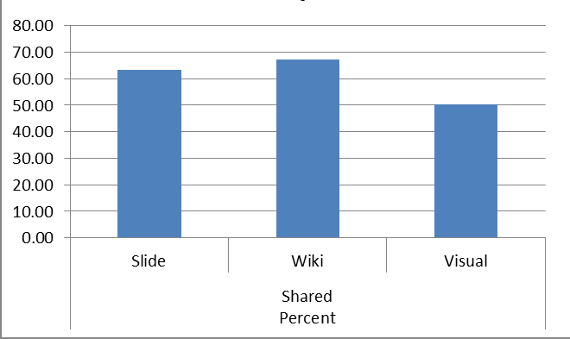
Percentage of shared information discussed in Mission 2

Slide 35
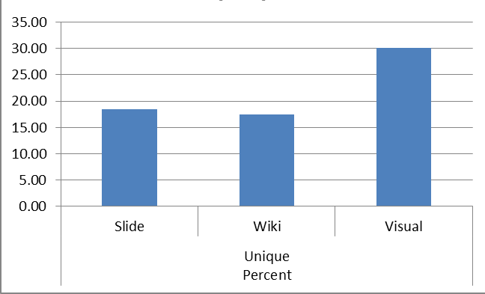
Percentage of unique information discussed in Mission 2

Slide 36
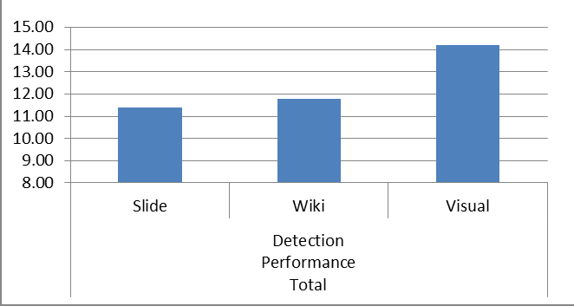
Number of attacks detected (Performance) in Mission 2

Slide 37
Multiple Comparisons

Slide 38
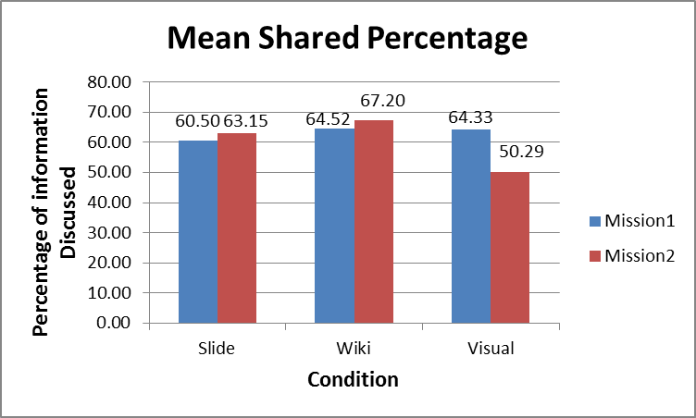
Percentage of shared information discussed compared between Missions

Slide 39
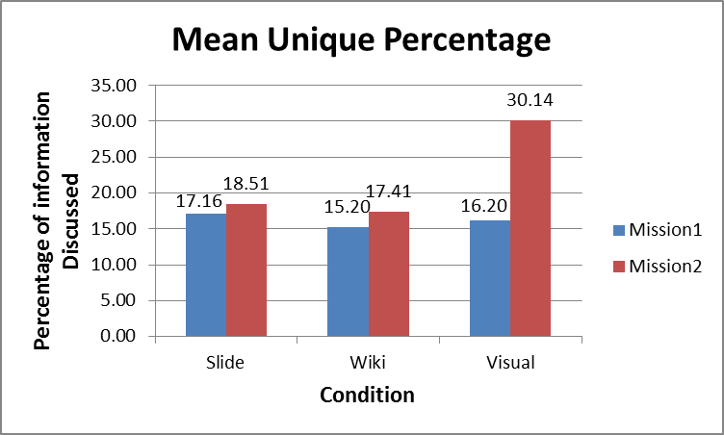
Percentage of unique information discussed compared between Missions

Slide 40
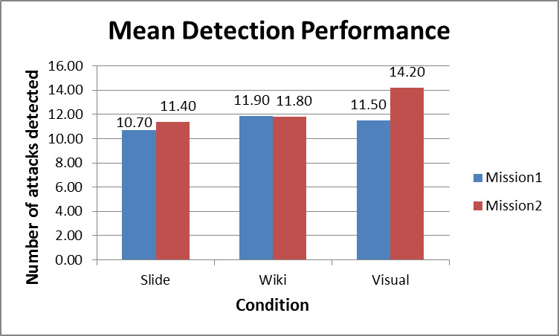
Number of attacks detected (Performance) compared between Missions

Slide 41
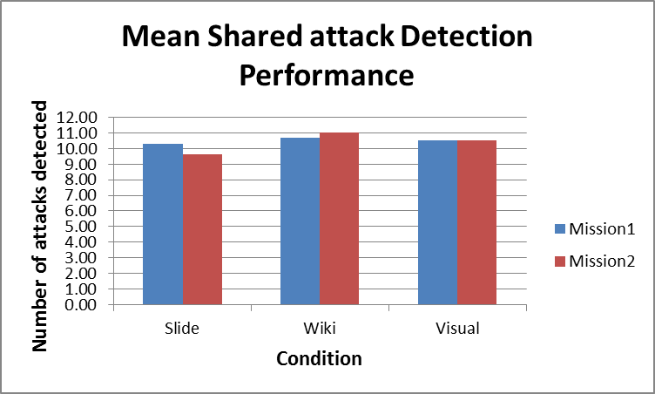
Number of shared attacks detected (Performance) compared between Missions

Slide 42
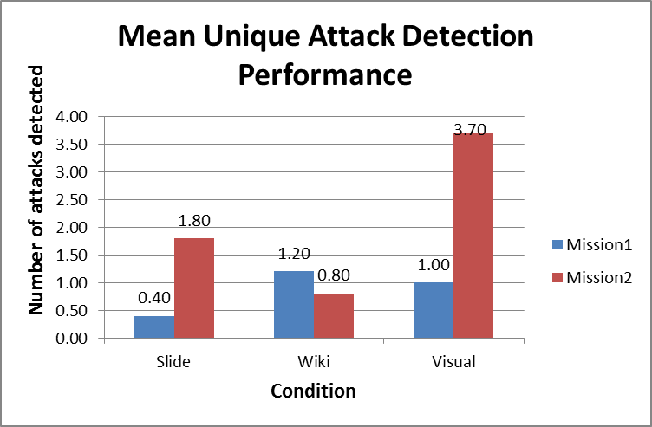
Number of unique attacks detected (Performance) compared between Missions

Slide 43
Summary of Experiment Results
Significantly more percentage of shared attack information discussed
  Cyber Defense analysts undergo information pooling bias
  Prevents from detecting APT kinds of attacks
Use of cognitive friendly visualization reduces the bias, improves performance
Off the shelf collaboration tools doesn’t help

Slide 44
Computational Model of Experiment
(Explained in Brevity)
Internal search process could be critical
Theorize about the underlying cognitive search process
Individual Information search process (cognitive) primed by social interactions
Human memory represented as search space

Slide 45
Models
Random
  Random walks in search of information
  Local Search (Local Search & Uphill)
  Discussion topic is the cue
  Searches information in the current neighborhood
  Uphill
  Memory Aided Search
  Uses recognition memory to identify regions to search
  Marks off attacks found

Slide 46
Measures
Measures in parallel to the experiment
Discussion Focus
Performance

Slide 47
How models faired against experiment
Bayesian statistics was employed
Cognitive search Less-biased
Local Search Biased discussion

Slide 48
Inferences from model
People are using simple heuristics and search locally for information when they undergo bias
  Lack global view & Low recognition
  Essential to develop associations and develop context on the data
Cognitive Friendly visualizations
  Higher recognition
  Less Load
  Global search

Slide 49
Conclusion
Cyber SA requires collaboration of analysts
Collaboration can be biased
Visualization prototype mitigates that bias
Agent-based model corroborates
Supports understanding of cognitive underpinnings of cyber SA in design of interventions

Slide 50
Future Questions
How to develop associations between reports for such a visualization ?
Other cognitive biases in forensics ?
  Confirmation Bias – High chance !

Slide 51

Questions
ncooke@asu.edu

