Slide 1
Architecture, models and experiments in cognitive-based cyber situation awareness
David Hall
Michael McNeese
Nicklaus Giacobe
Jeffrey Rimland

Slide 2
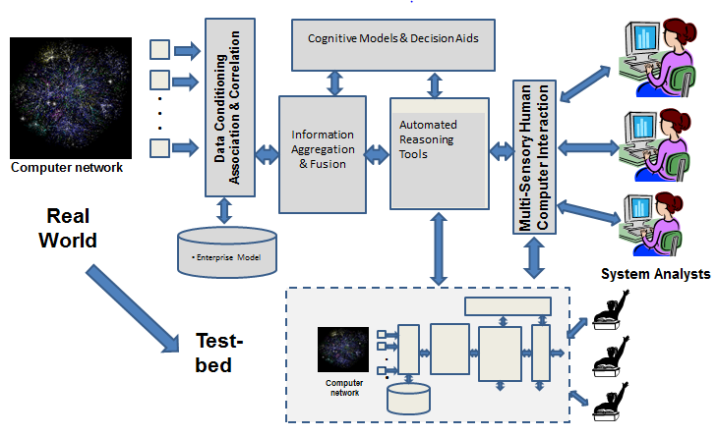
Computer-Aided Human Centric Cyber Situation Awareness
M. McNeese, D. Hall, N. Giacobe, J. Rimland
Objectives:
Understand cognitive/contextual elements of situation awareness in cyber-security domains
Implement a systems perspective to research linking real-world analysts with theory and human in the loop experiments
Utilize Multi-Modal research methodology
Focus on the human and team elements within real context applications
Scientific/Technical Approach
Living laboratory framework involving;
Ethnographic studies
Knowledge elicitation of domain experts
Development of cognitive and process frameworks and theories
Implementation of a scaled world prototype
Conduct of human in the loop experiments
Analysis and transition to real-world environments
Accomplishments
Developed general architecture/approach for cyber SA: automated reasoning and hypothesis generation with human in the loop context-based reasoning,
Developed a conceptual framework for Complex Event Processing (CEP) and Coherence Net processing for automated analysis of semantic information related to network situational data,
Acquired and utilized Tripwire Benchmark, a system for aggregating cyber-security sensor data from multiple platforms
Applied the Living Lab Framework and process, to cyber security
Challenges
Rapid evolution of cyber threats and threat environments
Access to domain experts and state of the art practice
Modeling adversarial threats – integration in simulation

Slide 3
Main Scientific/Technical Accomplishments (5th Year)
Motivation
Improvement in Cyber SA requires focus on the ultimate limited resource: the human cyber analyst. This in turn requires understanding of the cognitive processes, the context, limitations and issues associated with perception, cognition and decision making for cyber SA
Summary of Accomplishments
Developed a general architecture and approach for cyber situation awareness incorporating automated reasoning and hypothesis generation with human in the loop context-based reasoning,
Developed a conceptual framework for Complex Event Processing (CEP) and Coherence Net processing for automated analysis of semantic information related to network situational data
Developed Acquired and utilized Tripwire Benchmark, a system for aggregating cyber-security sensor data from multiple platforms
Applied the Living Lab Framework and the process, developed previously in the study of several human cognitive aspects and how they apply to cyber security
We disseminated our findings via peer-reviewed journal articles, conference papers, edited book chapters, and presentations.

Slide 4
5th Year Task Statistics and Summary
Students supported:
Three graduate students/Four undergraduate students: Tristan Endsley (10 %), Jaime Reep (50%), Erin Johnson ( 50 %), Dan Ocasio, James Rowley, Bryce Malinchak, Colin Burns
2 faculty (D. Hall, M. McNeese) – Note: funding for all faculty provided by Penn State
Degrees awarded: (MS, PhD): J. Rimland (PhD)
Degrees in progress: E. Johnson (M.S.), Tristan Endsley (PhD), E. McMillan (PhD)
Publications:
Refereed journal papers - 0
Conference papers – 5
Conference presentations -7
Dissertations and Theses – 1
Technical reports - 1
Technology Transitions:
Interactions with industry
Ethnographic studies/knowledge elicitation with network analysts working in education, military, government, and industry domains.
Briefings provided to several companies including: Deloitte, Lockheed Martin, Raytheon Corporation, GE, MITRE, Computer Sciences Corporation, MIT Lincoln Laboratory and TRIPWIRE, Inc.
Interactions with other government agencies
Briefings presented to representatives from the National Security Agency (NSA), Defense Threat Reduction Agency (DTRA), Office of Naval Research (ONR), Department of Homeland Security (DHS), the Department of Defense Intelligence Information Systems (DoDII)
Data includes support for personnel through the no-cost extension
4

Slide 5
Publications, Honors and Awards Year 5
Refereed Conference Proceedings
Rimland, J. and Ballora, M., “Using complex event processing (CEP) and vocal synthesis techniques to improve comprehension of sonified human-centric data”, Proceedings of the SPIE Conference on Sensing Technology and Applications, vol. 9122, June, 2014
Rimland, J., and Hall, D. "A Hitchhiker’s Guide to Developing Software for Hard and Soft Information Fusion", Proceedings of the International Society of Information Fusion (ISIF) FUSION 2014, Salamanca, Spain, July, 2014.
Rimland, J., and Ballora, M., “Using vocal-based sounds to represent sentiment in complex event processing”, Proceedings of the International Conference on Auditory Display (ICAD), June 22 – 25, 2014, New York City
Giacobe, N.A., “A Picture is Worth A Thousand Alerts”, Proceedings of the 57th annual Meeting of Human Factors and Ergonomics Society Annual Meeting, San Diego, 2013
Shaffer, S., “Automatic theory generation from analyst text files using coherence networks, Proceedings of the SPIE Conference on Sensing Technology and Applications, vol. 9122, June, 2014
Presentations
Rimland, J. and Ballora, M., “Using complex event processing (CEP) and vocal synthesis techniques to improve comprehension of sonified human-centric data”, the SPIE Conference on Sensing Technology and Applications, presented May 6th, 2014 in Baltimore, MD.
Shaffer, S., “Automatic theory generation from analyst text files using coherence networks, the SPIE Conference on Sensing Technology and Applications, presented May 6th, 2014 in Baltimore, MD.
Rimland, J., and Hall, D. "A Hitchhiker’s Guide to Developing Software for Hard and Soft Information Fusion", Proceedings of the International Society of Information Fusion (ISIF) FUSION 2014, July, 2014.
Rimland, J., and Ballora, M., “Using vocal-based sounds to represent sentiment in complex event processing”, Proceedings of the International Conference on Auditory Display (ICAD), June 22 – 25, 2014, New York City
Giacobe, N.A., “A Picture is Worth A Thousand Alerts”, Proceedings of the 57th annual Meeting of Human Factors and Ergonomics Society Annual Meeting, San Diego, 2013
• McNeese, M. Reset – Alternative Visions for Cyber Worlds, “Cognition and Cyber-Security” invited panel presentation, 57th
annual Meeting of Human Factors and Ergonomics Society Annual Meeting, San Diego, October, 2013
• McNeese, M. “Creating a Common Operational Picture with the Crowd” invited panel presentation, 11th International Conference
on Crisis Response and Management (ISCRAM), The Pennsylvania State University, University Park, PA, May 2014.

Slide 6
Publications, Honors and Awards Year 5
Dissertations and Theses
J. C. Rimland, Hybrid human-computing distributed sense-making: Extending the SOA paradigm for dynamic adjudication and optimization of human and computer roles”, Ph.D. dissertation in Information Sciences and Technology, The Pennsylvania State University, August, 2013

Slide 7
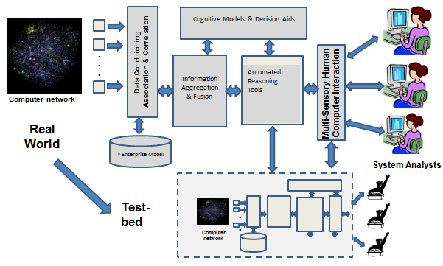
5th Year Focus and Contributions
Developed a general architecture & approach for cyber SA incorporating automated reasoning & hypothesis generation with human in loop
Developed & demonstrated Complex Event Processing (CEP) and Coherence Net processing for automated ingestion of semantic information
Developed a physical test bed to allow generation of “hard” sensor data
Acquired & utilized Tripwire Benchmark, a system for aggregating cyber-security sensor data
New theoretical frameworks involving team cognition, models of context (abstraction hierarchy) and models of SA decision-making
Planning and initial conduct of experiment using the idsNETS and TeamNets simulation to explore the effect of conditions of models
Extension of the NeoCities testbed to incorporate soft and hard sensor data for human in the loop experiments

Slide 8
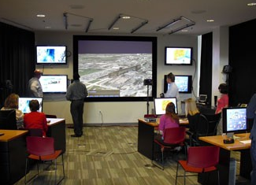
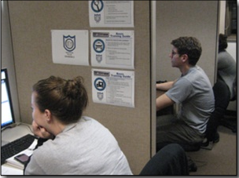
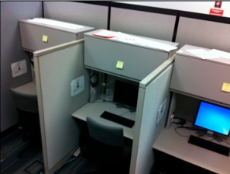
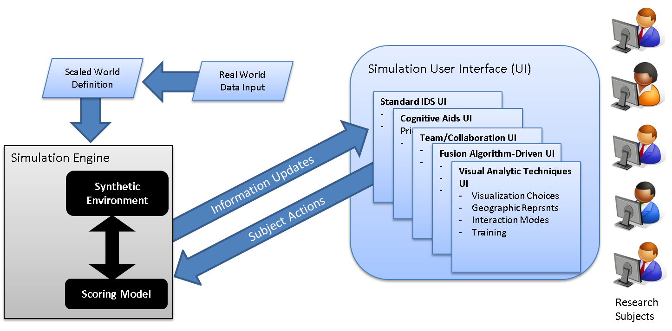
Test and Evaluation Environment
Three Laboratories in the Penn State College of Information Sciences and Technology enable human in the loop experiments with cyber situational awareness in individual and team environments
The Multidisciplinary Initiatives in Naturalistic Decision Systems (MINDS) Laboratory
The Extreme Events Laboratory
NC2IF Cyber Laboratory

Slide 9
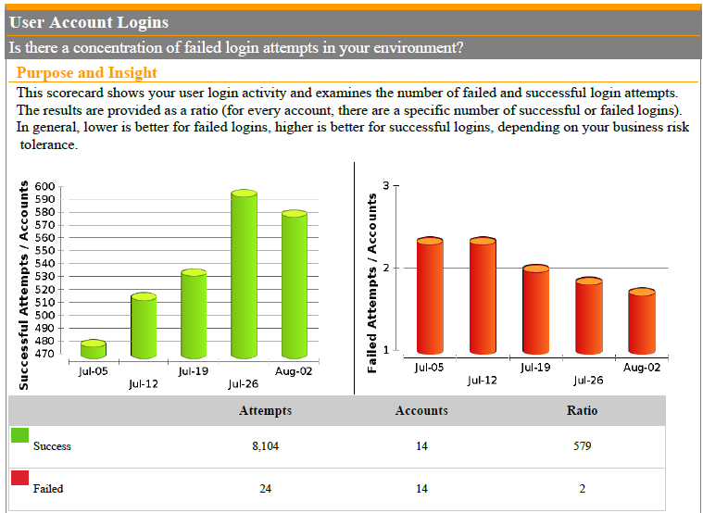
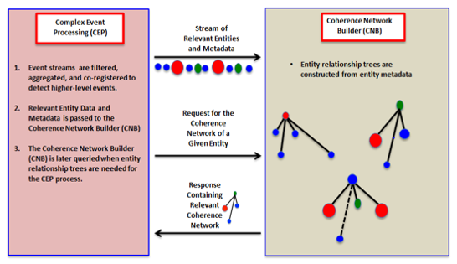
Physical Test bed for Generation of Hard Data
Centralized Cyber Security Servers
Scripted User Interaction
Tripwire Benchmark
Authentication
Logs
“normal” behavior
Anti-virus
Logs
unauthorized access
Patch Logs
Vuln. Scan Logs
Off-line machine
Open source
Blog & RSS Feed Data
Configuration Mgmt Logs
Access to risky web sites

Slide 10
Example of Tripwire Benchmark for Successful & Failed Authentication
Acquired the Tripwire Benchmark product
Collects, aggregates and assesses cyber-security data from centralized servers
Provides high-level scorecards to compare results with similar organizations (from an evolving community database)
Investigations
Exploration of utility of scorecards
Development of alternative representations & visualizations
Exploring the fusion of data across siloes (using the SKRM reference model)
Example of Tripwire Benchmark for Successful & Failed Authentication

Slide 11
Examples of Cyber Security Raw Data
Antivirus Logs
Filename | Risk | Action | Risk Type | Original Location | Computer | User | Status | Current Location | Primary Action | Secondary Action | Logged By | Action Description | Date and Time
0eecd17c6c215b358b7b872b74bfd800 | W32.Duqu | Cleaned by deletion | Virus | I:\duqu-samples\ | WORKSTATION3 | JValdez | Deleted | Deleted | Clean security risk | Quarantine | Auto-Protect scan | The file was deleted successfully. | 11/5/2014 0:35
c9a31ea148232b201fe7cb7db5c75f5e | W32.Duqu | Cleaned by deletion | Virus | I:\duqu-samples\ | WORKSTATION3 | JValdez | Deleted | Deleted | Clean security risk | Quarantine | Auto-Protect scan | The file was deleted successfully. | 11/5/2014 0:35
netp192.pnf | Trojan Horse | Quarantined | Virus | I:\duqu-samples\ | WORKSTATION3 | JValdez | Infected | Quarantine | Clean security risk | Quarantine | Auto-Protect scan | The file was quarantined successfully. | 11/5/2014 0:35
b4ac366e24204d821376653279cbad86 | Trojan Horse | Quarantined | Virus | I:\duqu-samples\ | WORKSTATION3 | JValdez | Infected | Quarantine | Clean security risk | Quarantine | Auto-Protect scan | The file was quarantined successfully. | 11/5/2014 0:35
9749d38ae9b9ddd81b50aad679ee87ec | Infostealer | Cleaned by deletion | Virus | I:\duqu-samples\ | WORKSTATION3 | JValdez | Deleted | Deleted | Clean security risk | Quarantine | Auto-Protect scan | The file was deleted successfully. | 11/5/2014 0:36
netp191.PNF | Trojan Horse | Quarantined | Virus | I:\duqu-samples\ | WORKSTATION3 | JValdez | Infected | Quarantine | Clean security risk | Quarantine | Auto-Protect scan | The file was quarantined successfully. | 11/5/2014 0:36
4541e850a228eb69fd0f0e924624b245 | W32.Duqu | Cleaned by deletion | Virus | I:\duqu-samples\ | WORKSTATION3 | JValdez | Deleted | Deleted | Clean security risk | Quarantine | Auto-Protect scan | The file was deleted successfully. | 11/5/2014 0:36
e8d6b4dadb96ddb58775e6c85b10b6cc | Trojan Horse | Quarantined | Virus | I:\duqu-samples\ | WORKSTATION3 | JValdez | Infected | Quarantine | Clean security risk | Quarantine | Auto-Protect scan | The file was quarantined successfully. | 11/5/2014 0:36
94c4ef91dfcd0c53a96fdc387f9f9c35 | Trojan Horse | Quarantined | Virus | I:\duqu-samples\ | WORKSTATION3 | JValdez | Infected | Quarantine | Clean security risk | Quarantine | Auto-Protect scan | The file was quarantined successfully. | 11/5/2014 0:37
cmi4464.PNF | Trojan Horse | Quarantined | Virus | I:\duqu-samples\ | WORKSTATION3 | JValdez | Infected | Quarantine | Clean security risk | Quarantine | Auto-Protect scan | The file was quarantined successfully. | 11/5/2014 0:37
b4ac366e24204d821376653279cbad86 | Trojan Horse | Quarantined | Virus | C:\Users\JValdez\Desktop\ | WORKSTATION3 | JValdez | Infected | Quarantine | Clean security risk | Quarantine | Auto-Protect scan | The file was quarantined successfully. | 11/6/2014 14:05
e8d6b4dadb96ddb58775e6c85b10b6cc | Trojan Horse | Quarantined | Virus | C:\Users\JValdez\Desktop\ | WORKSTATION3 | JValdez | Infected | Quarantine | Clean security risk | Quarantine | Auto-Protect scan | The file was quarantined successfully. | 11/6/2014 14:05
cmi4464.PNF | Trojan Horse | Quarantined | Virus | C:\Users\JValdez\Desktop\ | WORKSTATION3 | JValdez | Infected | Quarantine | Clean security risk | Quarantine | Auto-Protect scan | The file was quarantined successfully. | 11/6/2014 14:06
netp192.pnf | Trojan Horse | Quarantined | Virus | C:\Users\JValdez\Desktop\ | WORKSTATION3 | JValdez | Infected | Quarantine | Clean security risk | Quarantine | Auto-Protect scan | The file was quarantined successfully. | 11/6/2014 14:06
9749d38ae9b9ddd81b50aad679ee87ec | Infostealer | Cleaned by deletion | Virus | C:\Users\JValdez\Desktop\ | WORKSTATION3 | JValdez | Deleted | Deleted | Clean security risk | Quarantine | Auto-Protect scan | The file was deleted successfully. | 11/6/2014 14:06
c9a31ea148232b201fe7cb7db5c75f5e | W32.Duqu | Cleaned by deletion | Virus | C:\Users\JValdez\Desktop\ | WORKSTATION3 | JValdez | Deleted | Deleted | Clean security risk | Quarantine | Auto-Protect scan | The file was deleted successfully. | 11/6/2014 14:06
netp191.PNF | Trojan Horse | Quarantined | Virus | C:\Users\JValdez\Desktop\ | WORKSTATION3 | JValdez | Infected | Quarantine | Clean security risk | Quarantine | Auto-Protect scan | The file was quarantined successfully. | 11/6/2014 14:06
4541e850a228eb69fd0f0e924624b245 | W32.Duqu | Cleaned by deletion | Virus | C:\Users\JValdez\Desktop\ | WORKSTATION3 | JValdez | Deleted | Deleted | Clean security risk | Quarantine | Auto-Protect scan | The file was deleted successfully. | 11/6/2014 14:06
94c4ef91dfcd0c53a96fdc387f9f9c35 | Trojan Horse | Quarantined | Virus | C:\Users\JValdez\Desktop\ | WORKSTATION3 | JValdez | Infected | Quarantine | Clean security risk | Quarantine | Auto-Protect scan | The file was quarantined successfully. | 11/6/2014 14:06
0eecd17c6c215b358b7b872b74bfd800 | W32.Duqu | Cleaned by deletion | Virus | C:\Users\JValdez\Desktop\ | WORKSTATION3 | JValdez | Deleted | Deleted | Clean security risk | Quarantine | Auto-Protect scan | The file was deleted successfully. | 11/6/2014 14:06
0eecd17c6c215b358b7b872b74bfd800 | W32.Duqu | Cleaned by deletion | Virus | C:\Users\JValdez\Desktop\ | WORKSTATION3 | JValdez | Deleted | Deleted | Clean security risk | Quarantine | Auto-Protect scan | The file was deleted successfully. | 11/6/2014 14:06
4541e850a228eb69fd0f0e924624b245 | W32.Duqu | Cleaned by deletion | Virus | C:\Users\JValdez\Desktop\ | WORKSTATION3 | JValdez | Deleted | Deleted | Clean security risk | Quarantine | Auto-Protect scan | The file was deleted successfully. | 11/6/2014 14:06
94c4ef91dfcd0c53a96fdc387f9f9c35 | Trojan Horse | Quarantined | Virus | C:\Users\JValdez\Desktop\ | WORKSTATION3 | JValdez | Infected | Quarantine | Clean security risk | Quarantine | Auto-Protect scan | The file was quarantined successfully. | 11/6/2014 14:06
9749d38ae9b9ddd81b50aad679ee87ec | Infostealer | Cleaned by deletion | Virus | C:\Users\JValdez\Desktop\ | WORKSTATION3 | JValdez | Deleted | Deleted | Clean security risk | Quarantine | Auto-Protect scan | The file was deleted successfully. | 11/6/2014 14:06
b4ac366e24204d821376653279cbad86 | Trojan Horse | Quarantined | Virus | C:\Users\JValdez\Desktop\ | WORKSTATION3 | JValdez | Infected | Quarantine | Clean security risk | Quarantine | Auto-Protect scan | The file was quarantined successfully. | 11/6/2014 14:06
c9a31ea148232b201fe7cb7db5c75f5e | W32.Duqu | Cleaned by deletion | Virus | C:\Users\JValdez\Desktop\ | WORKSTATION3 | JValdez | Deleted | Deleted | Clean security risk | Quarantine | Auto-Protect scan | The file was deleted successfully. | 11/6/2014 14:06

Slide 12
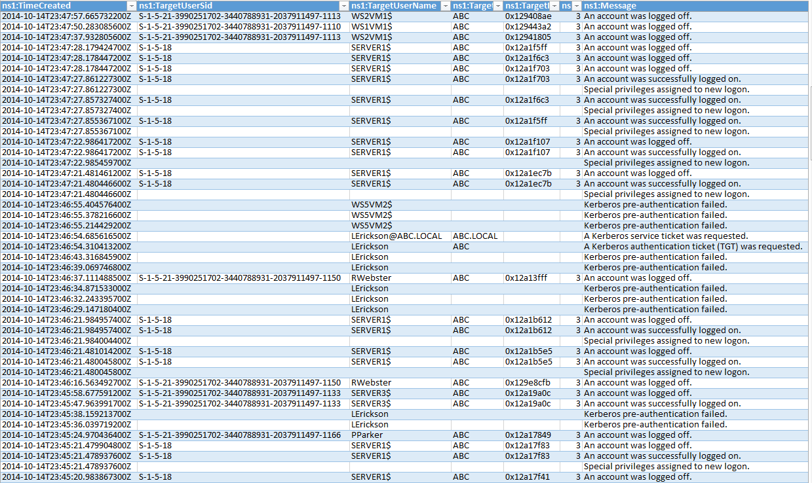
Examples of Cyber Security Raw Data
Authentication Logs

Slide 13
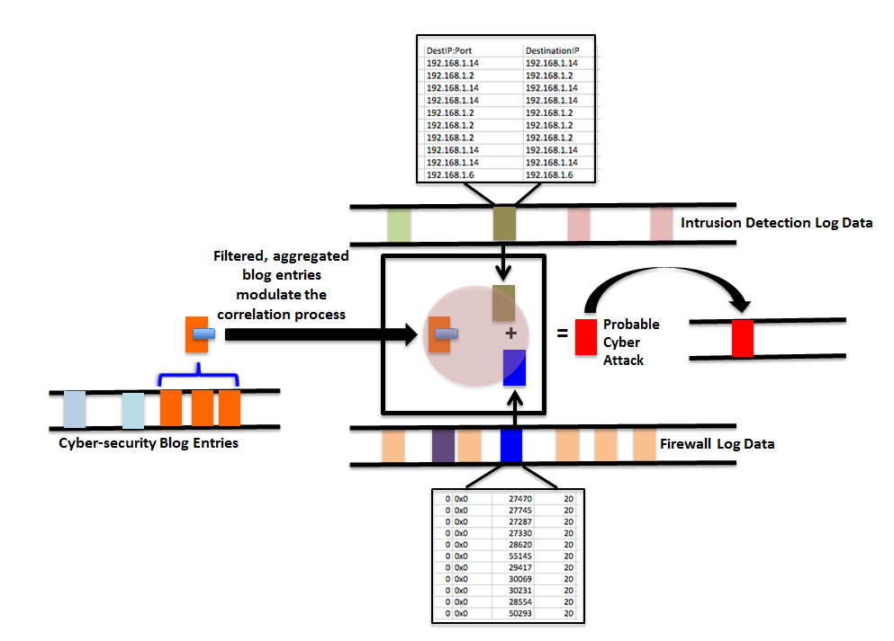
Complex Event Processing (CEP) for Cyber Situation Awareness
Complex event processing (CEP)
Originally created for financial and stock trading applications
Subsequently applied to smart energy, RFID middleware and limited data fusion applications
Capabilities for rapid rule-based filtering, aggregation and event detection
Allows hierarchy of “levels of analysis”
Low-level events (red and blue) filtered and aggregated into a higher-level event (green)

Slide 14
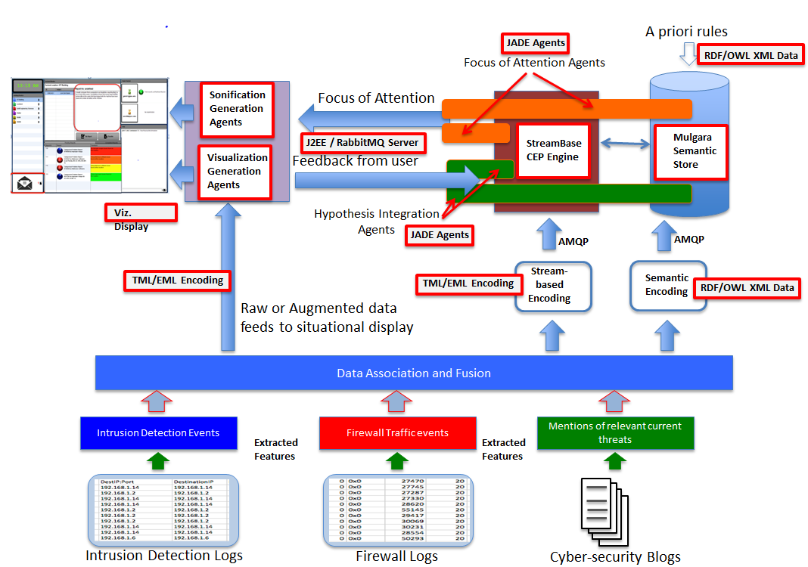
CEP Processing Infrastructure

Slide 15
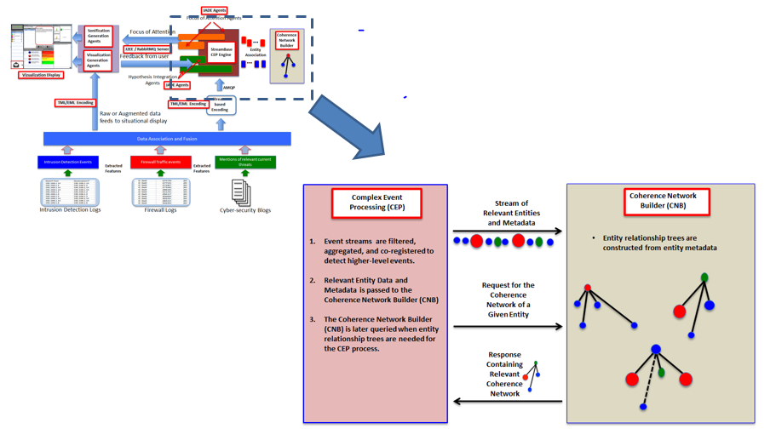
Synergy between CEP and Coherence Network Builder

Slide 16
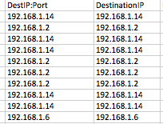
Crossing Hard Data Siloes using soft data (blogs)
Interaction/correlation between sources?
Modulation from blog data?
e.g.: http://www.threattracksecurity.com/it-blog/adobe-exploit-cve-2014-0502/ (see link here)
ID Systems vuln to CVE-2014-0502
AV Detection of SWF Malware
Failed AV removal of SWF Malware
Other AV Detection
Changed Authentication Behavior
Patch Management or Vuln Scan Events
Authentication Events
Antivirus Events
Mentions of relevant current threats
Extracted Features:
Vulnerable Machines?
Extracted Features: Failed Logons?
Extracted Features: Virus Activity?
Patch Management Logs
Authentication Logs
Antivirus Logs
Cyber-security Blogs

Slide 17
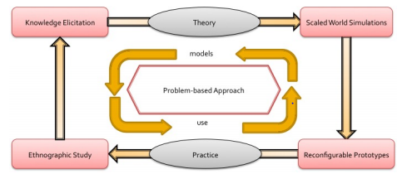
Application of Living Laboratory Framework
Focus of Human-Centric Research
Understand issues related to human component of cyber SA
Exploration of both individual and team performance
Modeling & test different intelligent system concepts via humans in the loop experiments
Determine the impact of contextual variation (time pressure, information, emergent complexity)
Ongoing Human in the Loop experiment
Utilization of the idsNETS/TEamNets simulation to explore 2 types of independent variables involving conditions of knowledge
Integration of hard and soft fusion processing
Incorporating hidden threat model and knowledge (intelligence collected versus unavailable)
Extension and refinement of the experimental test frame

Slide 18
Goals for Cyber Trans-Action
Cognitive Models / Experimentation in support of Cyber Situation Awareness
Objectives: 1) Descriptive Models of Cyber Activity and Context
2) Information Fusion Experiment employing Knowledge of Adversary
Functional Abstraction Hierarchy (Rasmussen, Sanderson) for Cyber Operations
- Functional work in cyber detection with other cross-function areas (threat assess)
Decision Ladder to portray decision making flow and adaptations across team members
- With and Without knowledge of the adversarial threat
— Use of previous and current qualitative / quantitative data to propagate models
• qualitative evaluation of student-led teams in cyber exercises
• document analysis and review of current extant cognitive models of cyber
— Foundational work for future CyberSA research initiatives
a) computational cognitive models b) human-agent teamwork concepts
Notes:
Based on interviews w 2 IST-SRA teams
Participating in Cyber Security Exercises
Collegiate Cyber-Defense Challenge
CSI CyberSEED hacking competition
We will utilize interviews to propagate the DL and AH. (pre and post hoc analysis)

Slide 19
Cyber Trans-Action Study
to be conducted Spring 2015
2 x 2 Between Subjects Design – SRA 221 students / 3-person teams
Research Question: How does:
IV 1 -- Information Fusion (silo-ed hard data, fuzed hard data) and
IV 2 -- Adversarial Knowledge (soft data: intel given, intel not given)
influence situation awareness and human performance.
DVs: Human Performance Score, 2 Measures of SA, Communication Measures
Simulation Task: TeamNETS variant (integration of hard data across silos - functional areas: password, virus, patch, authentication)
Expectation:
Main Effect: Information Fusion
Interaction Effect: Information Fusion x Adversary Knowledge
Notes:
Shared SA Inventory (Endsley,2009)
b) quick SA assessment

Slide 20
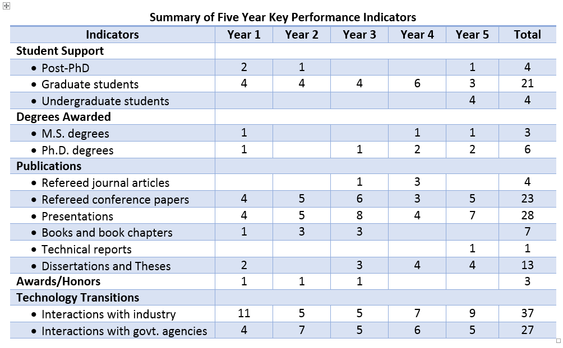
Summary of Five Year Key Performance Indicators
Note: 5th year numbers include theses and dissertations in progress

Slide 21
Summary of Five Year Accomplishments and Activities
Year 1 accomplishments
Developed cognitive models and aids;
Conducted ethnographic studies (via surveys, interviews) in both academic and industrial settings to understand challenges faced by real-world network analysts,
Conducted a literature review of information fusion and situation awareness models and developed a new framework for understanding cyber situation awareness,
Developed a situation awareness cognitive aid for NAC analysis and conducted an initial human in the loop experiment to evaluate impact on network system analysis
Developed new test-bed facilities for conducting human in the loop experiments to explore the impact of collaboration tools, data interaction aids and cognitive tools for network analysis;
Extended neoCITIES to support human in the loop studies of cyber analysts.
Created new human-computer interaction tools
Created new 3-D visualizations to support network understanding and characterization of cyber attacks
Developed sonification techniques for enhanced recognition of anomalies and identification of cyber threats.

Slide 22
Summary of Five Year Accomplishments and Activities
Year 2 Accomplishments
Conducted field research of practicing cyber-security analysts in military, government and educational contexts
Integrated data fusion methods on traditional cyber security data and rendered them in a geo-visual analytic toolkit
Implemented a simulation toolset for studying situation awareness in cyber security in the laboratory environment

Slide 23
Summary of Five Year Accomplishments and Activities
Year 3 Accomplishments
Developed a framework /process for studying SA in cyber security via a Living Laboratory framework
Collected interview/survey data from practicing analysts
Implemented a simulation toolset for cyber SA to support human in loop experiments
Conducted experiments in transactive memory, dynamic task prioritization and visualization aids
Developed new SA evaluation metrics framework

Slide 24
Summary of Five Year Accomplishments and Activities
Year 4 Accomplishments
Developed framework /process for studying SA in cyber security via a Living Laboratory framework
Collected interview/survey data from practicing analysts
Implemented a simulation toolset for cyber SA to support human in loop experiments
Conducted experiments in transactive memory, dynamic task prioritization and visualization aids
Developed new SA evaluation metrics framework

Slide 25
Summary of Five Year Accomplishments and Activities
Year 5 Accomplishments
Developed a general architecture and approach for cyber situation awareness incorporating automated reasoning and hypothesis generation with human in the loop context-based reasoning,
Developed concepts and demonstration of the use of Complex Event Processing (CEP) and Coherence Net processing for automated analysis of semantic information related to network situational data,
Acquired and utilized Tripwire Benchmark, a system for aggregating cyber-security sensor data from multiple platforms
Applied the Living Lab Framework and the process, developed previously in the study of several human cognitive aspects and how they apply to cyber security
We disseminated our findings via peer-reviewed journal articles, conference papers, edited book chapters, and presentations.

Slide 26
On-going activities
McNeese & Giacobe:
Now through Spring:
experimental data propagated; organization, setup and implementation of study
Now through Spring:
Initial Cognitive Models developed - Cyber Analyst Activities
document analysis and interviews of student-led teams in cyber exercises
Spring: Experiment to take place utilizing IST SRA 211 students as participants
Analysis and Interpretation
Final Papers related to this written
Spring: Final Cognitive Models Produced
Final Papers related to this written

