Slide 1
Gaining Cyber Situation Awareness in Enterprise Networks: A Systems Approach
Peng Liu, Xiaoyan Sun, Jun Dai
Penn State University

Slide 2
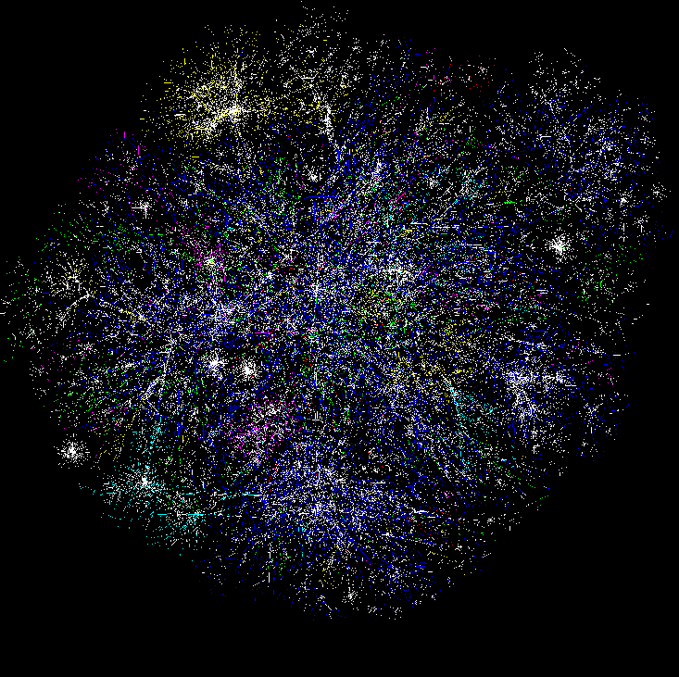

Cognitive Models & Decision Aids
Instance Based Learning Models
Simulation
Measures of SA & Shared SA
Software
Sensors, probes
Hyper Sentry
Cruiser
Information Aggregation & Fusion
Transaction Graph methods
Damage assessment
Automated
Reasoning
Tools
R-CAST
Plan-based narratives
Graphical models
Uncertainty analysis
Data Conditioning
Association & Correlation
Multi-Sensory Human Computer Interaction
Computer network
Enterprise Model
Activity Logs
IDS reports
Vulnerabilities
Real World
System Analysts
Test-bed
Computer network

Slide 3
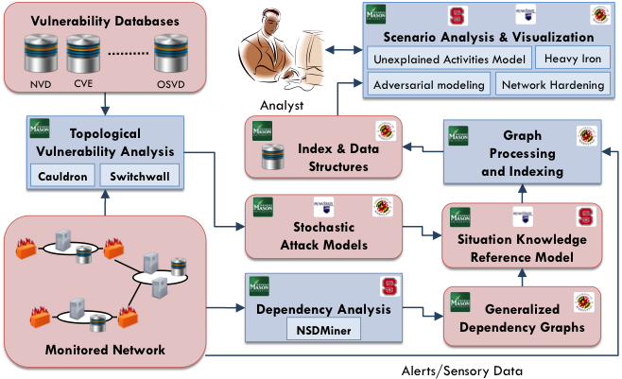
Theme A

Slide 4
Gaining Cyber SA in Enterprises
2013: operating point estimation via Bayesian modeling
2014: cross-layer BN analysis of stealth bridges in cloud
2010: BN analysis of attack graphs
Uncertainty analysis
2011: SKRM
2012: zero-day attack paths
2014: discover service dependencies via SODG
Cross-layer cyber SA

Slide 5
Part 1
Research Highlight:
2014: cross-layer BN analysis of stealth bridges in cloud

Slide 6
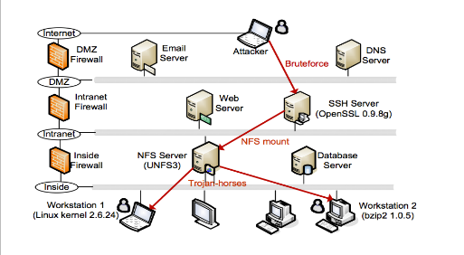
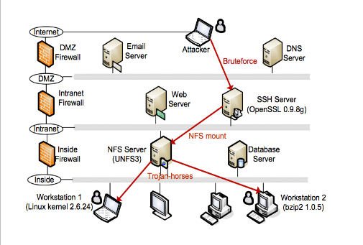
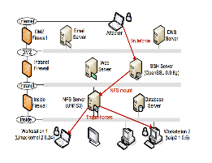
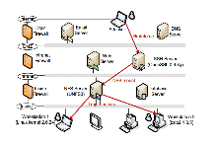
The Stealthy Bridge Problem in Cloud
Enterprise B
Enterprise A
…
C
D
Cloud

Slide 7


Cloud Features Enabling
Stealthy Bridges
Virtual Machine Image Sharing
  VMI repository
  Malicious VMI with security holes, e.g. backdoors
Virtual Machine Co-Residency
  No perfect isolation between virtual machines
  Co-residency can be leveraged, e.g. side-channel

Slide 8
Stealthy Bridges are
Inherently Unknown
Exploit unknown vulnerabilities
Cannot be easily distinguished from authorized activities
  E.g. side-channel attacks extract information by passively observing resources
  E.g. Logging into an virtual machine instance by leveraging intentionally left credentials

Slide 9
Our observation
Stealthy bridges per se are difficult to detect,
but,
the intrusion steps before and after the construction of stealthy bridges may trigger some abnormal activities.

Slide 10
Our Approach
Build a cloud-level attack graph
Model stealthy bridges as causality
Build a cross-layer Bayesian Network
Uses the evidence collected from other
intrusion steps to quantify likelihood

Slide 11
Logical Attack Graph

Slide 12
Public Cloud Structure

Slide 13
Cloud-level Attack Graph Model
VM Layer: major layer reflects the causality between vulnerabilities and exploits
VMI Layer: attacks caused by VMI sharing
Host Layer: attacks caused by VM co-residency

Slide 14
Bayesian Network
A portion of a BN with associated CPT table

Slide 15
Bayesian Network
Prediction Analysis
Pr(symptom|cause = True)
E.g. Pr(IDSalert|exploitation = True)
Diagnosis Analysis: “backward” computation
Pr(cause|symptom =True)
E.g. Pr(exploitation|IDSalert = True)
Our work: Diagnosis Analysis

Slide 16
Identify the Uncertainties
Uncertainty of stealthy bridges existence
Uncertainty of attacker action
Uncertainty of exploitation success
Uncertainty of evidence
Notes:
Attack graphs correlate vulnerabilities and potential exploits in different machines and enables determinstic reasoning. For example, if all the preconditions of an attack are satisfied, the attacker should be able to launch the attack. However, in real-time security analysis, there are a range of uncertainties associated with this attack that cannot be reflected in an attack graph. For example, has the attacker chosen to launch the attack? If he launched it, did he succeed to compromise the host? Are the Snort [22] alerts raised on this host related to the attack? Should we be more confident if we got other alerts from other hosts in this network? Such uncertainty aspects should be taken into account when performing real-time security analysis. BN is a valuable tool for capturing these uncertainties.

Slide 17
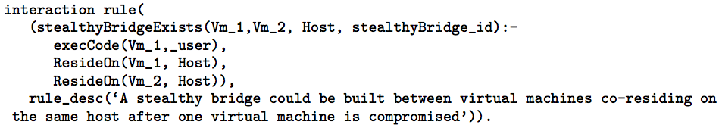
Uncertainty of Stealthy
Bridges Existence

Slide 18
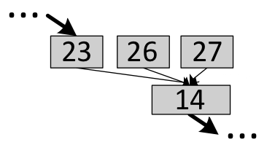
Uncertainty of Attacker Action
AAN
A portion of a BN with AAN node

Slide 19
Uncertainty of Exploitation Success
CVSS score: Access Complexity (High, Medium, Low)
0.3

Slide 20
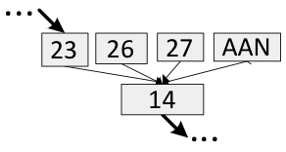
Uncertainty of Evidence
The support of evidence to an event is uncertain
Evidence from security sensors is not 100% accurate
Confidence(ECN)
Evidence

Slide 21
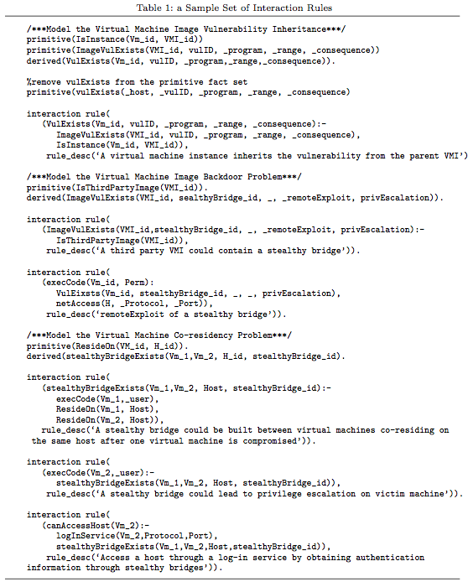
Implementation: Cloud-level Attack Graph Generation

Slide 22
Implementation: BN Construction
Remove rule nodes of attack graph
Adding new nodes
Determining prior probabilities
Constructing CPT tables

Slide 23
Experiment: Attack Scenario
Step 1
Step 7
Step 2
Step 3
Step 4
Step 5
Step 6

Slide 24
Experiment: Attack Scenario
Step 1: Publish a malicious VMI
Step 2: Exploit the instance of the malicious VMI in Enterprise A
Step 3: Exploit vulnerability on web server of B
Step 4: Leverage Co-Residency relationship of B and C’s web server, compromise the latter one
Step 5: Upload an application with trojan horse to the shared folder on C’s NFS
Step 6: Innocent user from C installs the malicious application
Step 7: Compromise other instances of the malicious VMI in Step 1

Slide 25
The Constructed Cross-Layer Bayesian Network

Slide 26
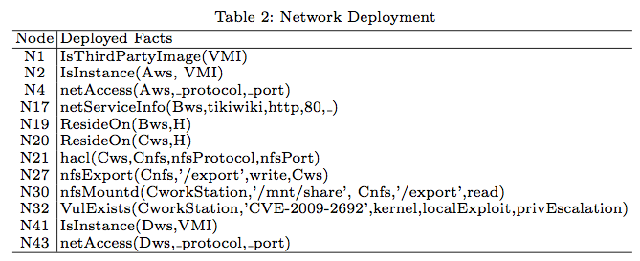
BN Input and Output
Input
  Network Deployment

Slide 27
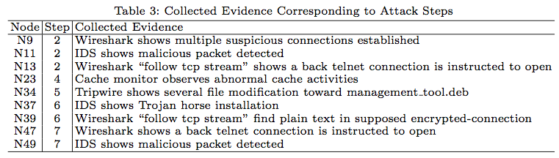
BN Input and Output
Input
  Evidence collected from Security Sensors

Slide 28
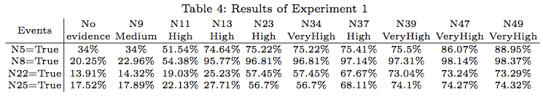
BN Input and Output
Output
  Probabilities of Interested Events (Nodes)

Slide 29
Experiment 1: Evidence is observed in the order of attack steps
N5: A stealthy bridge exists in enterprise A’s web server
N8: The attacker can execute arbitrary code on A’s web server
N22: A stealthy bridge exists in the host that B’s web server reside
N25: The attacker can execute arbitrary code on C’s web server
Notes:
N8 and N25 respectively imply that the stealthy bridges in N5 and N22 are successfully established. Table 4 shows the results of experiment 1 given supporting evidence with corresponding confidence values. The results indicate that the probability of stealthy bridge existence is initially very low, and increases as more evidence is collected. For example, P r(N 5 = T rue) increases from 34% with no evidence observed to 88.95% given all evidence presented. This means that a stealthy bridge is very likely to exist on enterprise A’s web server after enough evidence is collected.
The first stealthy bridge in our attack scenario is established in attack step 2, and the corresponding pieces of evidence are N9, N11, and N13. P r(N 8 = T rue) is 95.77% after all the evidence from step 2 is observed, but Pr(N5 = True) is only 74.64%. This means that although the BN is almost sure that A’s web server has been compromised, it doesn’t have the same confidence of attributing the exploitation to the stealthy bridge, which is caused by the unknown vulnerability inherited from a VMI. Pr(N5 = True) increases to 88.95% only after evidence N47 and N49 from other enterprise networks is observed for attack step 7. This means that if the same alerts appear in other instances of the same VMI, the VMI is very likely to contain the related unknown vulnerability.
The second stealthy bridge is established in step 4, and the corresponding evidence is N23. P r(N 22 = T rue) is 57.45% after evidence N9 to N23 is collected. The number seems to be low. However, considering the unusual difficulty of leveraging a co-residency relationship, this low probability still should be treated with great attention. After all evidence is observed, the increase of Pr(N22 = True) from 13.91% to 73.29% may require security experts to carefully scrutinize the virtual machine isolation status on the related host.

Slide 30
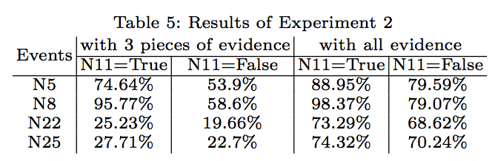
Experiment 2: Test the influence of false alerts to BN
Notes:
Experiment 2 tests the influence of false alerts to BN. In this experiment, we assume evidence N11 is a false alert generated by IDS. We perform the same analysis as in experiment 1 and compare results with it. Table 5 shows that when only 3 pieces of evidence (N9, N11, and N13) are observed, the probability of the related event is greatly affected by the false alert. For instance, P r(N 5 = T rue) is 74.64% when N11 is correct, and is 53.9% when N11 is a false alert. But P r(N 8 = T rue) is not greatly influenced by N11 because it’s not closely related to the false alert. When all evidence is input into the BN, the influence of false alerts to related events is reduced to an acceptable level. This shows that a BN can provide relatively correct answer by combining the overall evidence set.

Slide 31
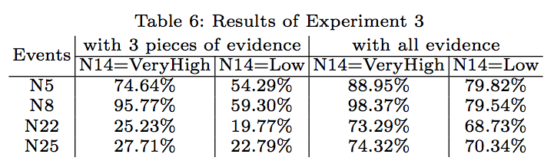
Experiment 3: Test the influence of evidence confidence value to the BN

Slide 32
Experiment 4: test the affect of evidence input order to the BN analysis
Bring forward the evidence N47 and N49 from step 7 and insert them before N23 and N37 respectively
BN can still produce reliable results in the presence of changing evidence order

Slide 33
Part 2
Research Highlight:
2014: discover service dependencies via SODG

Slide 34
The Network Service Dependency
Discovery Problem
Benefits of Service Discovery
  fault localization
  identification of mission-critical services
  prioritizing the defense options
Notes:
Let’s look at a problem called …
When a Client requests web service from Web Server, the Web Server usually depends on the Authentication Server to verify whether the Client is an authorized user. During authentication, the Authentication Server further depends on Database Server 2 to access user data about privileges. If the authentication is passed, the Web Server further relies on the Database Server 1 to access data required for the final output to the Client.
Understanding the dependencies between network services essentially benefits the enterprise cyber security defense. The discovery of network dependencies enables several capabilities that can be used to facilitate the diagnosis of the well-being of an enterprise network in the presence of network attacks or failures.

Slide 35
Overview: service dependency discovery
NSDMiner
2014: discover service dependencies via SODG
Rippler
System call centric
-- more accurate
-- less transparent
Traffic centric
-- transparent to hosts
-- less accurate
tradeoffs

Slide 36
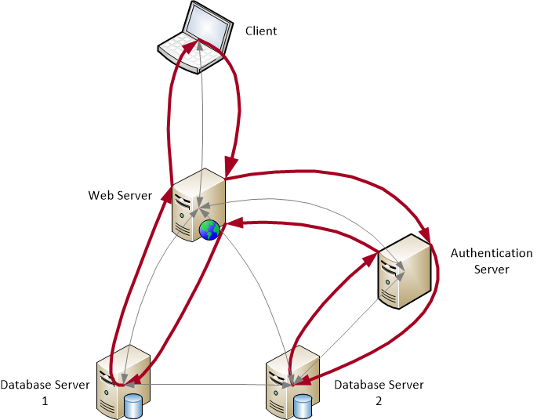
Key Insights (1) - Causal Path
“causal paths” hidden behind the interdependencies of services and applications
Notes:
These paths are caused by the communication-based interactions of relevant applications and services to provide functionality to 3rd party or the rest of the network. We call such paths as “causal paths“. Such causal paths are also observed by network-based approaches, but they leverage from the network perspective.

Slide 37
Key Insights (2):
OS Layer Causal Path
Causal paths get captured by the neutral network SODG
Notes:
Each blue dotted line is a portion of OS level service execution path, inherently a subset of the per-host SODG.
Each blue dotted line equivalently denotes a transitive dependency.

Slide 38
Example Actual OS Layer
Causal Path
t0
t1
t8
t2
t7
t6
t3
t4
t5
Notes:
An example OS Layer Causal Path resulted from the response to an upload request towards tikiwiki 1.9.5.
Two services: apache2 and mysqld

Slide 39
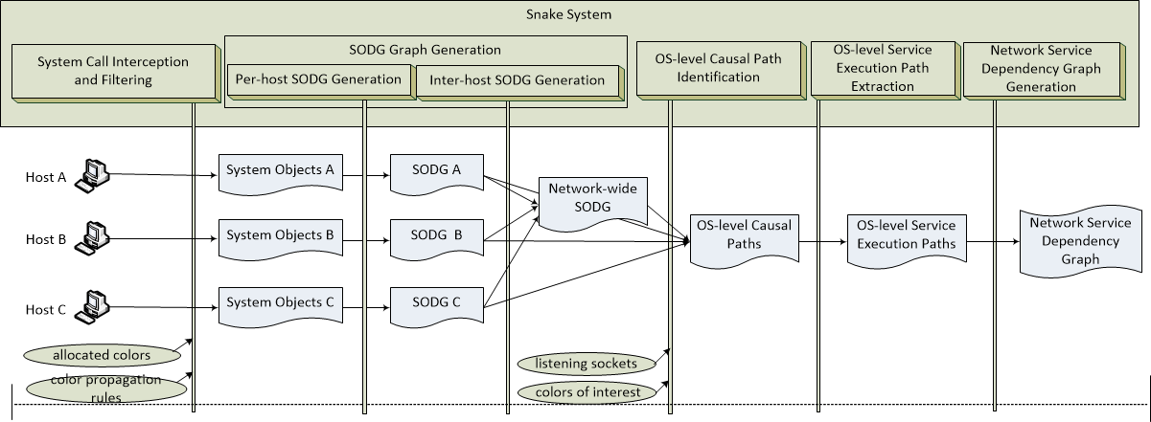
The Snake System
System call interception
SODG Representation/Generation
OS level Causal Path Identification
OS level Service Execution Path Extraction
Network Service Dependency Graph Generation
Notes:
In addition, Snake also performs …
OS-level Causal Path Identification. With some sockets with particular Ips/port numbers, and colors of interest, specified to trigger the forward dependency tracking across the network, request-specific SODGs can be identified. We further check if it has above-defined color propagation pattern. If yes, the request-specific SODG is an OS Layer causal path.
OS-level Service Execution Path Extraction. When an OS-level causal path is successfully identified, the corresponding service execution paths can be extracted and stored as service profiles, which we call as request graphs.
Network Service Dependency Graph Generation. All the OS-level causal paths can be merged, when put together to become a directed graph, which is the network service dependency graph. Basically, this graph will be made up of socket communication edges, concatenating OS-level service execution paths. An OS-level network service dependency graph will be a subset of the network-wide SODG.
Our next question is how to find such causal paths?
Like Patrol, we design a system. And this figure shows the implementation architecture.
As you can see, like Patrol, Snake also performs system call interception, SODG representation and generation. But, beyond what Patrol does, Snake also does extra things, like color allocation and propagation, which will be introduced specifically later.

Slide 40
Evaluation
Case study 1
… …
Case study 14

Slide 41
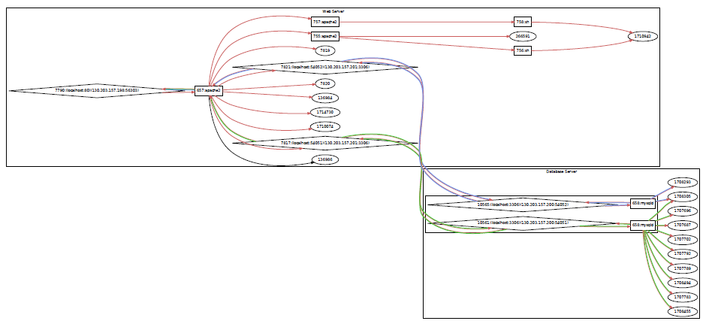
Case Study: Avactis 2.1.3
Notes:
Avactis 2.1.3 in response to a client request of registering an account.

Slide 42
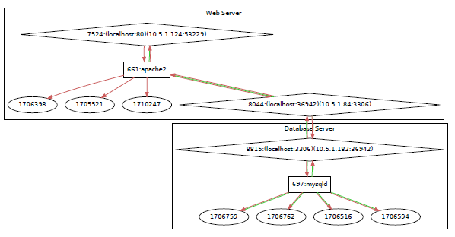
Case study: add a user
in tikiwiki 1.9.5
/var/log/apache/access.log
/var/log/apache/error.log
/var/lib/mysql/tiki/users_usergroups.MYD
/var/lib/mysql/tiki/tiki_pageviews.MYD
/var/lib/mysql/tiki/users_users.MYD
/var/lib/mysql/tiki/tiki_sessions.MYD
Notes:
In addition to discovering service dependencies, our evaluations show that Snake can also be used to profile the service dependencies.
For example, …

Slide 43

Q & A
Thank you.

Slide 44
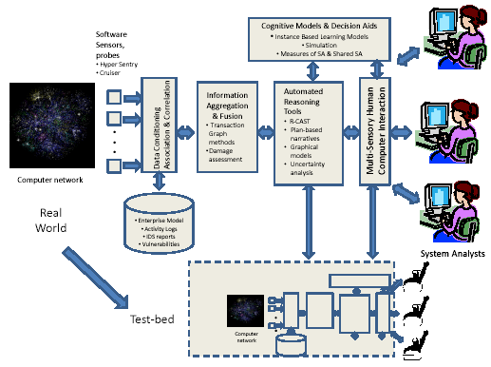
ARO MURI: Computer-aided Human-Centric Cyber Situation Awareness: SKRM Inspired Cyber SA Analytics
Penn State University (Peng Liu)
Tel. 814-863-0641, E-Mail: pliu@ist.psu.edu
    Objectives: Improve Cyber SA through:
    A Situation Knowledge Reference Model (SKRM)
    A systematic framework for uncertainty management
    Cross-knowledge-abstraction-layer SA analytics
    Game theoretic SA analytics
DoD Benefit:
Innovative SA analytics lead to improved capabilities in gaining cyber SA.
Uncertainty analysis
Scientific/Technical Approach
Leverage knowledge of “us”
Cross-abstraction-layer situation knowledge
integration
Network-wide system all dependency analysis
Probabilistic graphic models
Game theoretic analysis
Accomplishments
A suite of SKRM inspired SA analytics
A Bayesian Networks approach to uncertainty
A method to identify zero-day attack paths
A signaling game approach to analyze cyber
attack-defense dynamics
Challenges
Systematic evaluation & validation

