Slide 1
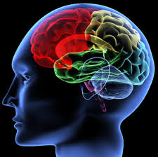
Non-intrusive Capturing and Analysis of the Cognitive Process of Network Security Analyst
Annual Review
ARO MURI on Computer-aided Human-centric Cyber SA
November 18, 2014
Pennsylvania State University
John Yen
Chen Zhong
Gaoyao Xiao
Peng Liu
Army Research Laboratory
Robert Erbacher
Steve Hutchinson
Renee Etoty
Hasan Cam
Christopher Garneau
William Glodek

Slide 2
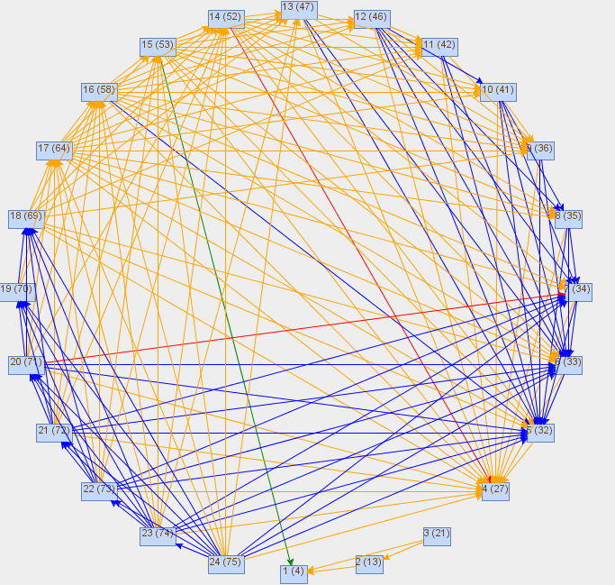
Computer-Aided Human Centric Cyber
Situation Awareness
J. Yen, C. Zhong, G. Xiao, P. Liu,
R. Erbacher, S. Hutchinson, R. Etoty, H. Cam, C. Garneau, W. Glodek
Objectives:
Understand the cognitive process of cyber analysts
Non-intrusive capture of the cognitive process of cyber analysts
Automated analysis of the cognitive traces
Design training procedure based on an improved understanding about the cognitive process
Design cognitive aids based on improved understanding about the cognitive process of analysts.
Scientific/Technical Approach
  Developed a general framework for capturing cognitive traces based on Action-Observation-Hypothesis (AOH) model.
  Extended Analytical Reasoning Support Tool for Cyber Analysis (ARSCA) to integrate with incident reports.
  Designed experiments for studying the potential benefits of linking incident reports to relevant cognitive traces.
  Introduced a novel Network Representation of filtering activities for extracting data triage behaviors of analysts.
  Developed an algorithm for automating the construction of Filtering Networks from cognitive traces.
Accomplishments
Conducted additional experiments, in collaboration with Army Research Lab, involving CNDSP analysts
Initial trace analysis suggest relationship between characteristics of traces and performance
Initial analysis of filtering networks indicate different data triage strategies among analysts.
Opportunities
Technology Transition: Support shift transition among analysts
Technology Transition: ARSCA-based training procedure
Investigate the difference strategies between experts and novice
Investigate using aggregated analyst experiences to support analytical reasoning process.

Slide 3
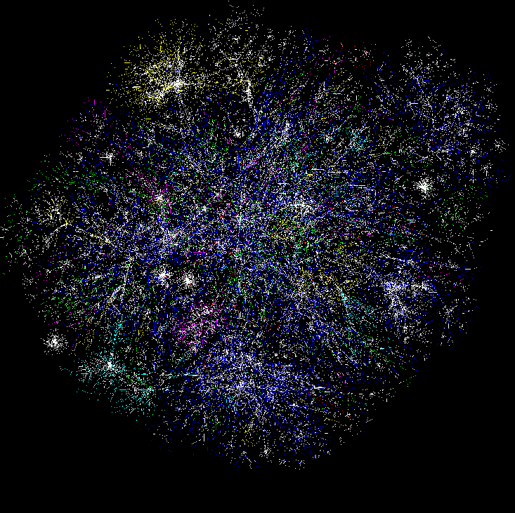

Cognitive Models & Decision Aids
Instance Based Learning Models
Simulation
Measures of SA & Shared SA
Software
Sensors, probes
Hyper Sentry
Cruiser
Information Aggregation & Fusion
Transaction Graph methods
Damage assessment
Automated
Reasoning
Tools
R-CAST
Plan-based narratives
Graphical models
Uncertainty analysis
Data Conditioning
Association & Correlation
Multi-Sensory Human Computer Interaction
Computer network
Enterprise Model
Activity Logs
IDS reports
Vulnerabilities
Real World
System Analysts
Test-bed
Computer network

Slide 4
Year 5 Accomplishments at a Glance
Publications:
C. Zhong, D. S. Kirubakaran, J. Yen, P. Liu, S. Hutchinson, H. Cam, “How to Use Experience in Cyber Analysis: An Analytical Reasoning Support System,” in Proc. 2013 IEEE Conference on ISI, 2013.
C. Zhong, M. Zhao, G. Xiao, J. Xu, “Agile Cyber Analysis: Leveraging Visualization as Functions in Collaborative Visual Analytics,” in Proceedings of IEEE VAST Challenge 2013 Workshop of IEEE 2013 Visualization Conference.
C. Zhong, D. Samuel, J. Yen, P. Liu, R. Erbacher, S. Hutchinson, R. Etoty, H. Cam, and W. Glodek, “RankAOH: Context-driven Similarity-based Retrieval of Experiences in Cyber Analysis,” to appear in Proceedings of IEEE CogSIMA Conference, 2014.
Yen, R. Erbacher, C. Zhong, and P. Liu, “Cognitive Process”, in Cyber Situation Awareness, A. Kott, C. Wang, R. Erbacher (ed), in press.
Technology Transfer:
Deep collaborations with ARL researchers
Brought the ARSCA toolkit to Adelphi site
  20 ARL security analysts participated
  Weekly teleconferences
  Joint work on a series of papers
Shift Transition
ARSCA-based Training Procedure
Integration of ARSCA and CAULDRON through Petri Nets
Awards:
Chen Zhong: Grace Hopper Celebration of Women in Computing Scholarship.
Chen Zhong, Honorable Mention, VAST Challenge 2013, Mini-Challenge 3 (Visual Analytic for Cyber SA)
Students:
Chen Zhong, PhD
Gaoyao Xiao, PhD
Tools:
ARSCA

Slide 5



Cyber SA Depends on Human Analysts
Attacks
Network
Depicted
Situation
Compare
Data
Sources
(feeds)
Ground
Truth
(estimates)
Job
Performance

Slide 6
Scientific Objectives (MURI Overview Liu)
Develop a deep understanding on:
  Why the job performance between expert and rookie analysts is so different? How to bridge the job performance gap?
  Why many tools cannot effectively improve job performance?
  What models, tools and analytics are needed to effectively boost job performance?
Develop a new paradigm of cyber SA system design, implementation, and evaluation.
Notes:
6

Slide 7
Scientific Barriers (MURI Overview, Liu)
Massive amounts of sensed info vs. poorly used by analysts
Silicon-speed info sensing vs. neuron-speed human cognition
Stovepiped sensing vs. the need for "big picture awareness"
Knowledge of “us”
Lack of ground-truth vs. the need for scientifically sound models
Unknown adversary intent vs. publicly-known vulnerability categories
Notes:
7

Slide 8
Potential Scientific Advances (MURI Overview Liu)
Understand the nature of human analysts’ cyber SA cognition and decision making.
Let this nature inspire innovative designs of SA systems.
Break both vertical stovepipes (between compartments) and horizontal stovepipes (between abstraction layers).
“Stitched together” awareness enables advanced mission assurance analytics (e.g., asset map, damage, impact, mitigation, recovery).
Discover blind spot situation knowledge.
Make adversary intent an inherent part of SA analytics.
Notes:
8

Slide 9
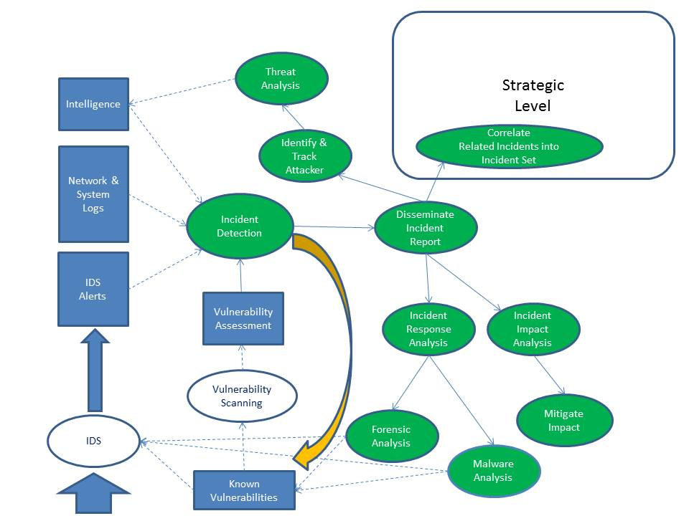
Breaking Down Stovepipes across Different Cognitive Tasks by Analysts

Slide 10
Scientific Principles (MURI Overview, Liu)
Cybersecurity research shows a new trend: moving from qualitative to quantitative science; from data-insufficient science to data-abundant science.
  The availability of sea of sensed information opens up fascinating opportunities to understand both mission and adversary activity through modeling and analytics. This will require creative mission-aware analysis of heterogeneous data with cross-compartment and cross-abstraction-layer dependencies in the presence of significant uncertainty and untrustworthiness.
SA tools should incorporate human cognition and decision making characteristics at the design phase.
Notes:
10

Slide 11
Network Analysis, Temporal Causality, Argumentation Systems
Q1: What are the differences between expert analysts and rookies?
Computer and
Information Science
of Cyber SA
Q2: What analytics and tools are needed to effectively boost job performance?
Q3: How to develop the better tools?
Cognitive
Trace
Cognitive Science
of Cyber SA
Decision Making
and Learning Science
of Cyber SA
Previous CTAs of Network Security Analysts
Sense Making Theory

Slide 12
Technical Approach (MURI Overview, Liu)
Draw inspirations from cognitive task analysis, simulations, modeling of analysts’ decision making, and human subject research findings.
Use these inspirations to develop a new paradigm of computer-aided cyber SA
  Develop new analytics and better tools
  Let tools and analysts work in concert
  “Green the desert” between the sensor side and the human side
Develop an end-to-end, holistic solution:
  In contrast, prior work treated the three vertices of the “triangle” as disjoint research areas
Notes:
12

Slide 13
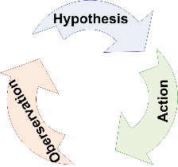
A New Paradigm: A Non-intrusive Capturing of the Cognitive Process of Analysts
Inspired by the challenges of previous CTA’s
  CTA’s are costly
  Difficult to obtain the fine-grained cognitive processes of analysts
Informed by Sense Making Theory
  Provides domain-agonistic constructs: Actions, Observations, Hypotheses (AOH)
Non-intrusive capture of AOH-based cognitive traces of analysts.

Slide 14
AOH-based Cognitive Trace

Slide 15
A Framework for Capturing AOH-based Cognitive Trace

Slide 16
The Architecture of Cognitive Trace Capture Tool (ARSCA)

Slide 17
The Interface of ARSCA

Slide 18
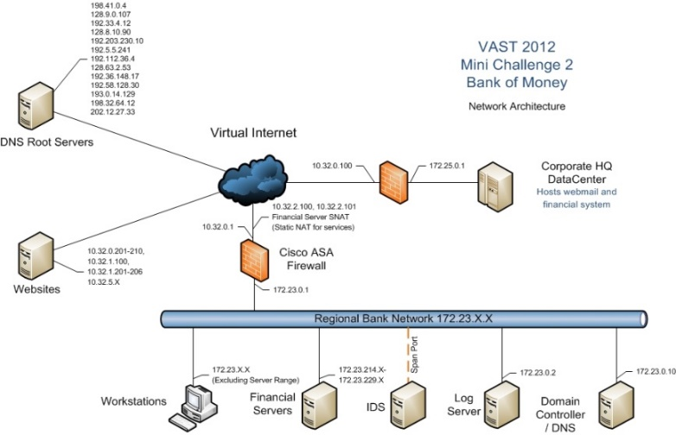
The Network Topology of VAST 2012

Slide 19
The AOH Objects and Their Relationships in An Analyst’s Cognitive Trace

Slide 20
An Example of Trace File
Action
Observations
Observations
Hypothesis

Slide 21
Characteristics of Cognitive Traces

Slide 22
The Completion Time and the Number of A-O-H Objects Grouped by Performance Scores

Slide 23
Types and Numbers of Operations Across Ten Analysts

Slide 24
Width and Depth of Hypothesis Trees

Slide 25
Number of Operations vs Performance

Slide 26
The proposed cyber SA framework
(MURI Overview, Liu)
It is a ‘coin’ with two sides:
The life-cycle side
  Shows the SA tasks in each stage of cyber SA
  Vision pushes us to “think out-of-the-box” in performing these tasks
The computer-aided cognition side
  Build the right cognition models
  Build cognition-friendly SA tools
A link of the two sides is the analysis of cognitive trace
  Traces are collected from stages in the life-cycle side
  Analysis results can be used to build computer-aided cognition models/supports.
Notes:
26

Slide 27
Principles of Cognitive Trace Analysis
Scalability for Big Data: Enables efficient analysis of a large number of cognitive traces.
Domain-agonistic analysis methodology: Aim to extract patterns of analyst behaviors that have broad applicability.
  Data Triage Behaviors
Leverages qualitative observations from traces and quantitative network analysis methods.

Slide 28
Three Filtering Activities Captured in Trace
Filter for certain condition on a data source
Select a set of observations with certain common conditions
Search for certain condition on a data source

Slide 29
Filtering for a Condition (FILTER)
FILTER
<Item Timestamp="08/08 16:15:50">
FILTER(
Select * from Task2IDS where DestPort!= '80',
Task2IDS
)
</Item>

Slide 30
Selecting Observations with a Common Condition (SELECT+LINK)
SELECT+LINK is a type of Filtering
<Item Timestamp="08/08 16:12:32">
SELECT (
FIREWALL-[4/5/2012 10:19:00 PM]-[Deny]-[TCP](172.23.235.57, 10.32.5.51),
FIREWALL-[4/5/2012 10:19:00 PM]-[Deny]-[TCP](172.23.235.57, 10.32.5.51),
FIREWALL-[4/5/2012 10:19:00 PM]-[Deny]-[TCP](172.23.235.57, 10.32.5.51)
)
  </Item>
  <Item Timestamp="08/08 16:12:52">
  LINK (
  Same Dest Port: 21,
  FIREWALL-[4/5/2012 10:19:00 PM]-[Deny]-[TCP](172.23.235.57, 10.32.5.51)
  FIREWALL-[4/5/2012 10:19:00 PM]-[Deny]-[TCP](172.23.235.57, 10.32.5.51)
  FIREWALL-[4/5/2012 10:19:00 PM]-[Deny]-[TCP](172.23.235.57, 10.32.5.51)
  )
  </Item>
Notes:
Whether the select creates hypothesis (select could be: filtering or identifying something noteworthy)
First do subgraph analysis
Then we make the select as a special node and then subgraph analysis to compare the results

Slide 31
Search for a Condition
SEARCH is a type of Filtering
<Item Timestamp="08/07 09:55:10">
  SEARCH(
  Firewall_Logs,
  172.23.2
  )
  </Item>

Slide 32
Definition of Filtering Activities
F(d, c, t) is a filtering activity, where d is a data source, c is a filtering condition, and t is the time.
Simple conditions: R(field, value), where R is a logic operator (>, >=, <, <=, =, <>), field is defined in data source.
Complex Condition: a set of simple conditions combined by AND and OR.

Slide 33
Complementary Relationship Between Filters
F1: Filter for DestPort = 80
Alerts
F2: Filter for DestPort <> 80
The results of the two filters have no overlap.

Slide 34
Subsumption Relationship Between Filters
Alerts
F2: Filter Alerts for DestPort <> 80
F3: Filter Alerts for DestPort < 80 AND DestPort = 6667
F3 is-subsumed-by F2: The filtering result of F3 is always a subset of the filtering result of F2.

Slide 35
Corresponding Relationship Between Filters
F1: Filter Alerts for DestPort = 6667
F2: Filter Firewall Logs for DestPort = 6667
Alerts
Firewall Logs
F1 corresponds-to F2: The filtering conditions for F1 and F2 are equivalent, though applying to different data sources.

Slide 36
Computing Relationships Between Filtering Activities
Convert each filtering activities into a standard form (F1, I11, I12, …) AND (F2, I21, I22, …) …
Where F1, F2 are fields of a data source
I11, I12, … are intervals for F1
I21, I22, … are intervals for F2
Comparing two filtering activity by
  Comparing intervals associated with the same field.

Slide 37
The Filtering Network of An Analyst
Nodes (Filtering)
Ordered by time around the circle.
Edges
(Relationship from a filtering to its preceding activities)
Orange: Complementary
Red: Equal to
Blue: Subsumed by
Green: Corresponding to
Notes:
Generate graph for novice
Com: they are continuously narrowing the data, not doing duplicated stuff
Link: change data sources,

Slide 38
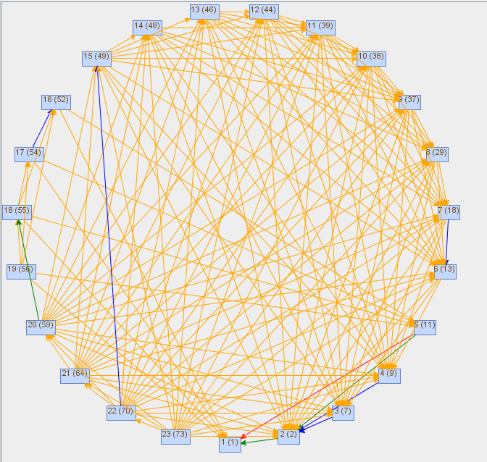
Filtering Network of Another Analysts
Both analysts have high performance score.
Their filtering networks reveal different data triage strategies.

Slide 39
Technology Transfer (1)
Partner:
Contact:
Focus:
Status:
ARL
Rob Erbacher, Bill Glodek, Steve Hutchinson, Hasan Cam, Renee Etoty, Chris Garneau
Collect the cognitive traces of CNDSP analysts
-- Over two years
-- Over 30 traces collected
-- ARSCA tool is being used at ARL
-- Weekly teleconferences
-- In discussion: directly operate on ARL datasets
Notes:
39

Slide 40
Technology Transfer (2)
Partner:
Contact:
Focus:
Status:
ARL
Rob Erbacher, Bill Glodek, Steve Hutchinson
Shift transitions
-- A user study on shift transition fully designed
-- IRB developed and approved
-- ARSCA-shift-transition tool developed
-- Shipped to ARL site and tested there
-- Pilot study is being scheduled
Notes:
40

Slide 41
Leveraging the Trace of Analysts for Supporting Shift Transitions
An analysts in one shift may generate an incident report that needs to be further investigated (due to a lack of observations or a lack of time).
These incident reports (labeled Category 8) need to be completed by analysts of the next shift.
An analyst in one shift may detect and report an attack.
The analyst in the second shift may detect and report another attack, which can be linked to the attack detected by the previous shift (for a multi-step attack).
An analyst in one shift may detect and report a malware.
The analyst in the second shift can detect the malware faster. by leveraging the trace of the analyst of the previous shift.

Slide 42
Incident Reports Linked to Relevant Hypotheses and Observations

Slide 43
FY 2015 Plan
Analyze the filtering networks of all traces gathered
Technology transition, in collaboration with ARL, a shift-transition study
  Does the traces generated by analysts of a shift help analysts in the next shift?
Technology transition, in collaboration with ARL, a pilot study about ARSCA-based training procedure (with Erbacher, Hutchinson, Gonzalez)
Technology transition, in collaboration with ARL, an integration of ARSCA and CAULDRON (with Jajodia, Albanese, Cam) through Petri Nets.
Notes:
43

Slide 44
Technology Transfer (3)
Partner:
Contact:
Focus:
Status:
ARL
Hasan Cam
Enhance the ARL petri-net model for impact assessment
-- feed outputs of CAULDRON and ARSCA into petri-net
-- Proposal developed and approved
-- Just started (Nov 2014)
-- First experiment sketched
Notes:
44

Slide 45
Technology Transfer (4)
Partner:
Contact:
Focus:
Status:
ARL
Rob Erbacher, Christopher Garneau
(a) Investigate how the current practice of training professional CNDSP security analysts can be enhanced by leveraging ARSCA.
(b) A pilot study for investigating the feasibility of using ARSCA-facilitated training procedures for supporting the
training of analysts about their analytical reasoning process.
-- Proposal developed and approved
-- Just started (Nov 2014)
-- Weekly teleconferences
Notes:
45

Slide 46
Technology Transfer (5)
Partner:
Contact:
Focus:
Status:
ARL
Christopher Garneau, Rob Erbacher
Human subject experiments on the cognitive effects of different (visualization) views
-- IRB developed and approved
-- User study fully designed
-- Pilot study being scheduled at Penn State
Notes:
46

Slide 47

Q & A
Thank you.

