Slide 1
Ensemble Visualization for Cyber Situation Awareness of Network Security Data
Lihua Hao¹, Christopher G. Healey¹, Steve E. Hutchinson²
¹North Carolina State University, ²U.S. Army Research Laboratory
lhao2@ncsu.edu
ARO MURI Meeting, UCSB, Nov. 18, 2014

Slide 2
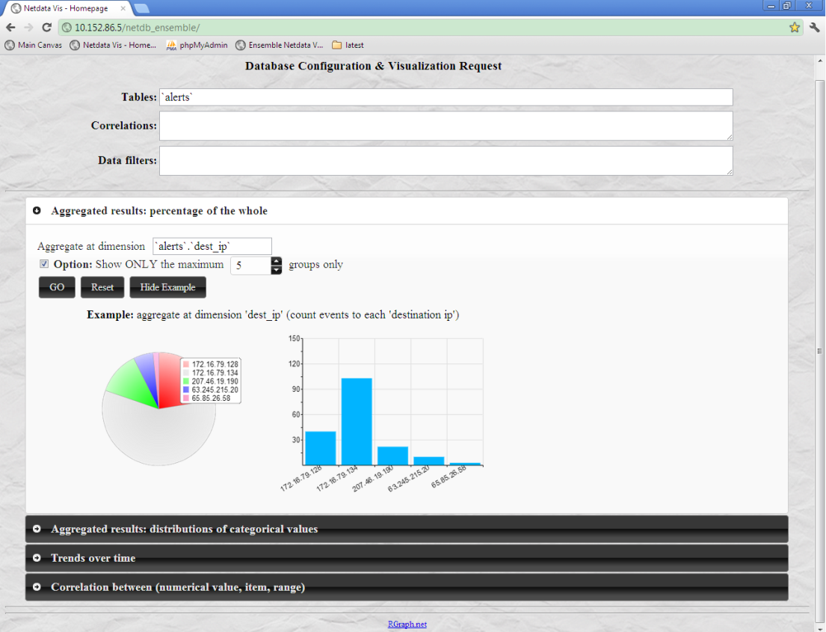
Our Last Presentation
Design Constraints
Mental models - Working environment
Configurability - Accessibility
Scalability - Integration
Flexible web-based visualization
Data management (MySQL & PHP)
Web-based visualization
Analysts driven 2D charts
Interactive visualization
Correlated views (track requests)
Practicability of ensemble visualization in network security domain
Notes:
A quick overview of topics covered in our last presentation
Avoid pre-defined presentations; steep learning curve
multiple data sources; augment analysts’ current problem-solving strategies with useful support

Slide 3
Outline
Ensemble & network ensemble
Ensemble visualization is a very active research area
How is it related to network security data analysis
How to define a network ensemble
How to perform ensemble analysis
Network ensemble visualization - examples
Alert ensemble visualization
NetFlow ensemble visualization
Summarization
Notes:
Ensemble visualization is a very active research area in visualization.
If it can be applied to network data, any advanced in ensemble viz would have potential impact on cyber security analysis and visualization

Slide 4
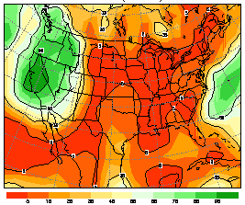
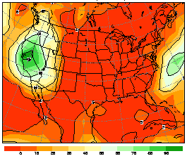
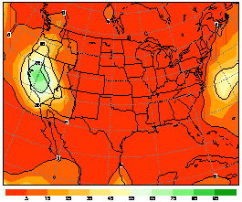
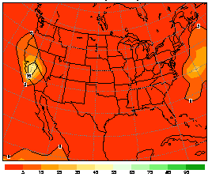
Ensemble Data
A collection of related datasets (members), from runs of a simulation or an experiment, with slightly varying parameters or initial conditions
Large, time-varying, multi-dimensional, multi-attribute
Exploration of inter-member relationships
Discover correlated members and/or separate subsets of data that have out of ordinary behavior
Member 1
Member 2
Member 3
Member 4
Time
(Hour)
… …
…
…
…
…
Precipitation probability forecast ensemble
Notes:
Originated in scientific visualization.
Weather model -> set up parameter -> run simulation -> generate a member
Inter-member relationships -> deeper understanding about the weather model
(Simulate complex system, mitigate uncertainty, handle unknowns in initial conditions, investigate sensitivity to parameters)

Slide 5
Extension to Network Ensemble
Motivation of network ensemble analysis
Scalability is also critical
Discovery of related or out of ordinary network traffics (members)
Time dependent alert/NetFlow data
Opportunity to apply ongoing research from ensembles
How is a network security dataset an ensemble?
Define a member, e.g., network traffic to a destination
Define correlated time window and/or time-steps, e.g., hour / day
Define a data value, e,g, number of alerts per time-step
Are ensemble techniques useful in network security domain?
Determine the value added to this analysis
Notes:
Attach a note saying “No through road, please turn another way”
Be the pioneer that bursts the door and welcome the army of ensemble research into the word of network security awareness.

Slide 6
Two Stages of Ensemble Analysis
Overview of inter-member relationships
Structure the members into clusters based on their similarities
Visualize the cluster hierarchy of a level of detail clustering as a tree
Visualizing member sets
K=1
Cluster 7
K=2
Cluster 6
Cluster 5
K=3
Cluster 1
Cluster 2
Cluster 5
K=4
Cluster 1
Cluster 2
Cluster 3
Cluster 4
Notes:
How do we perform ensemble analysis in scientific domain
2 stages: high level overview vs. detailed visualization & connection btw the 2 stages
Example: bottom up clustering

Slide 7
Network Ensemble Analysis - Procedure
Define member, time window and data value (configurability)
Determine a methodology to compare members, i.e., a measure of inter-member relationships
Perform a level-of-detail clustering, resulted as a cluster tree visualization (scalability)
Analysts choose members to visualize from the cluster tree (configurability)
Visualize selected member sets using web-based 2D charts visualization (work environment, accessibility)
Notes:
We will explain this procedure in details with two examples

Slide 8
Example: Alert Ensemble Visualization
Member
Option 1: a combination of table columns (e.g., destination IP, destination port)
Option 2: a number of equal length time windows (e.g., per day)
Inter-member Relationship
Similarity of changes in numbers of alerts over time
Example
Alerts from source IP = 64.120.250.242
Member: destination IP, destination port
Notes:
How do we perform network ensemble analysis with the data collected from trap server?

Slide 9
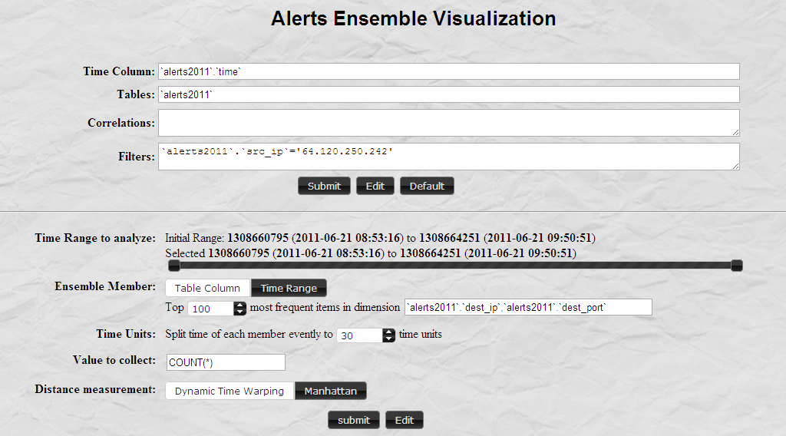
Define an Alert Ensemble
Extract alerts from
source IP 64.120.250.242
Time Range
Ensemble Member
Data Value
Time-step
Member Comparison

Slide 10
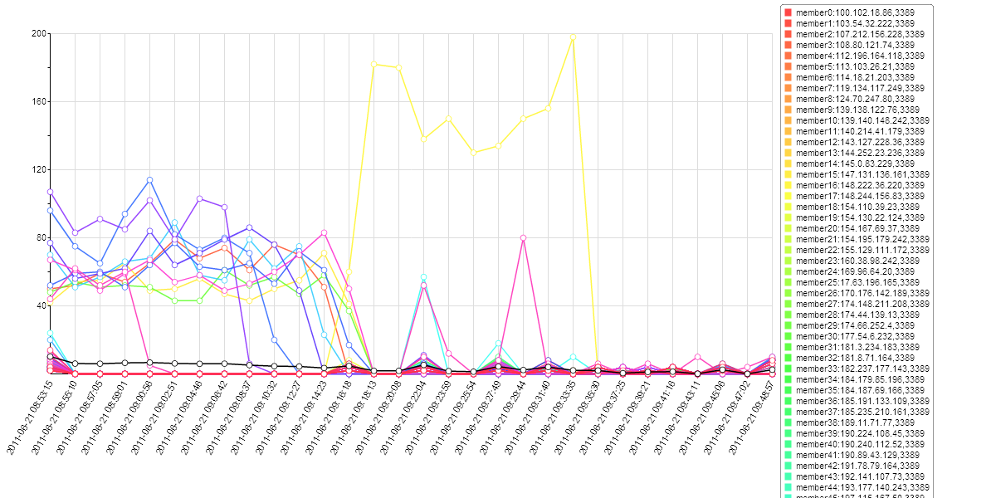
Source IP 64.120.250.242 – 100 members
Number of alerts
Time
Notes:
Number of alerts in a sequence of time slices sent to each destination ( ip, port )

Slide 11
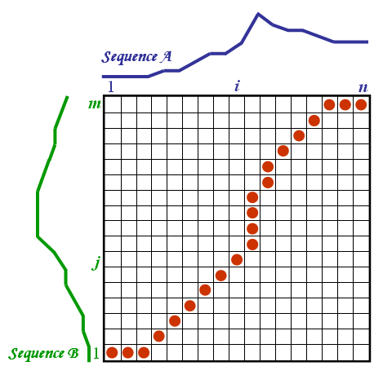
Dynamic Time Warping
Find the optimal non-linear alignment
A warping path that minimizes distances between two sequences
Allow shifting & distortion over time
Sequences do not have to be equal length
Notes:
The min dis btw first i items in seq A & first j items in seq B
= dis btw i-th item in A and j-th item in B + (plus) min dis of the optimal warping paths one step ahead

Slide 12
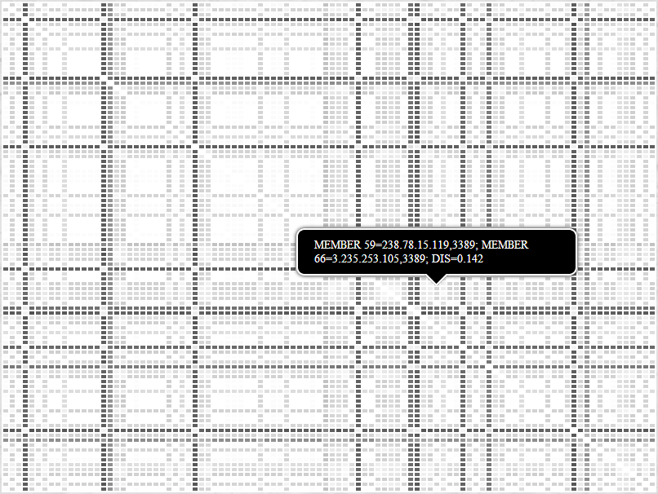
100 X 100 Dissimilarity Matrix
A large number of white or light gray cells indicate most alert traffics are similar.
A small portion of dark cells indicate members (destinations) with out of ordinary traffics.

Slide 13
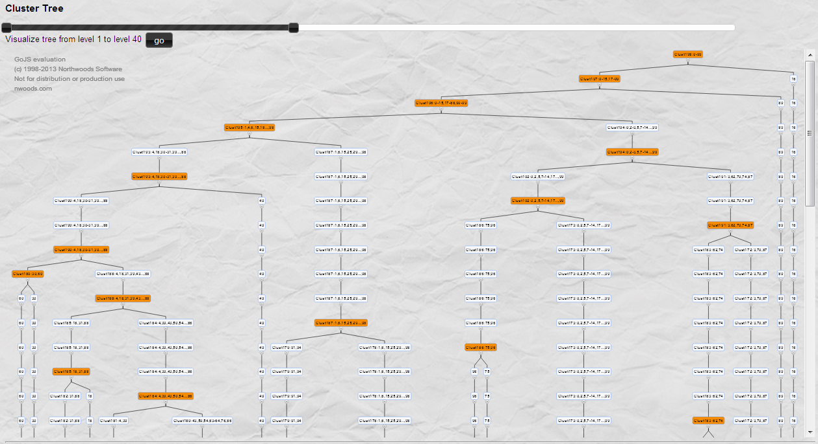
Cluster Tree Visualization
Out of
Ordinary
Member
Notes:
Out of ordinary traffic: a member that is not combined into any cluster until it goes very close to the root.

Slide 14
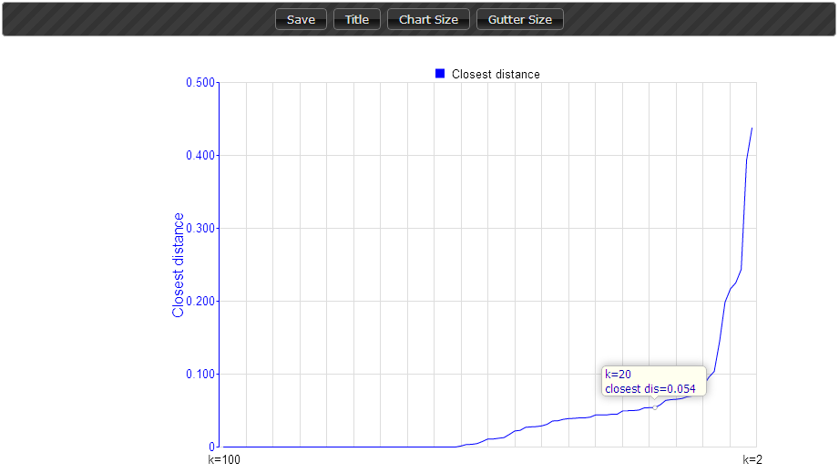
Closest Cluster Distance In Each Iteration
Out of ordinary members may exist
Range to select an optimal k value
(number of clusters)
A group of identical members
Pattern discovered
Notes:
The cluster tree is built by recursively combine two closest clusters at each level

Slide 15
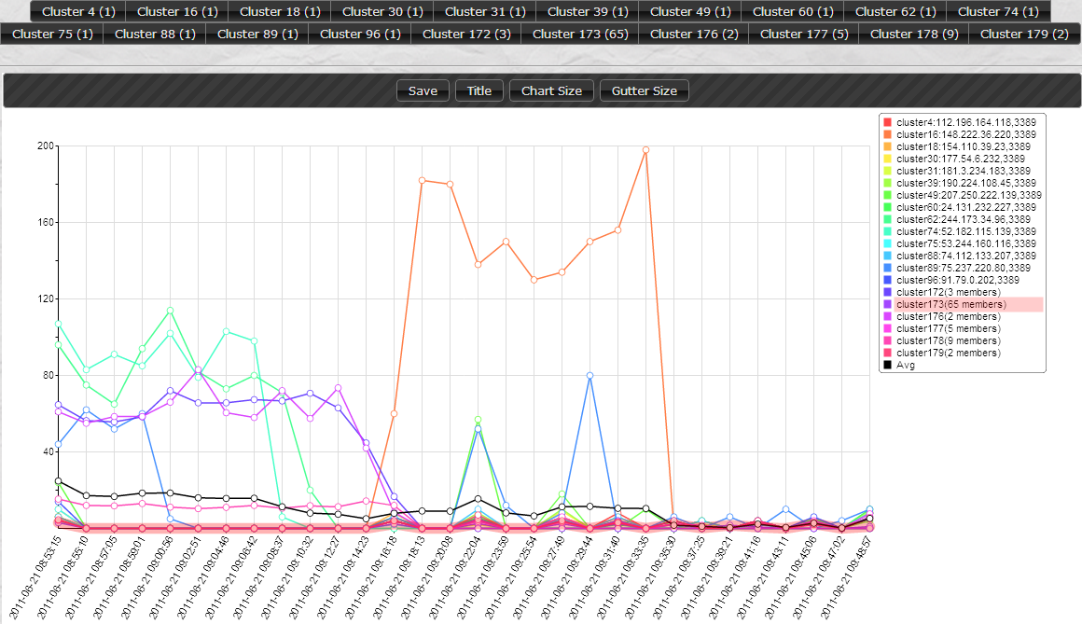
Clusters Visualization k=20
Cluster 173
(65 Members)
Highlighted
Does the 65
members share
a pattern
(similar traffic)?
Average Number of alerts

Slide 16
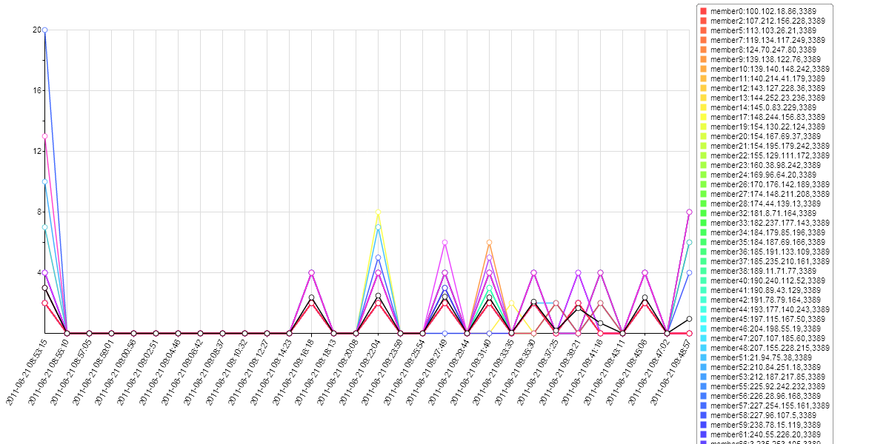
Cluster 173 (65 members)
Number of alerts

Slide 17
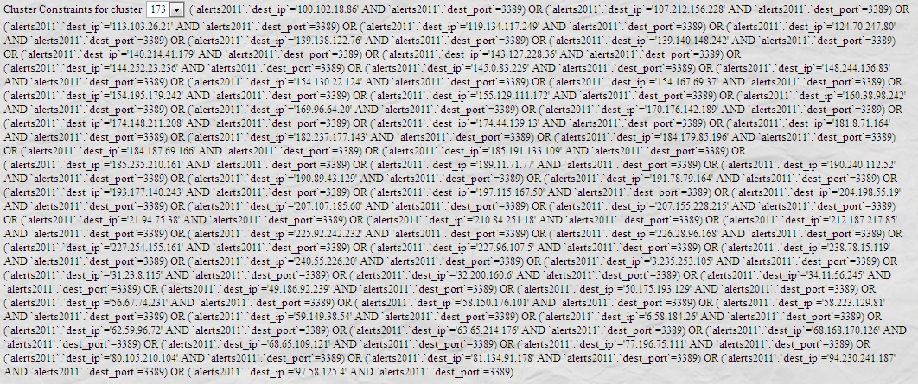
Constrains For Cluster 173
Extract the member cluster for a follow on ensemble analysis or general visual request
Notes:
System generate MySQL constraints to extract alert traffics specified by a member cluster
For a follow-on visualization request

Slide 18
Follow-on: NetFlow Ensemble
Member
A sequence of NetFlows over time
NetFlow Similarity Measure
Time duration - Density of alerts - Distribution of alerts (intervals)
Inter-Member Relationship
Similarity between time-series of NetFlows
Example
NetFlows related with cluster 173 from the alerts ensemble
Member: destination IP, destination port
Notes:
Import netflow data to further analyze traffics correlated to the 65 member cluster in the alert ensemble

Slide 19
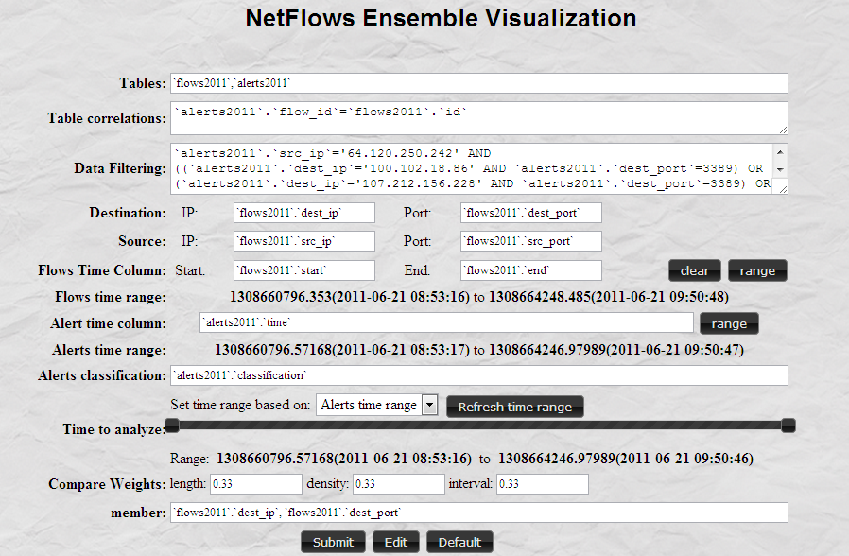
Define a NetFlow Ensemble
Extract Traffics Related
with the 65 Member Cluster in the Alert Ensemble
Time Range
Weights of Measurements of NetFlow Dissimilarity
Ensemble Member

Slide 20
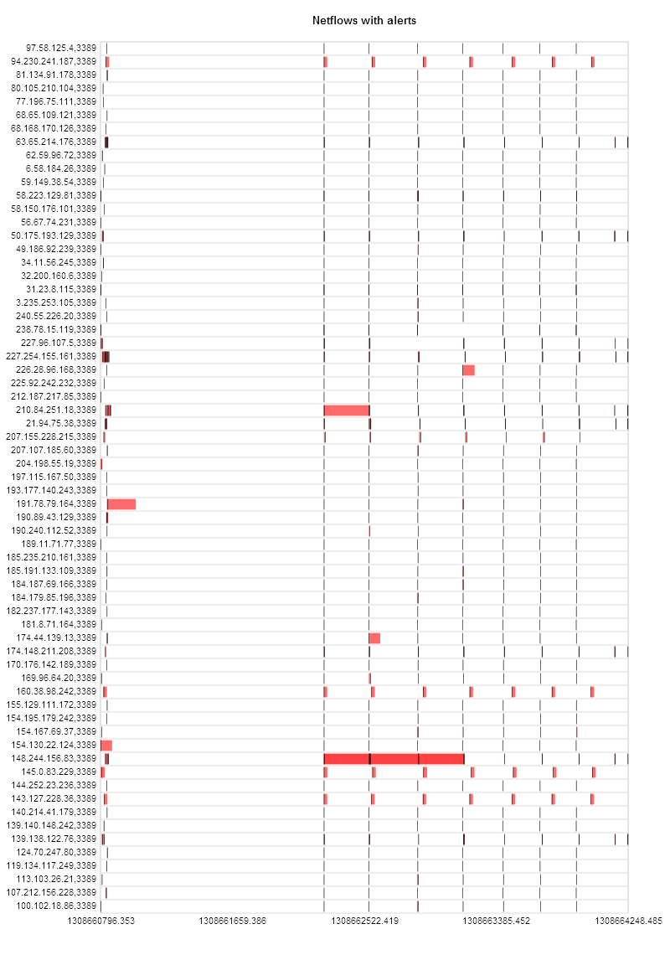
All Members – 65 Members
The traffic looks similar
Remember:
The members are within the alert member cluster
Can we further differen-tiate them by comparing their NetFlow traffics?
destination IP, port
time

Slide 21
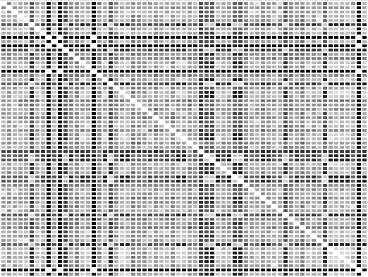
65 X 65 Dissimilarity Matrix
The dissimilarity matrix speaks:
The NetFlow traffics are not as similar as they look like.
Notes:
Further differentiate the traffic to different destinations

Slide 22
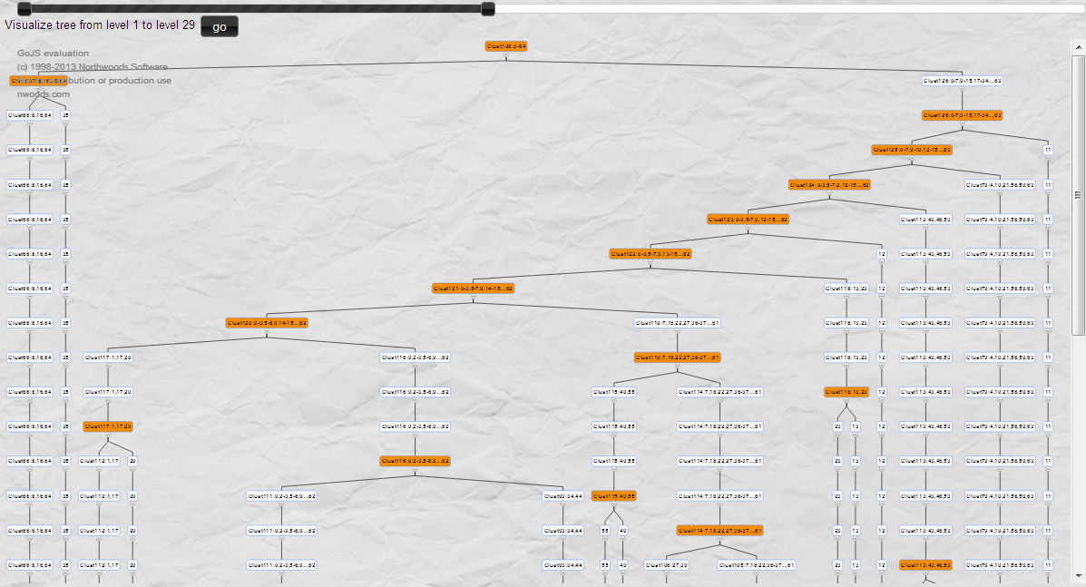
Cluster Tree Visualization

Slide 23
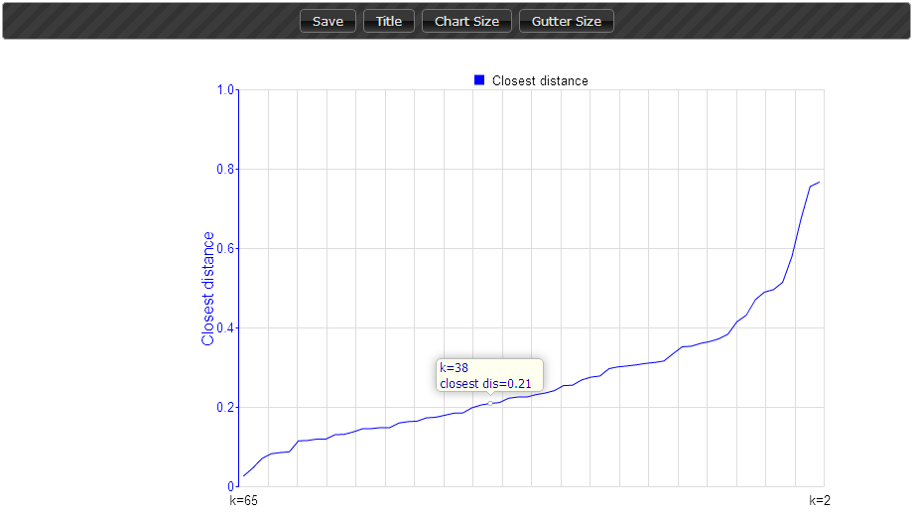
Closest Cluster Distance In Each Iteration

Slide 24
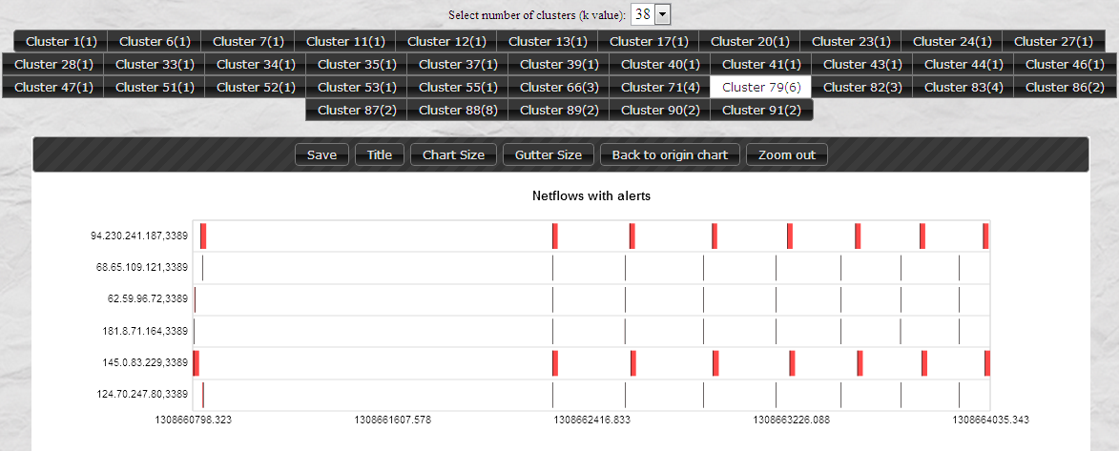
K=38 – Cluster 79 (6 Members)

Slide 25
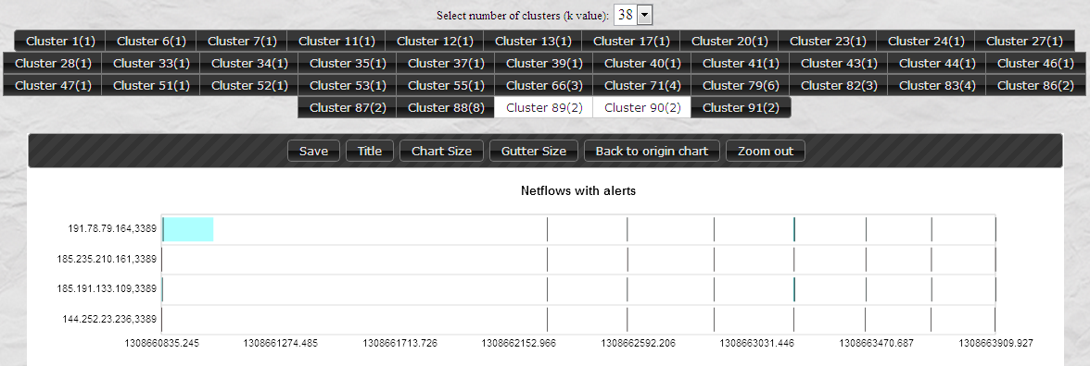
K=38 Cluster 89, 90 (2 Members Each)

Slide 26
Summary
Opportunity to apply on-going ensemble visualization researches to network security data
Handle scalability and discovery in time dimension
Extract related or out of ordinary traffics
Challenges of network ensemble analysis
How to define an ensemble and inter-member relationships
How to compare traffics and analyze their correlations
How to select and visualize member clusters
Examples: alert ensemble & NetFlow ensemble visualization
Flexible definition of ensemble
Visualization of inter-member relationships with cluster tree
Member sets visualization based on 2D charts in web browser
Notes:
Can be integrated with the previous flexible network visualization system

Slide 27
Questions?

Slide 28
Summary
Motivation to extend ensemble visualization to network security domain
Handle scalability and discovery in time dimension
Extract related or out of ordinary traffics
Opportunity to apply on-going ensemble visualization researches
Procedure of network ensemble analysis
Define an ensemble and inter-member relationships
Compare members and build cluster tree hierarchy
Select member sets to visualize
Examples: alert ensemble & NetFlow ensemble visualization
Flexible definition of ensemble
Cluster tree visualization
Member sets visualization based on 2D charts

Slide 29
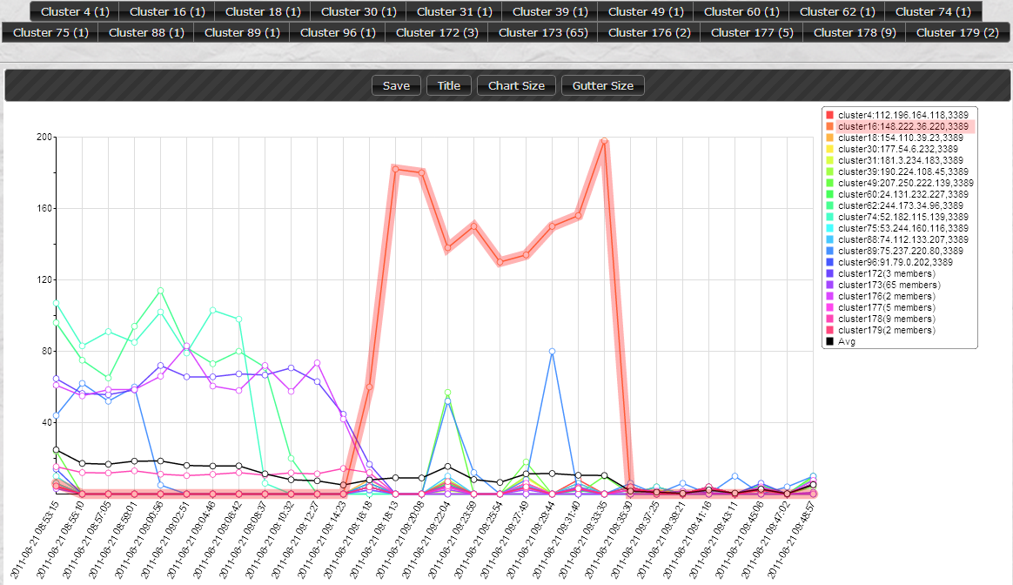
Clusters Visualization k=20
Cluster 16
(1 Member)
Highlighted
Traffic to
IP: 148.222.36.220
Port: 3389
Average Number of alerts

