Slide 1
EASEAndroid: Automatic Analysis
and Refinement for SEAndroid Policy
via Large-scale Audit Log Analytics
Ruowen Wang,
Xinwen Zhang, Peng Ning,
Douglas Reeves, William Enck
Notes:
This is a joint work with Samsung Knox team

Slide 2
Human-centric Security Policy Analysis
Previously,
Automated Service Discovery in Networks
Automated Analysis and Snort Rule Generation for Metasploit-like Exploits
Now
Enhancing SEAndroid Policy by Learning from Security Analysts (work-in-progress)
Notes:
We continue the path of helping security analyst better understand and analyze the security situation and provide better defense.
This time, we are trying to help Samsung’s SEAndroid policy analysts to understand real-world attacks in mobile devices and help them make better decisions on developing security policy for defense.

Slide 3
Outline
SEAndroid Background
Motivation and Challenges
EASEAndroid
Subject-Behavior Classification
Policy Refinement
Implementation & Current Results
Future Work
Notes:
Here is our agenda

Slide 4
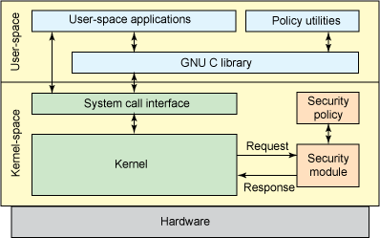
Security Enhanced Android
Android Framework & Applications
SEAndroid

Slide 5
SEAndroid
Based on SELinux, ported to Android since 4.3
Mandatory Access Control
confine flawed/malicious apps and reduce attack surface/limit damage from unauthorized operations
Default policies: very permissive and unconfined (4.3/4.4) to enforced and more confined (5.0)
Notes:
Introduce what SELinux is, and explain the new things added into SEAndroid when porting SELinux to Android

Slide 6
SEAndroid in Samsung KNOX
Notes:
First vendor enforces SEAndroid in flagship commercial devices
/* Revise policy to work with KNOX containers to provide strong isolation between personal and business apps */
Harden the system from various root exploits and privilege escalation of untrusted apps

Slide 7
SEAndroid Core: Policy
“Vendors don’t know how to write policies”
--@pof “Defeat SEAndroid” at Defcon 2013
Notes:
So the most important thing in SEAndroid is the policy. Only a good policy can achieve the purpose of MAC. However, it is non-trivial to write a good policy, even hacker says it is difficult.

Slide 8
Policy Example (Same as SELinux policy)
Abstract types <=> Concrete Subjects/Objects
app_data_file <=> /data/data/.*
Allow rules grant benign operations
allow appdomain app_data_file:file {read write execute}
Neverallow rules define privilege escalation
neverallow untrusted_app init:file {read} (Compile-time)
Notes:
Before we explain why writing policy is challenging, first, we need to show what a policy looks like.
SEAndroid uses types to represent a group of subject/object with same feature/functionalities.
During runtime, specific allow rules will be checked to decide certain operations are allowed or denied.
(Compile-Time)

Slide 9
Policy Requirements
Least Privilege Principle is the goal
Avoid incorrect type mapping
Avoid overly permissive rules
Policy requires continuous refinement
Knowledge keeps increasing
New Android releases keep adding new functionalities
New attack patterns keep emerging
Notes:
Then why people saying vendor don’t know how to write policy. Because a good policy has several requirements.
Least Privilege means subjects can only access the information and resources that are necessary for its legitimate purpose. If unnecessary, we don’t allow.
By doing so, we can reduce attack surface
Policy refinement is like virus signature/firewall rules updates. Human policy analysts usually work with heavy load on refining policy.

Slide 10
Traditional Approach: Audit Log
Refining Policy by Manually Analyzing Audit Log
Based on Linux Kernel Syslog
Log denied operations (either malicious or benign) not matched by allow rule
AVC denial entry:
<sbj_type, obj_type, obj_class, denied_perm>
System call entry:
<concrete_sbj, concrete_obj, syscall_name>
Notes:
Audit log is a major source for understanding subject-object interaction, evaluating and improving policy
Sufficient audit logs must be analyzed to discovery new knowledge that help understand real-world Android apps and system binaries
Real-world audit logs are heavily mixed with new benign operations and unseen Privilege Escalation (PE) attempts (thousands of root-required apps in Google Play)
Mainly unknown operations, a small set of known

Slide 11
Audit Log Example
type=1400 msg=audit(14580641.671:14): avc: denied { execute } for pid=285 comm="init" path="/system/etc/install-recovery.sh" dev="mmcblk0p16" ino=3799 scontext=u:r:flash_recovery:s0 tcontext=u:object_r:system_file:s0 tclass=file VE=SEPF_SAMSUNG-SGH-I337_4.4.2_0011_H

Slide 12
Audit Log Example
type=1300 msg=audit(14580641.671:14): arch=40000028 syscall=11(execve) per=800000 success=no exit=-13 a0=6b9d5 a1=740f4 a2=379fc a3=1 items=1 ppid=1 pid=285 auid=4294967295 uid=0 gid=0 euid=0 tty=(none) ses=4294967295 comm="init" exe="/init" subj=u:r:init:s0 key=(null)
Notes:
DSR: What’s the purpose of showing this: just to impress them it’s difficult for people to process and understand these log entries?

Slide 13
Audit Log Example
type=1302 msg=audit(14580641.671:14): item=0 name="/system/etc/install-recovery.sh" inode=3799 dev=b3:10 mode=0100755 ouid=0 ogid=0 rdev=00:00 obj=u:object_r:system_file:s0
Notes:
As we can see just one Audit Log entry encodes a lot of information. A policy analyst needs to understand these information and correlate with other knowledge together to make a decision, which is really heavy.

Slide 14
Real-World Challenges
Millions of audit logs need to be analyzed
Millions of real-world Samsung devices
Thousands of Android apps/binaries
Real-world audit logs are combinations of:
New benign operations
New Privilege Escalation (PE) operations
Notes:
Real-world Challenges encountered by Samsung after deploying SEAndroid to commercial devices. has huge number of audit logs, (thousands of root-required apps in Google Play)
Logs are collected anonymously after user’s explicit agreement.

Slide 15
Questions
Is it a PE or a benign operation?
If PE, is it blocked explicitly by an existing neverallow rule, or is this an unknown attack pattern?
If benign, how to refine the existing policy to allow this operation, while still following the Least Privilege principle?
Notes:
For every AVC, a policy analyst needs to answer three non-trivial questions:
, it is difficult to answer the above questions without sufficient semantic and statistical knowledge

Slide 16
EASEAndroid
Elastic Analytics of SEAndroid Audit Log for Analyzing and Refining SEAndroid Policy
Goals:
Conduct the first large-scale study of SEAndroid’s impact on real-world apps
Classify new PE operations and new benign operations from audit logs
Propose policy refinement by reasoning the classification result

Slide 17
EASEAndroid
Observations:
Known subjects performing new behaviors
Known behaviors performed by new subjects
High-level Idea:
Mimic policy analysts
Expand knowledge by connecting new subjects/behaviors with known ones
Notes:
The design EASEAndroid is to mimic what policy analysts usually do.
We have two observations. Policy analysts have some initial knowledge. There are connections/correlation between unknown and known
EASEAndroid mimic policy anlaysts do, find knowledge connection
The high-level idea actually Mimic what policy engineers do by learning knowledge after manually analyzing audit logs

Slide 18
EASEAndroid Workflow
Notes:
Three components:
A data warehouse collects both policy rules and audit logs with large-scale query capability.
A semi-supervised classifier classifies mixed logs into likely malicious AVC set and likely benign AVC set.
A policy refiner generates new rule candidates by clustering benign AVCs above a threshold.

Slide 19
Semi-supervised Classification
Use both labeled and unlabeled data to build better classifiers
Labeled data: Known PE sbjs & behaviors
Unlabeled data: New sbjs & behaviors
Iteratively find unlabeled data that is close to labeled data, and assign that label

Slide 20
Subject-Behavior Bipartite Knowledge Graph Expansion
If a new behavior is found being performed by at least k known PE sbjs, and $\frac{\text{n}\text{(}\text{known}\text{_}\text{sbjs}\text{)}}{\text{n}\text{(}\text{total}\text{_}\text{sbjs}\text{)}}>σ$, then we include it as a new PE behavior.
If a new sbj is found performing at least k known PE behaviors, and $\frac{\text{n}\text{(}\text{known}\text{_}\text{behaviors}\text{)}}{\text{n}\text{(}\text{total}\text{_}\text{behaviors}\text{)}}>σ$, then we include it as a new PE sbj.
Notes:
Use initial known PE sbjs & behaviors knowledge to iteratively find relevant new sbjs & behaviors based on two assumptions:
K-nearest neighbor core: majority vote

Slide 21
Graph Expansion Example
One app “com.huluxia.gametools” in audit logs
1. Initially, match with a neverallow rule in existing policy:
<com.huluxia.gametools, kill, process_with_diff_uid>
2. Find other operations performed by the same subj
<com.huluxia.gametools, open, /proc/pid/mem>
<com.huluxia.gametools, open, /dev/input>
<com.huluxia.gametools, ptrace, process_with_diff_uid>
3. Find other subjs performing the same operations
<cn.maocai.gamekiller, open, /dev/input>
<com.x0.strai.frep, open, /dev/input>
<com.cih.gamecih, open, /dev/input>
……

Slide 22
Policy Refinement Recommendation
Behavior:
<open, /data/misc/zoneinfo/tzdata>
/data/.* system_file
/data/misc/zoneinfo/tzdata tzdata_file
Subjects:
/system/bin/qmuxd
/system/bin/dhcpcd
/system/bin/time_daemon
/system/bin/hostapd
=>
allow { qmuxd dhcpcd time_daemon hostapd } tzdata_file:file {read}
Behavior:
<open, /dev/input>
/dev/input/.* input_device
Subjects:
com.huluxia.gametools
cn.maocai.gamekiller
com.x0.strai.freq
com.cih.gamecih
<untrusted_app>
=>
neverallow untrusted_app input_device:chr_file {read}
Subject: com.googlecode.android.wifi.tether
Behavior:
<open, /data/misc/zoneinfo/tzdata>
<init_module/delete_module>
Notes:
After multiple rounds of expansion, previous unlabeled sbjs & behaviors are connected in graphs centered with initial labeled data
Since we focus on concrete sbjs/objs, we further investigate whether the type mapping can be improved.
Then we overlay the classification result with the types in their corresponding AVC denials.
Outliers? Possible. First, we reduce the searching scope. We highlight the ones we need further investigation. We may also leverage other auxiliary metrics

Slide 23
Implementation
8-node Hadoop Cluster, 256 GB Memory.
Use Distributed SQL (“Impala”) on HDFS.
SLOC: 15K Java + 5K SQL
Raw data is TB-level. After table compression, log data almost 200GB.
Notes:
Huge effort spent on reducing query time from days to hours to minutes, making real-time + large-scale possible.

Slide 24
Samsung Audit Log DataSet
Time Period: 2014-01-01 to 2014-08-31
Total Valid Log Count (contain both AVC denials & syscalls): 27,095,967
Total Unique AVC Denials: 10,569
Total Syscall executables: 2,387
Total Subjects (binary exe/app package name): 1,069
Total Non-built-in Subjects: 950

Slide 25
Generalized Syscall Statistics
Total specific Syscall operations <subj, syscall, obj>: 503,467,355
Apply Dimension Reduction
Total Generalized Subject-Object Behaviors <subj, category, generalized_obj>: 7003
Notes:
“Generalized” means
Group specific syscalls into categories (172 syscalls => 38 categories)
Group file obj to up to 3-level path depth, like ‘/data/data/com.android.abc/xxx’ => ‘/data/data/com.android.abc’

Slide 26
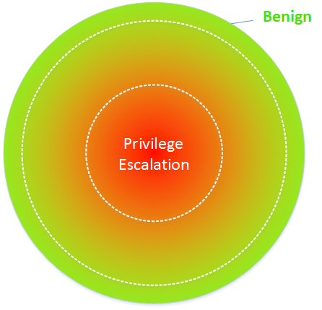
Current Result
Currently run 5 rounds, current threshold, k = 5, σ = 0.75
Round 1: sbjs 280 (26.19%), behaviors 941 (13.44%)
Round 2: sbjs 633 (59.21%), behaviors 4702 (67.12%)
Round 3: sbjs 680 (63.61%), behaviors 5269 (75.24%)
Round 4: sbjs 703 (65.76%), behaviors 5412 (77.28%)
Round 5: sbjs 714 (66.79%), behaviors 5480 (78.25%)
Left out sbjs: com.facebook.katana, /system/bin/dhcpcd
Notes:
So it quickly expands and then gets stable. The rest sbjs, many are really benign, like com.facebook.katana. But there are also quite a few outliers, due to the isolated and unpopular behaviors, which means other auxiliary metrics may be necessary.
We are working with Samsung SEAndroid Policy Analysts to verify whether the malicious subjects are really malicious.

Slide 27
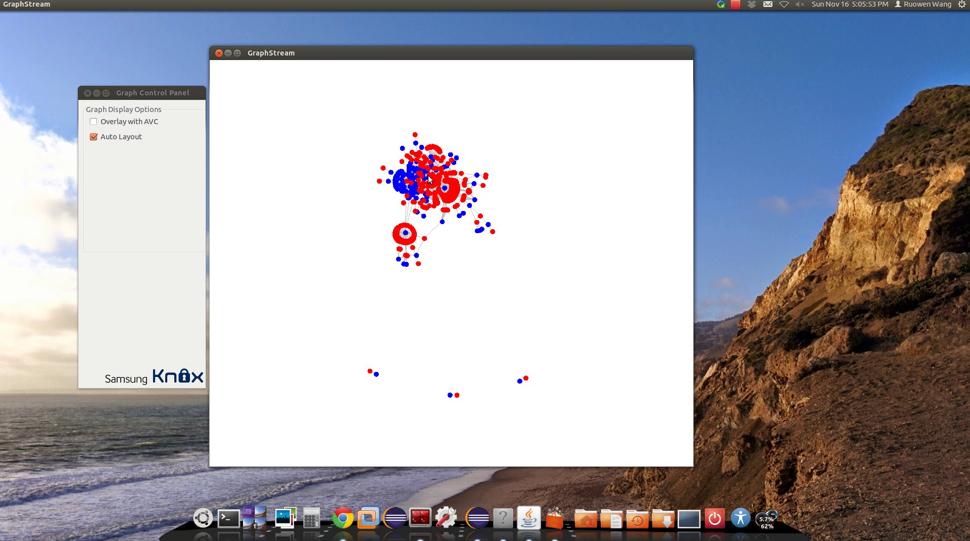
Graph Visualization Demo
Notes:
Screenshot

Slide 30
Third-party app with “untrusted_app” type changes itself into “init” type. MALICIOUS!

Slide 31
Future Work
Evaluate with more datasets
Measure False-Positive/False-Negative
Feedback from Samsung policy engineers
Refine to improve precision
Submit for publication Spring 2015

