Slide 1

MURI Research on Computer Security
V.S. Subrahmanian
Lab for Computational Cultural Dynamics
Computer Science Dept. & UMIACS
University of Maryland
vs@cs.umd.edu
www.cs.umd.edu/~vs/

Slide 2
Key Contributions
Parallel architecture for detection of unexplained activities (PADUA). [Molinaro, Moscato, Picariello, Pugliese, Rullo, Subrahmanian]
Automatic identification of bad actors (trolls) on signed social networks (e.g. Slashdot) [Kumar, Spezzano, Subrahmanian]

Slide 3
ARO-MURI on Cyber-Situation Awareness
Identifying Behavioral Patterns in a Scalable Way
V.S. Subrahmanian, University of Maryland
Tel. (301) 405-6724, E-Mail: vs@cs.umd.edu
Objectives
To detect known and unexplained threat patterns in a highly scalable manner as vast amounts of observations are made.
DoD Benefit:
To identify on-going attacks while they occur so that appropriate counter-measures can be taken before attackers cause serious damage.
Scientific/Technical Approach
- Develop stochastic temporal automata for expressing high level activities in terms of low level primitives.
Develop index structures and parallel algorithms to identify highly probable instances of an activity
Develop parallel algorithms to identify activities in an observation that are not well explained by known activities.
Developed algorithms to identify bad behaviors in Slashdot and signed social networks
- Develop prototype system implementing the above and test/validate approach.
Accomplishments
Can automatically detect unexplained activities in a observation streams > 335K+ observations per second.
Demonstrated the ability to identify unexplained behavior in observation streams with precision over 90% and recall over 80%.
Demonstrated high accuracy in identifying bad actors in social media
Challenges
Automatic learning of activity models.
To scale the ability to detect unexplained activities to 1M observations/second..
3

Slide 4

Probabilistic Penalty Graph
Graph consisting of 4 parts:
V – set of vertices
E – set of directed edges
δ:$E→[0,1]$ specifies the transition probability of an edge
ρ: 𝐸→[0,1] specifies the noise-degradation of an edge

Slide 5
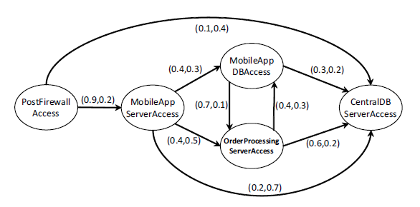
Probabilistic Penalty Graph
Prob of transitioning from “PostFirewall Access” to “CentralDBServerAccess”
Penalty assessed for any intervening observations b/w these 2 states
Event “Central DB Server Access” occurs with 10% probability after “Post Firewall Access”. There is a 0.4 degradation factor for every bit of noise that occurs between these two events are observed.

Slide 6
Activity Instance
Observation sequence (OS) Set of time stamped events.
Occurrence of an activity (OS) is a pair (L*,I*) s.t.
  L* is a contiguous sequence [shown below]
  I* is a subsequence of it [shown via shaded boxes below]
  Edges in an activity must connect consecutive events in the subsequence [yellow edge]
  Starts at a start node [l₁ below]
  Ends at an end node [l₉ below]

Slide 7
Score of Occurrence
Score of this occurrence is calculated as:
(δ_{l1,l5}*ρ_{l1,l5}³)*(δ_{l5,l6}*ρ_{l5,l6}⁰)*(δ_{l6,l9}*ρ_{l6,l9}²)
δ_{l1,l5} is the probability of transition from state l1 to l5.
ρ_{l1,l5} is the penalty for each noise `` noise’’ item between l1 and l5.
As more noise occurs, the score of the occurrence goes down in a manner specified by ρ.
(δ_{l5,l6}*ρ_{l5,l6}⁰)
(δ_{l1,l5}*ρ_{l1,l5}³ )
(δ_{l6,l9}*ρ_{l6,l9}²)

Slide 8
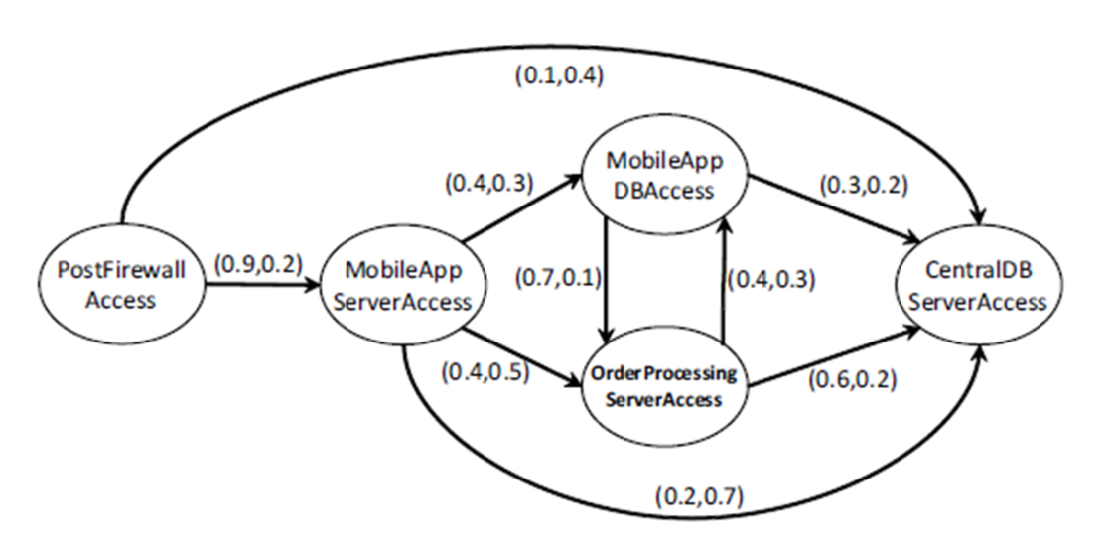




Example: Score of Occurrence
OBS LOG: PostFirewallAccess, x, MobileAppServerAccess, OrderProcessingServerAccess, y, z, CentralDBServerAccess, z
OCCURRENCE = <1,3,4,7>, all observations except the x,y,z’s
$$SCORE=\left(0.9∗0.2^{1}\right)∗\left(0.4∗0.5^{0}\right)∗(0.6∗0.2^{2})$$
Edge labeled (1) leads to $\left(0.9∗0.2^{1}\right)$term because of one noise (x) between PostFirewallAccess and MobileAppServerAccess
Edge labeled (2) leads to $\left(0.4∗0.5^{0}\right)$ term as there’s no noise b/w these two states
Edge labeled (3) leads to $\left(0.6∗0.2^{2}\right)$ term as there are two noisy observations between OrderProcessingServerAccesss and CentralDBServerAccess

Slide 9
Unexplained Situation
A sequence (L_{u},I_{u}) satisfying:
  L_{u} is a contiguous sequence
  I_{u} is a subsequence of it
  Edges in an activity must connect consecutive events in the subsequence
  Starts at a start node
  Last action is not an end node
  No occurrence (L_{u}*,Iu*) s.t. L_{u} is a prefix of L_{u}* and I_{u} is a prefix of I_{u}*
  No other pair (L’,U’) s.t. L_{u} is a prefix of L’, I_{u} is a prefix of I’ and (L’,U’) satisfies all the above conditions.
  τ-unexplained situation is one with score τ or more:

Slide 10

Example: Unexplained Situation
OBS LOG: $L_{u}=$ (PostFirewallAccess, x, MobileAppServerAccess, MobileAppDBAccess,y,z)
Let $I_{u}=(1,3,4)$, i.e. everything except x,y,z
$$SCORE=\left(0.1∗0.8^{1}\right)∗\left(0.6∗0.7 \right)$$
Edge labeled (1) leads to unexplained-ness of $\left(1−0.9\right)∗{\left(1−0.2\right)}^{1}=0.1∗{0.8}^{1}$ term because of one noise (x) between PostFirewallAccess and MobileAppServerAccess
Edge labeled (2) leads to $\left((1−0.4)∗(1−0.3^{0}\right)=0.6∗0.7$ term
Overall unexplainedness score is 0.0336

Slide 11
Unexplained Situation
A log is τ-unexplained iff its unexplained-ness score is τ or more.
Log on previous slide is 0.03-unexplained meaning its chance of being consistent with the activity is below 3%.
Developed algorithms to learn degradation values from a training set.
Developed algorithms to
  Merge a set P of PPGs into one super-graph and
  index the set P of PPGs that we wish to monitor.
In this talk, we instead focus on parallelizing discovery of τ-unexplained activities on a compute cluster

Slide 12

Partitioning Super-PPGs
Developed 5 ways to partition a Super-PPG.
For an edge e, let $δ^{′}\left(e\right),ρ′(e)$ be the average probability and degradation factor (resp) across all PPGs considered.
Prob Partitioning (PP): Edge-cut partition of the graph according to $cost\left(e\right)=1−δ^{′}\left(e\right).$
Prob Penalty Partitioning (PPP): Edge-cut partition of the graph according to $cost\left(e\right)=\left(1−δ^{′}\left(e\right)\right)∗(1−ρ^{′}\left(e\right)).$
Expected Penalty Partitioning (EPP): $cost\left(e\right)= (1−ρ^{′}{\left(e)\right)}^{occ(v_{i}, v_{j})}$ where $occ\left(v_{i},v_{j}\right)$ is the prob of${ v}_{j}$ occurring after $v_{i}$.
Temporally Discounted EPP (tEPP): Adjusts costs above based on recency
Occurrence Probability (OP): Sets $cost\left(e\right)= \frac{1}{occ(v_{i},v_{j})}$

Slide 13
Parallel Algorithm
Given a cluster with (K+1) nodes, PADUA splits the super-graph into K sub-graphs according to one of the previous splitting methods.
1 compute node is used as a master, others are slaves.
When a new observation is made, the master node hands this off to the appropriate slave node managing the observed action.
At any time, the master node can update the list of τ-unexplained sequences.
Ran experiments to assess efficacy of different splitting methods.

Slide 14
Experimental Setting
Two full days of network traffic (1.215M log tuples) from Univ of Naples
350 PPGs defined corresponding to 722 SNORT rules
Accuracy measured as follows:
  detect instances of PPGs in the traffic
  Then leave some out
  See how well our algorithm finds them

Slide 15
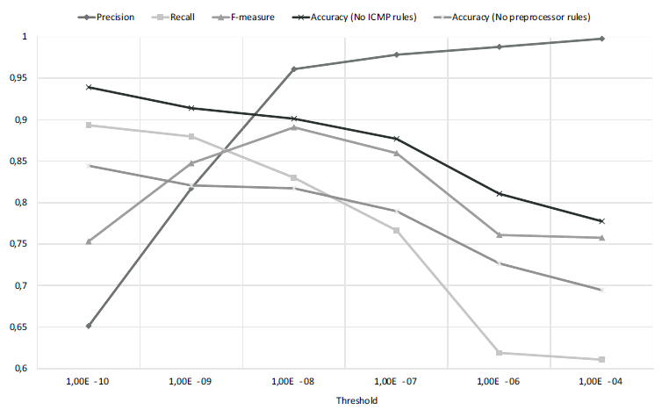
Accuracy Results
Best accuracy occurs when τ = 10⁻¹⁰.
But highest F-measure occurs when τ = 10⁻⁸
Run-times for the entire 2 days of traffic were on the order of just over 3 seconds.

Slide 16
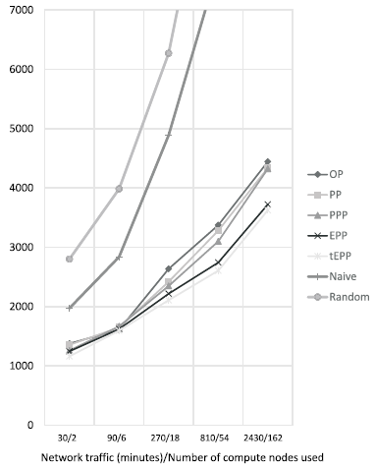
Experimental Setting
tEPP gives the best results in terms of run-time (y-axis in milliseconds)

Slide 17
Key Contributions
Parallel architecture for detection of unexplained activities (PADUA). [Molinaro, Moscato, Picariello, Pugliese, Rullo, Subrahmanian]
Automatic identification of bad actors (trolls) on signed social networks (e.g. Slashdot) [Kumar, Spezzano, Subrahmanian]

Slide 18
Trolling
The Problem
Trolls deliberately make offensive or provocative online postings with the aim of upsetting someone or receiving an angry response.
Being annoying on the web, just because you can.
How can we automatically identify trolls?
Solution
Remove the “hay” from the “haystack”, i.e. remove irrelevant edges from the network, to bring out interactions involving at least one malicious user.
Then find the “needle” in the reduced “haystack”.

Slide 19

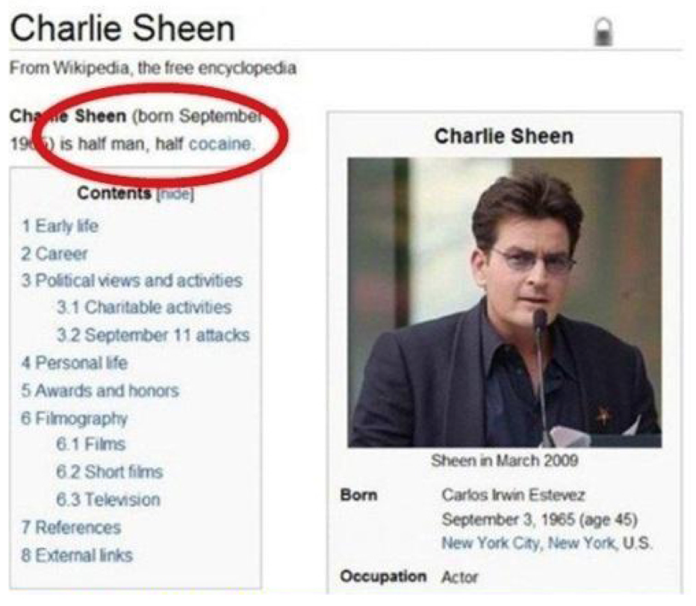
Trolling on Twitter and Wikipedia
Source: http : //www.thisisparachute.com/2013/11/trolling/
Source: http : //i.imgur.com/I3Gv7.jpg

Slide 20
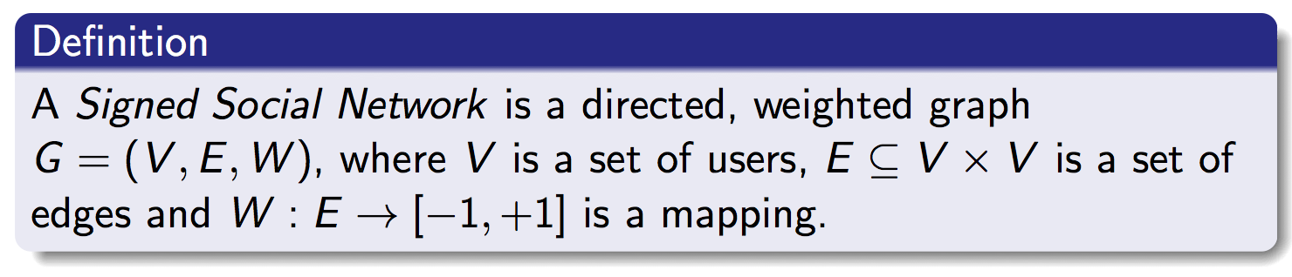
Signed Social Network
Slashdot
technology-related news website.
contains threaded discussions among users.
Comments labeled by administrators
  +1 if they are normal, interesting, etc. or
  -1 if they are unhelpful/uninteresting.

Slide 21
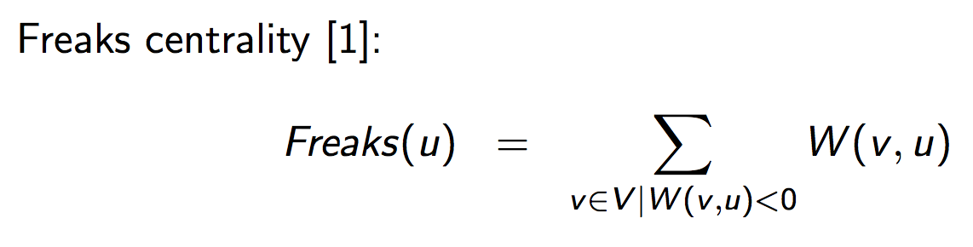
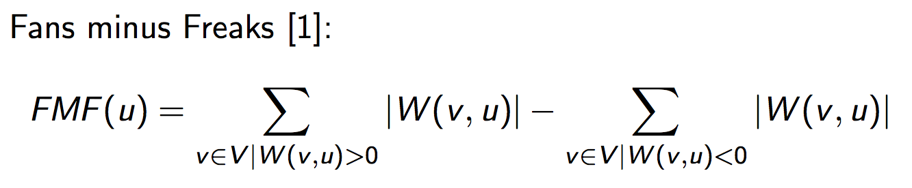
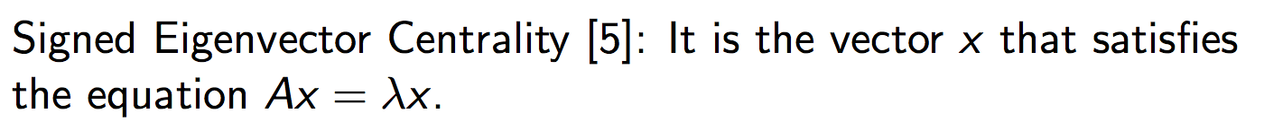
Users ranking: Centrality Measures

Slide 22
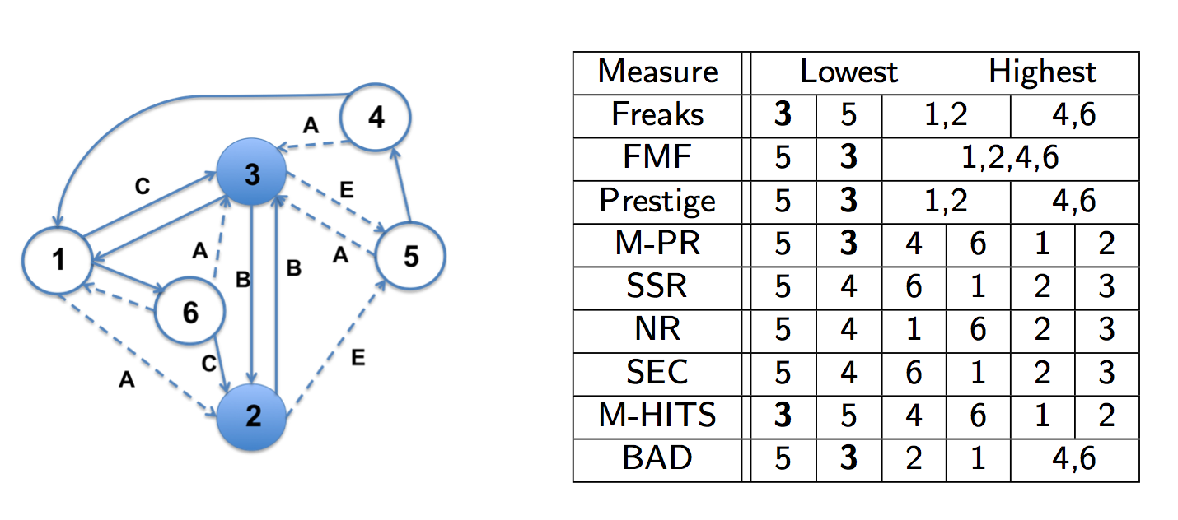
Users ranking: Centrality Measures

Slide 23
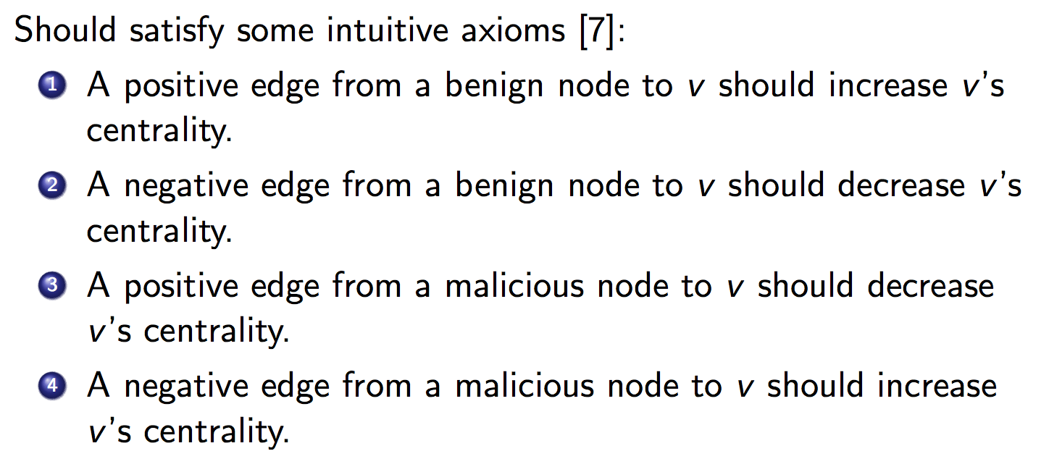
Requirements of a good ranking measure: Axioms
Only SSR and SEC conditionally satisfy all the axioms

Slide 24
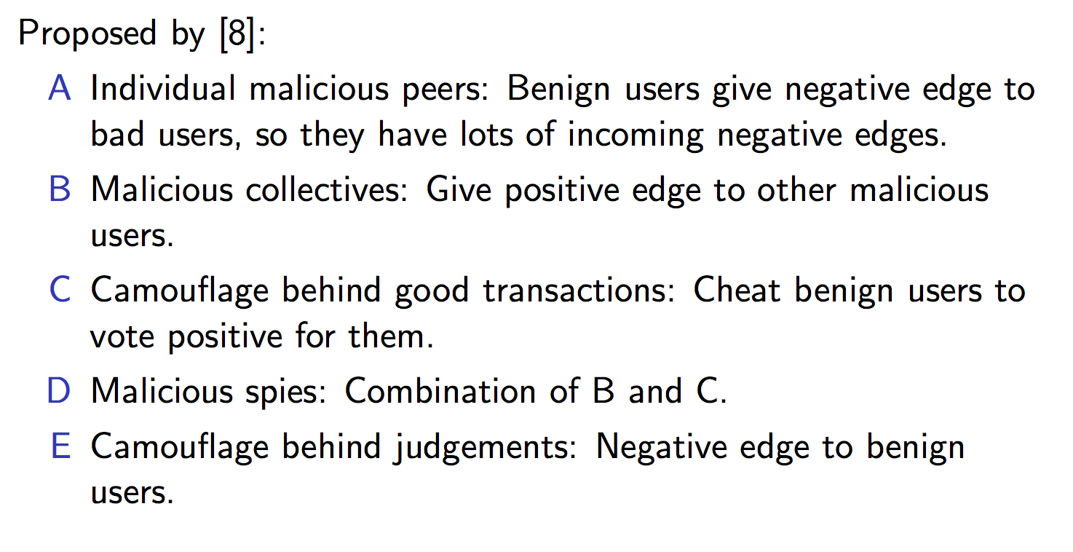
Requirements of a good ranking measure:
Attack Models
No centrality measure protects against all the attack models

Slide 25
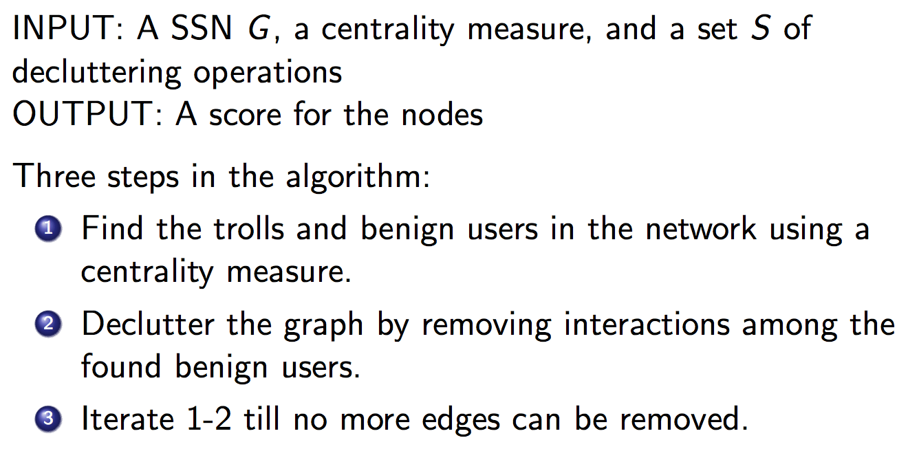
TIA: Troll Identification Algorithm

Slide 26
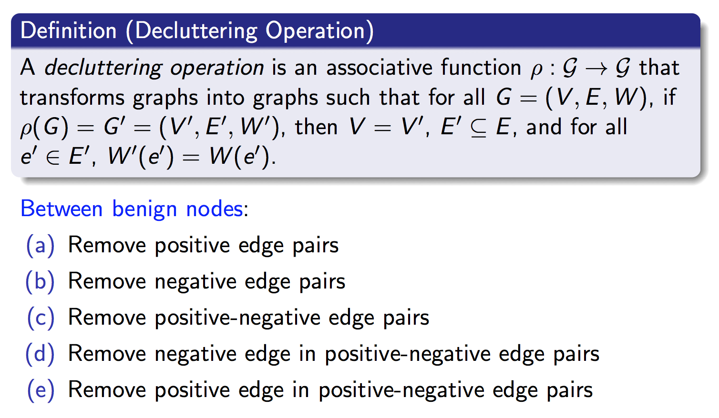
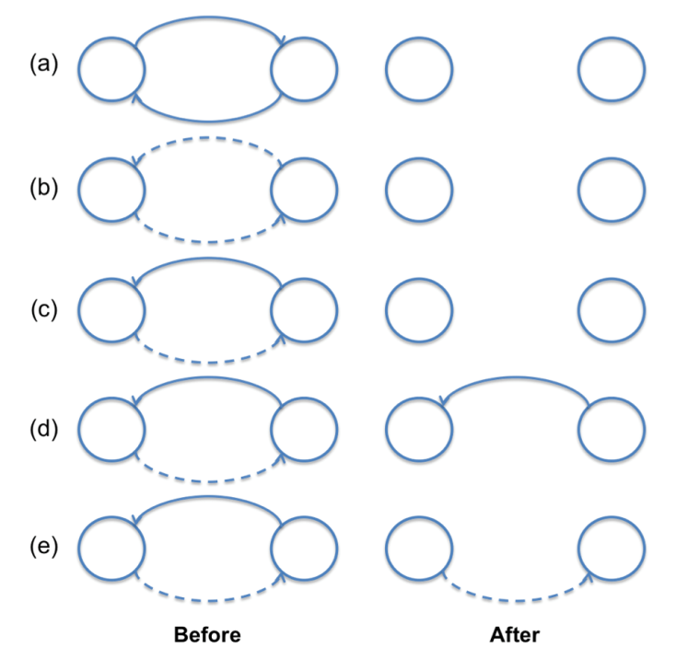
Decluttering Operations
Given a centrality measure C, we mark as benign, users with a positive centrality score. Those with a negative centrality score are marked malignant.

Slide 27
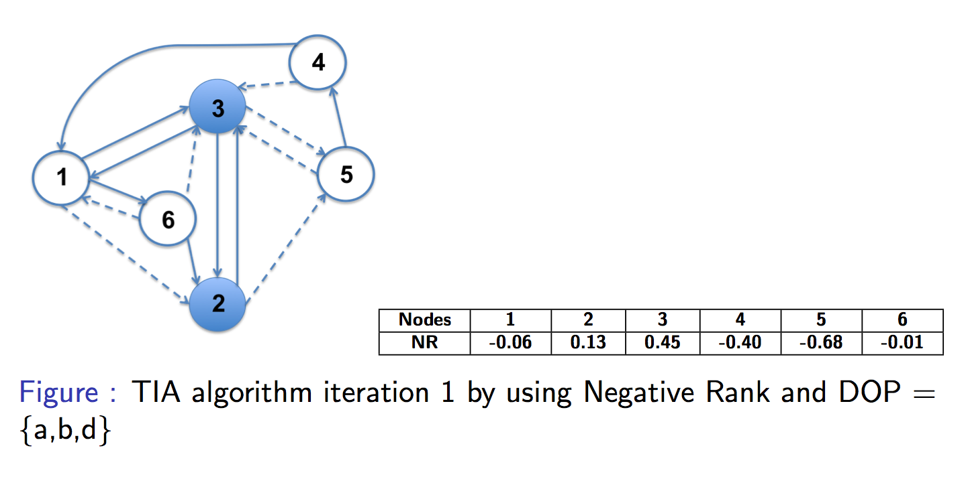
TIA Example
DOPs considered:
remove positive edges pair
remove negative edges pair
d) remove negative edge in positive-negative edges pairs

Slide 28
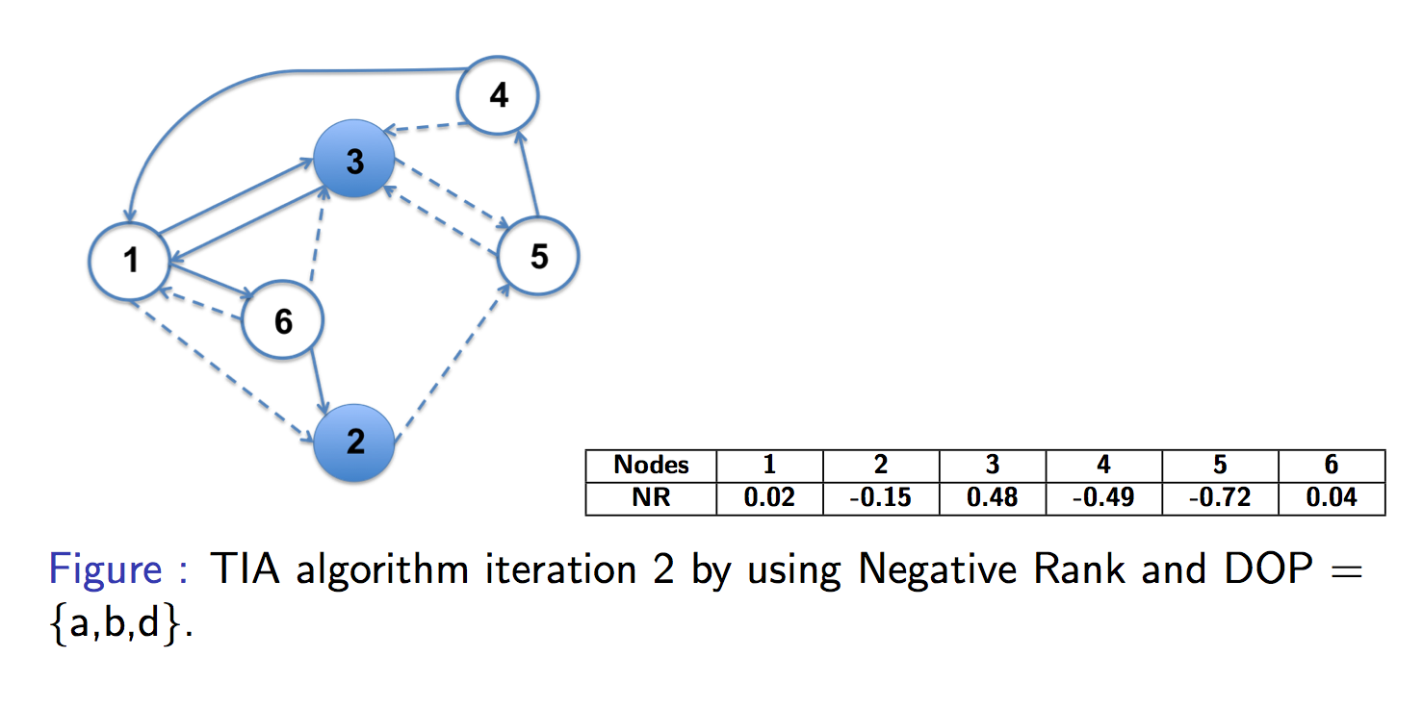
TIA Example
DOPs considered:
remove positive edges pair
remove negative edges pair
d) remove negative edge in positive-negative edges pairs

Slide 29
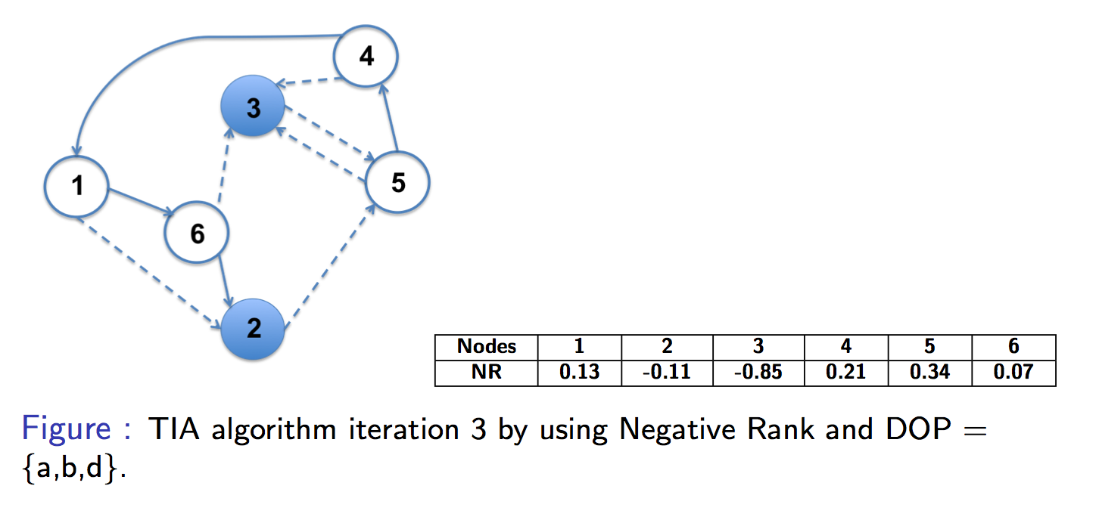
TIA Example
DOPs considered:
remove positive edges pair
remove negative edges pair
d) remove negative edge in positive-negative edges pairs

Slide 30
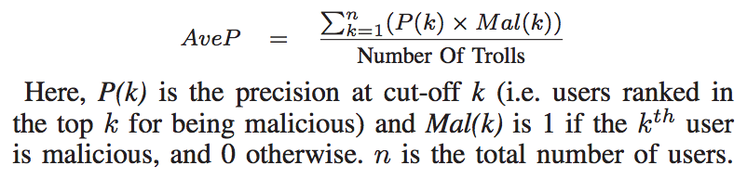
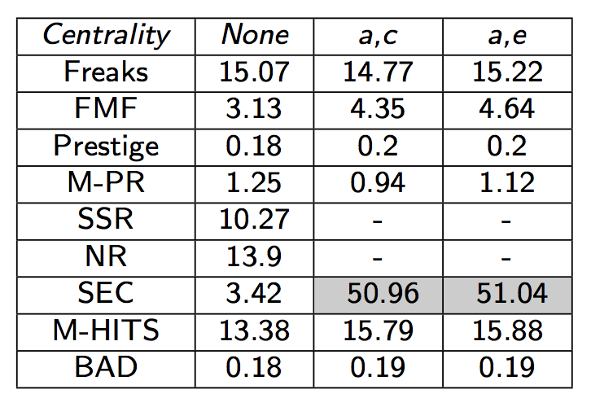
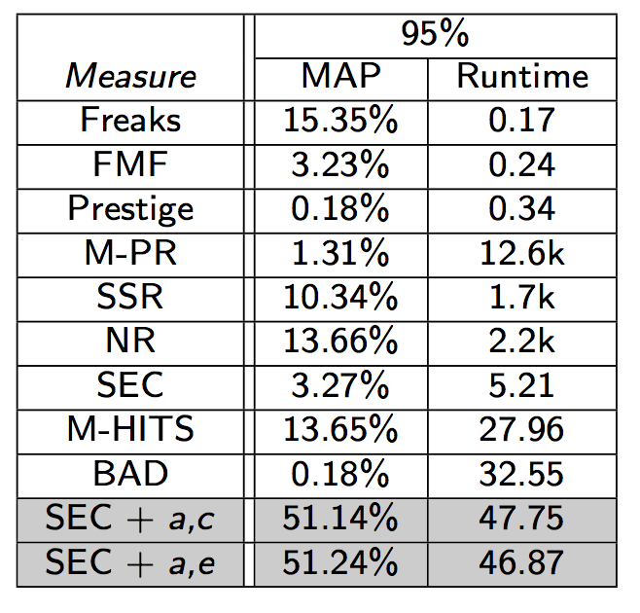
Experiments
Table comparing Average Precision (in %) using TIA algorithm on Slashdot network (Original + Best 2 columns only)
Table showing Average Precision averaged over 50 different versions for 95% randomly selected nodes from the Slashdot network.

Slide 31
Experiments
Average precision of random ranking is 0.001%
Table comparing Average Precision (in %) using TIA algorithm on Slashdot network (Original + Best 2 columns only)
Table showing Average Precision averaged over 50 different versions for 95% randomly selected nodes from the Slashdot network.

Slide 32
Contact Information
V.S. Subrahmanian
Dept. of Computer Science & UMIACS
University of Maryland
College Park, MD 20742.
Tel: 301-405-6724
Email: vs@cs.umd.edu
Web: www.cs.umd.edu/~vs/

